Slide 1
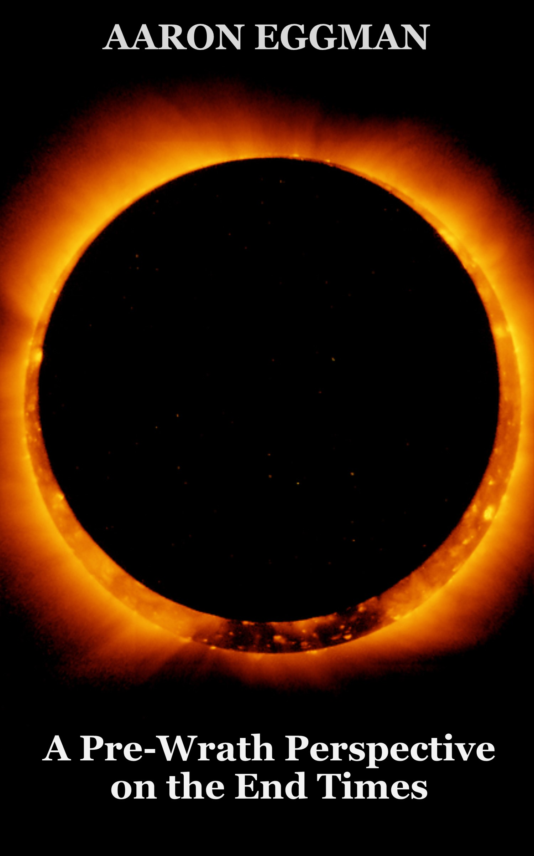

Notes:
Hello and thank you for joining us for this 5 part teaching series. My name is Aaron Eggman, the author of the book “The Saints Go UP and the Wrath Comes Down,” which presents a classic pre-wrath perspective on the end times. My wife Sally Eggman, the editor and chart-designer for the book will be the voice you hear in this presentation. Now let’s get started!

Slide 2
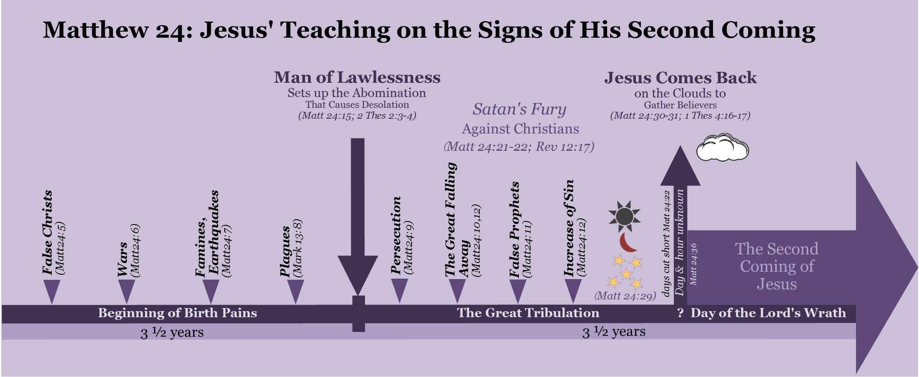
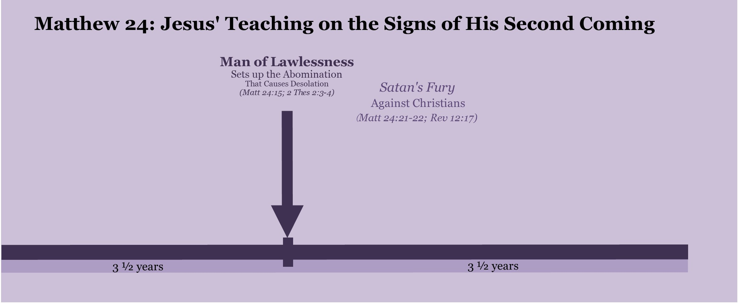
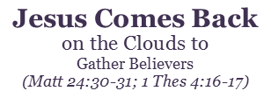












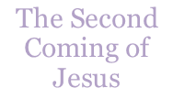
Notes:
In this teaching series, we are going to examine concepts concerning Jesus’ second coming, which are illustrated in visual maps and charts such as this one. This visual has been adapted from Jesus’ Olivet discourse, found in Matthew 24. The Olivet discourse is Jesus’ teaching on his second coming which he preached on the Mount of Olives. It is also found in Mark 13 and Luke 21. We are going to use Jesus’ teaching as found in Matthew 24 as a base timeline and will bring in other major end time passages such as those found in Daniel, 1st and 2nd Thessalonians, and the book of Revelation. We will use Matthew 24 as our base timeline because it is the easiest to understand, chronological teaching on the end times found anywhere in the bible. Jesus gives a clear, detailed chronological account of 1.) Events that lead up to Jesus’ second coming 2.) Signs to look for immediately before and at the time of his coming
3.) How he will come back 4.) What happens to Christians when he comes back and 5.) What happens to nonbelievers when he comes back.

Slide 3
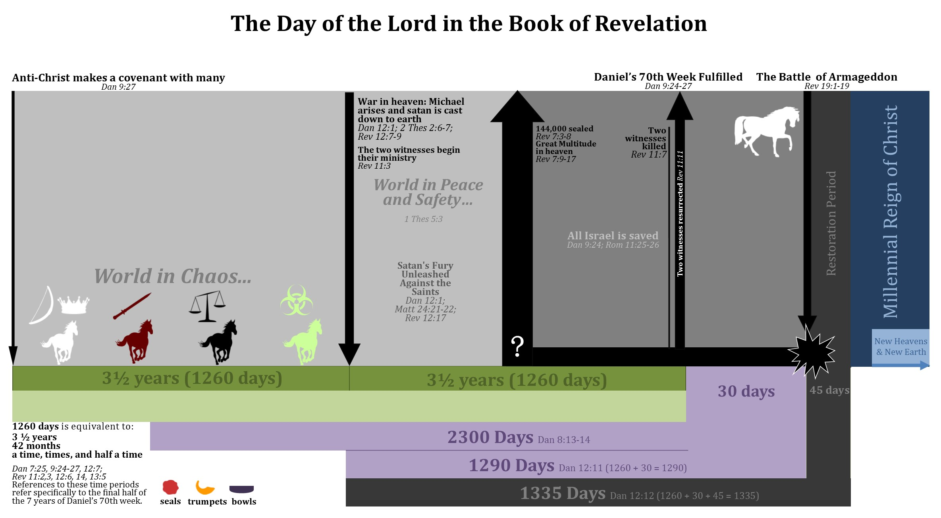
















5
3
2
4
1
Daniel’s Seventieth ‘Seven’ (7 years)
Notes:
This chart is a harmony of all of these different teachings. Throughout this study I will be referring to various charts and breaking them down to make their content simple and easy to understand. Although this chart might seem overwhelming at first glance, by the end of this study you will be able to easily understand it.
Now, let me introduce the major concepts that I will be focusing on. In Part 1: I will examine Daniel’s prophecy found in Daniel 9: 24-27 called the seventy ‘sevens’ prophecy. This introduces a future 7 year time period that anchors all other major end time teachings. Understanding this prophecy is important because it provides a timeline that both Jesus and Paul refer to. In part 2: I will talk about events that will occur on the earth before the Great Tribulation with a focus on what Jesus called “the beginning of birth pains” as well as the revealing of the man of lawlessness, who is popularly known as the Anti-Christ. In part 3, I will examine the Great Tribulation which is the time when the man of lawlessness consolidates world power and persecutes Christians. In part 4, I will talk about the time period known as the day of the Lord, which is the time God pours out his wrath upon the earth. Finally, in part 5, I will talk about the coming of our Lord Jesus and the rapture of the saints from the earth, which occurs at the commencing of the day of the Lord.
This study is a classic pre-wrath teaching on the end times, which teaches that the coming of Jesus occurs directly after God shortens the Great Tribulation, for the sake of Christians. This happens at the sixth seal, before the wrath of God is poured out on the earth as found in the trumpet and bowl judgements. The key to understanding end time chronology is understanding the definition of the day of the Lord and understanding the signs in the sun, moon, and stars that occur directly before the Day of the Lord.

Slide 4
Principles of Biblical Interpretation
1.) Take scriptures literally unless prompted by the
passage to take the verses symbolically.
2.) If prophecies have not been fully fulfilled by past events, there is a future fulfillment.
3.) Allow scripture to interpret scripture, if possible.
Notes:
All scripture is God breathed and is useful for teaching, rebuking, correcting and training in righteousness 2 Tim2:16.
The Bible is the divine word of God, infallible, and preserved through the ages for us today. I take the bible literally unless a passage prompts me not to. Just as prophecies were literally fulfilled at Jesus first coming, so they will be at his second. Some aspects of prophetic scripture are stated as symbolic, however, I try not to interpret them based simply on my own ideas, instead, I look to other scriptural passages and find the interpretation based upon them. As we journey together through the end times, I encourage you not to take my word for it. If anything I say doesn’t agree with the counsel of scriptures, don’t believe it. I implore every individual to be a good Berean and to search out scriptures for yourself. Scriptures are the truth, not my teachings on them. Now let’s dive in to part 1.

Slide 5
Part 1:
Daniel’s Seventy ‘Sevens’
Daniel 9: 24-27
Notes:
Welcome to Part 1 entitled Daniel’s Seventy “Sevens’. In this part we will examine Daniel 9: 24-27. Let’s get started.

Slide 6
Daniel 9:24
“Seventy ‘sevens’ are decreed for your people [Israel] and your holy city [Jerusalem] to finish transgression, to put an end to sin, to atone for wickedness, to bring in everlasting righteousness, to seal up vision and prophecy and to anoint the Most Holy Place.
This prophecy concerns the people of Israel and the city of Jerusalem.
A ‘seven’ is a 7-year period. Also known as a ‘week.’
A biblical prophetic year consists of 360 days.
The duration of this prophecy is 70 x 7 years which equals 490 years.
This study uses information found in Sir Robert Anderson’s book, “The Coming Prince.” For a more in-depth study please refer to that book.
Note: this is one perspective on how the Daniel 9:25-26 prophecy has been fulfilled, but it is not the only view. What’s important is that it has been fulfilled.
Notes:
Now lets go through this prophecy, verse by verse. Starting in verse 24. “Seventy ‘sevens’ are decreed for your people [Israel] and your holy city [Jerusalem] to finish transgression, to put an end to sin, to atone for wickedness, to bring in everlasting righteousness, to seal up vision and prophecy and to anoint the Most Holy Place. This prophecy concerns the people of Israel. In order to understand this prophecy, one must understand what a ‘seven’ refers to. A ‘seven’ is a group of seven years. These years are measured in 360 days. Thus, what this prophecy is stating is that there are 490 years until six prophesied events will be fulfilled for the Jewish people and/or the city of Jerusalem.

Slide 7

The six conditions of Daniel 9:24
1.) "finish transgression "
2.) "put an end to sin "
3.) "atone for wickedness "
4.) "bring in everlasting righteousness "
5.) "seal up vision and prophecy "
6.) "anoint the Most Holy Place"
Notes:
Here are the six conditions of Daniel 9:24 that prophecies about the people of Israel and Jerusaelm. The first four conditions speak of the salvation of Israel. By the time this prophecy is fulfilled all of Israel will be saved, just as Paul prophecies in Romans 11:25-27. The first, finish transgression, prophecies that the jewish peopke will stop transgressing against God as a nation. The second, put an end to sin, prophecies that Israel will stop sinning not only on a national level but also on an individual level. The third, atone for wickedness, proclaims that all living Jews at the time of the fulfillment of the prophecy will accept Jesus’ atoning sacrifice and their sins will be forgiven and rememberd no more. The fourth, bringi n everlasting righteousness, speaks of Israel as a nation living in righteousness under Jesus’ leadership for the rest of eternity. The fifth, seal up vision and prophecy, gives insight that after the completion of this prophecy, there will be no more prophecies given to Israel, because Israel will begin to walk in their promises. Finally, the sixth condition, anoint the most holy place, prophecies that the most holy place in the temple will be anointed. Since not all of these six conditions have been fully fulfilled, this prophecy will be fulfilled in the future. Notice the blue star in the top right corner of this slide. In several different charts, you will notice this blue star representing the time this prophecy is fulfilled.

Slide 8
Daniel 9:25a
²⁵ “Know and understand this: From the time the word goes out to restore and rebuild Jerusalem until the Anointed One, the ruler, comes, there will be seven ‘sevens,’ and sixty-two ‘sevens.’
From the time word goes out to rebuild Jerusalem until Jesus Christ comes there will be seven ‘seven year periods’ and sixty-two ‘seven year periods’.
(7 x 7) + (62 x 7)= 483 years
This part of this prophecy has been fully fulfilled by events that occurred in history.
This study uses information found in Sir Robert Anderson’s book, “The Coming Prince.” For a more in-depth study please refer to that book.
Note: this is one perspective on how the Daniel 9:25-26 prophecy has been fulfilled, but it is not the only view. What’s important is that it has been fulfilled.
Notes:
The first part of verse 25 says, ²⁵ “Know and understand this: From the time the word goes out to restore and rebuild Jerusalem until the Anointed One, the ruler, comes, there will be seven ‘sevens,’ and sixty-two ‘sevens.’ Here we find the starting point of this prophecy. The starting point is when word goes out to restore and rebuild Jerusalem. This passage states that from the time this happens to the time that the Jewish messiah will come there will be seven ‘sevens’ and sixty-two ‘sevens’. Seven ‘sevens’ are equal to 49 years, and sixty-two ‘sevens’ are equal to 434 years. When you add these two time periods together you will get a total of 483 years. Therefore, one could sum up this part of the prophecy by saying, from the time a public proclamation is made to rebuild Jerusalem until the Jewish messiah is first revealed. There will be a time period consisting of 483 years. Sir Robert Anderson in his book The Coming Prince examined history and found that amazingly this part of the prophecy has been perfectly fulfilled to the very day. Let’s take a look.

Slide 9
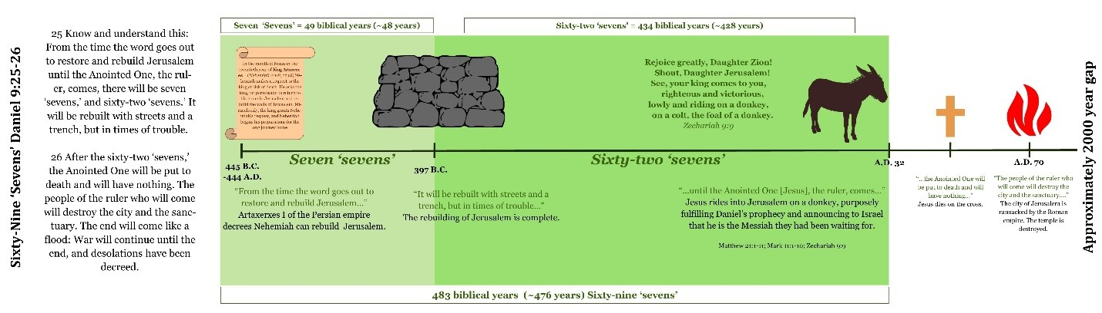
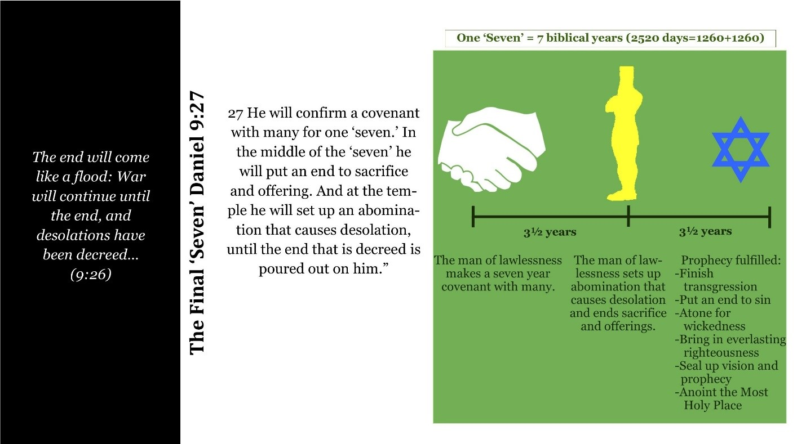
Notes:
The command to restore and rebuild Jerusalem was made by King Artaxerxes. This story can be found in Nehemiah chapter 2. King Artaxerxes gave Nehemiah permission and a written decree enabling him to rebuild Jerusalem. This decree gave Nehemiah safe passage back to Judea and provided Nehemiah the timber he needed to complete his task.
From the day King Artaxerxes wrote the decree to rebuild Jerusalem until the walls of Jerusalem were completed (in addition to other parts of the city) there were exactly 49 prophetic years to the day. The rebuilding of the wall is the seven “sevens” of this prophecy. Nehemiah 4 explains the difficult circumstances in which the wall was rebuilt, showing it to be a time of trouble. The people in the surrounding nations plotted against the Jews. They did not like the idea of Israel rising up again as a nation and potentially being a threat to their countries. The Jews had to be ready for an attack at any moment.
434 prophetic years after the rebuilding of the wall was the very day that Jesus rode into Jerusalem on a donkey fulfilling the sixty-two “sevens” of this prophecy, In doing so, Jesus fulfilled the Messianic prophecy found in Zechariah 9:9, "Rejoice greatly, Daughter Zion! Shout, Daughter Jerusalem! See, your king comes to you, righteous and victorious, lowly and riding on a donkey, on a colt, the foal of a donkey." Up until this point Jesus had continually said that it was not yet his time to be revealed. Jesus knew exactly what signal he was sending the people of Israel; he was signaling to all of Israel that he was the Messiah that they had been waiting for. Israel recognized their Messiah and welcomed him with palm branches and exuberant praise saying, "Blessed is he who comes in the name of the Lord" and "Blessed is the coming kingdom of our father David!" Many Jews had probably heard of the seventy ‘sevens’ prophecy and could have recognized that their Messiah was going to be revealed on that very day. This prophecy is astounding in its exactness. The precise nature of this and all other prophecies concerning Jesus’ first coming teach us that prophetic scriptures are meant to be taken literally, and each passage that hasn’t been perfectly fulfilled, will be in the future.
At this point in the prophecy we have seen how the seven ‘sevens’ and sixty-two ‘sevens’ were fulfilled in history. This leaves just one ‘seven’ or seven-year period before this prophecy will be fulfilled and all of its six conditions met, namely, the salvation of all of Israel. Verse 26, talks about different events that will happen before the final ‘seven’ will transpire. Verse 26 reads, “After the sixty-two ‘sevens’ the Anointed One will be put to death and will have nothing.” The ‘Anointed One’ refers to Jesus. He was put to death and had nothing when he died on the cross. (Mark on Chart) Next, the verse states, “The people of the ruler who will come will destroy the city and the sanctuary.” This occurred in 70 Ad when the city of Jerusalem was ransacked by the Roman empire and the temple destroyed. (Mark on Chart). The ‘ruler who is to come’ is a reference to the man of lawlessness and the ‘people’ of the ruler refers to the Romans. The man of lawlessness will be referenced again in verse 27, which we will take a look at in the next slide. The next part of verse 26 reads, “The end will come like a flood: War will continue until the end, and desolations have been decreed." This is the final time gap, where the prophecy is currently. (MARK: We are here). We will continue to be in this time period until the time of the end, the last seven years begins. It is during this last ‘seven’ that the Lord Jesus will come back and gather believers to him in the clouds and begins to pour out his wrath upon the earth.

Slide 10
Notes:
Verse 27 reads, “…” The “He” here refers to the man of lawlessness. At the start of the last ‘seven’, the man of lawlessness will make a covenant with many. This is the only time in the Bible that this event is mentioned. The Bible is silent on the specifics of how this will come to pass. Will this be a public or private covenant? What group or groups constitute “the many”? What are the provisions of the covenant that “the many” enter into? It is possible that Christians who know these prophecies and are watching the world scene may be able to catch this event occurring; but it is also possible that those watching will not be able to identify this event. Think about how many covenants between countries and organizations and people happen on a regular basis without our knowledge. Even if Christians are able to identify this covenant, it will still be impossible to identify the man of lawlessness with 100% certainty, as he will just be one of “many.” It is important to understand that the Bible does not emphasize the beginning of the seven. Whereas, the Bible only clearly mentions this covenant with many one time; the Bible mentions the events that occur in the middle of the seven numerous times. In the verses shown here, Daniel, Jesus, Paul, and John prophesy about events that happen in the middle of the seven. Of these verses, four of them refer to the abomination that causes desolation which is set up in the temple in the middle of the seven. Later in this study we are going to find that it is in the middle of the seven that the man of lawlessness sits in God’s temple proclaiming himself to be God and thus, is revealed to Christians as the anti-Christ.

Slide 11

An Important definition:
The abomination that causes desolation | An object, such as an idol, that the man of lawlessness will set up in the Jewish temple at the midpoint of Daniel’s seventieth ‘seven.’ This object will be something that greatly blasphemes the true, Living God. This abomination will cause desolation; it will ultimately lead to the judgment and destruction of the earth (Dan 9:27; Dan 12:11; Matt 24:15; Mark 13:14).
Notes:
The abomination that causes desolation is the defining marker of the mid-point of Daniel’s seventieth seven. “The abomination that causes desolation” is an object, such as an idol, that the man of lawlessness will set up in the Jewish temple, greatly blaspheming the true, Living God. This abomination will cause …desolation; it will ultimately lead to the judgment and destruction of the earth. Notice that the abomination that causes desolation occurs inside the Jewish temple. This prophecies that one day the Jewish temple will be rebuilt. Whereas, the temple was destroyed after the sixty-nine sevens part of this prophecy, a new temple will be rebuilt and this time desecrated instead of torn down. At Jesus’ coming this future temple will be reconsecrated as recorded in Daniel 8: 13-14).

Slide 12
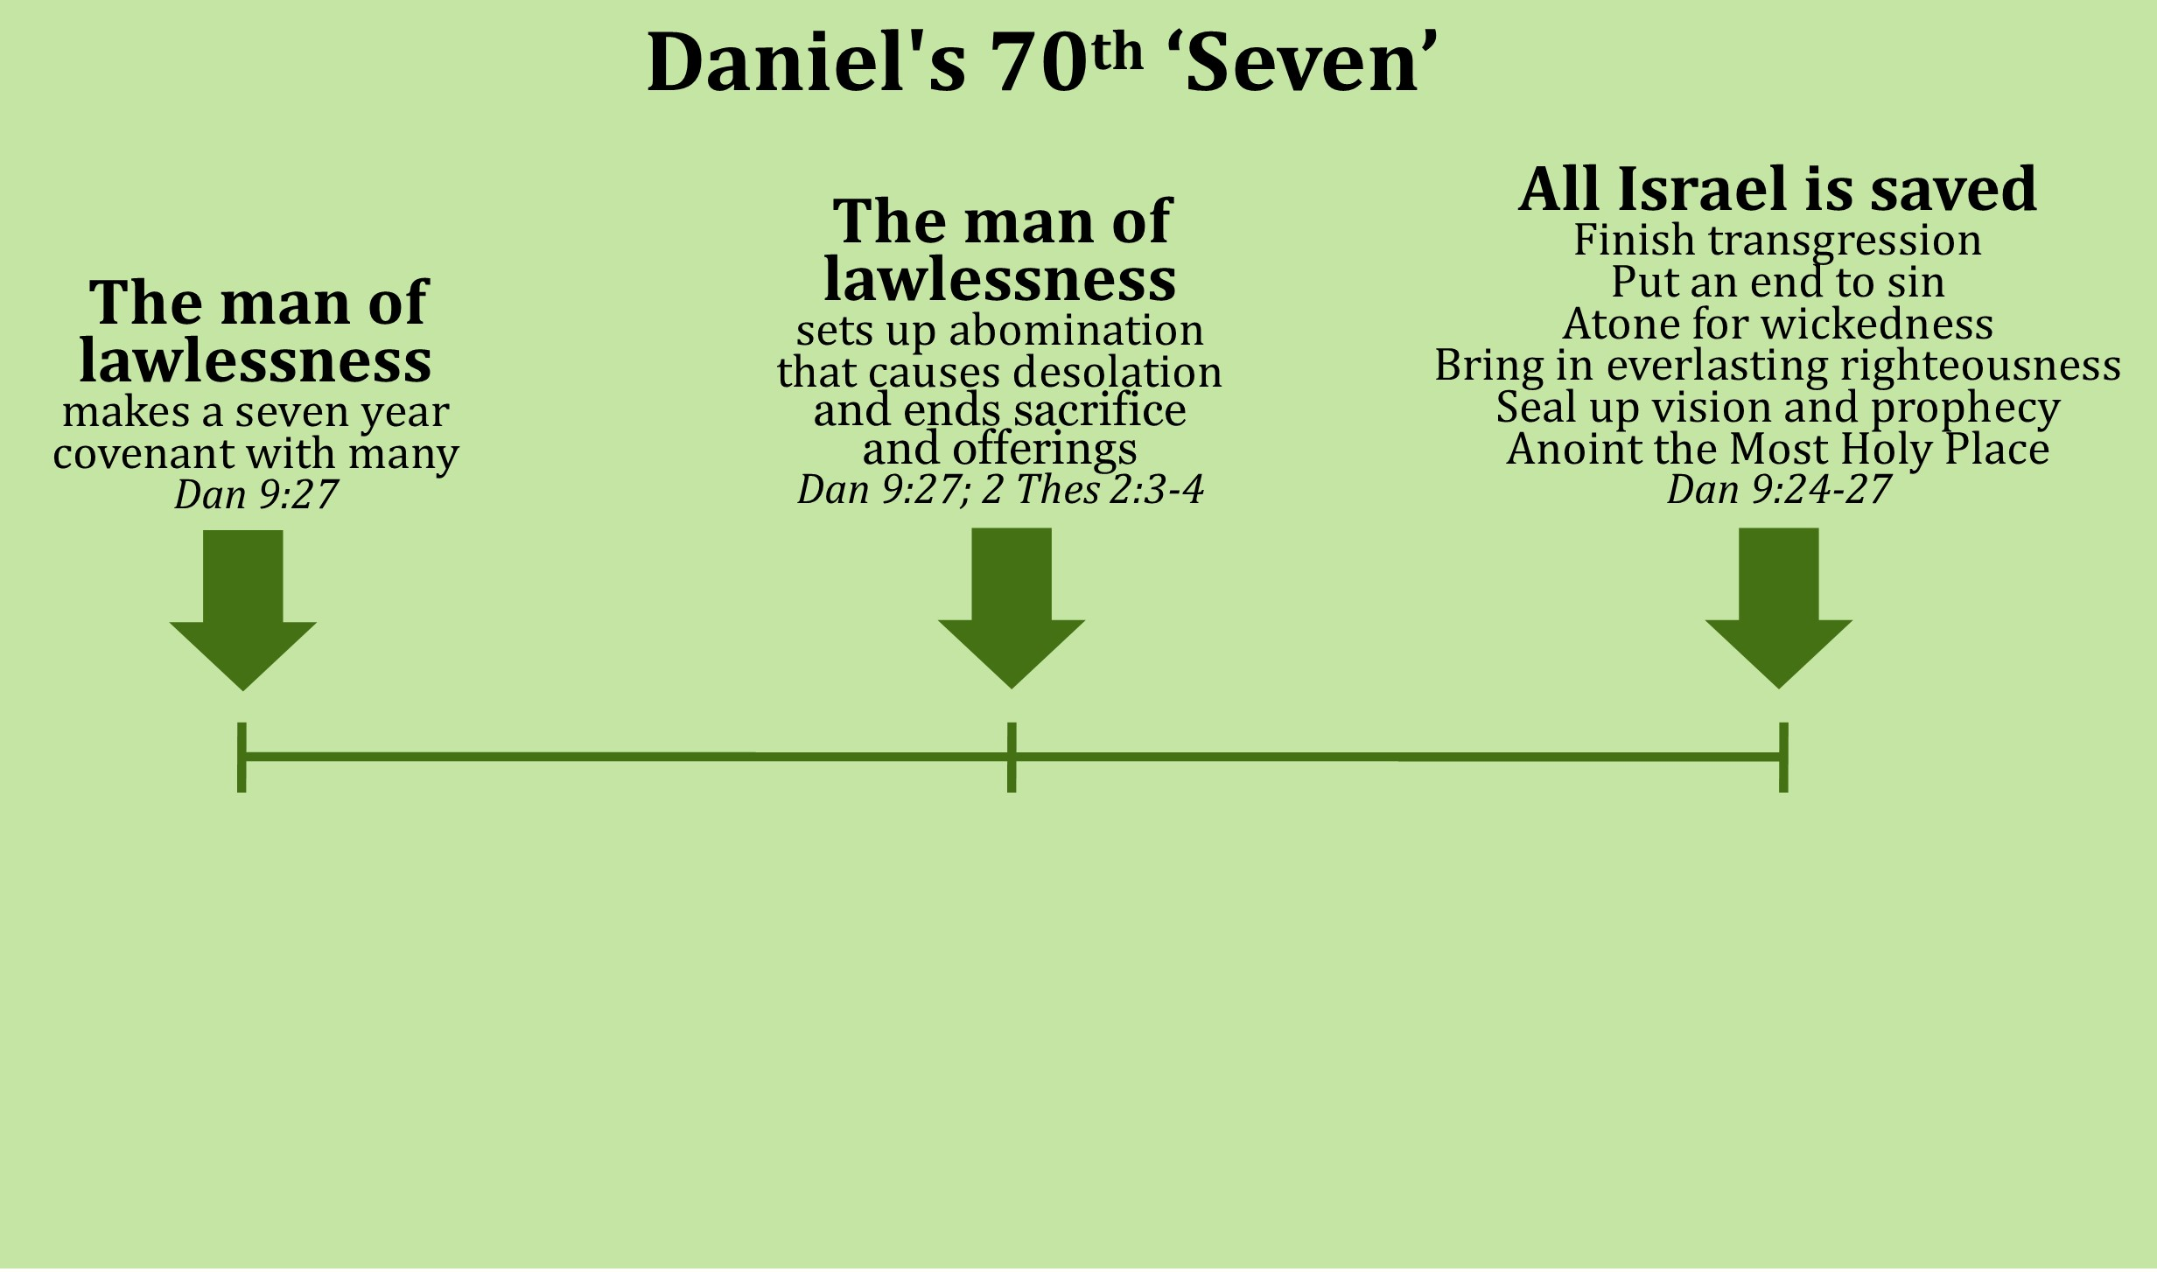



3 ½ years
3 ½ years
Notes:
Now let’s define Daniel’s seventieth ‘seven.’ It is a future seven-year period consisting of 2,520 days, or two groups of 1,260 days. This seven-year period begins when the man of lawlessness makes a covenant with many for seven years. At the three-and-a-half-year mark or after 1,260 days after the covenant was made, the man of lawlessness will ends the Jewish daily sacrifice and offering and set up the abomination that causes desolation. After another 1,260 days all six conditions that this prophecy speaks of will be fulfilled, namely, the salvation of all of Israel.

Slide 13
Notes:
Now let’s review the major aspects of Daniel’s Seventy ‘Sevens’ prophecy one last time to make sure that we all have a solid understanding of it. This prophecy spans time 490 years from its start to it’s finish. 483 of these years have already been fulfilled, while 7 of these years will yet be fulfilled in the future. The 483 years started when Artaxerses issued a decree to rebuilt Jerusalem. Exactly 483 years later after this decree was issued, Jesus was revealed as Israel’s messiah. Next, this prophecy goes into events that would occur before the final ‘seven’. Two of these events included Jesus’ death on the cross and the destruction of Jerusalem. This prophecy is currently in the final time gap awaiting the start of the final seven year period. This final ‘seven’ will start when the man of lawlessness will make a covenant with many. 1,260 after this covenant the man of lawlessness will set up the abomination that causes desolation in the Jewish temple. 1,260 after this event every living Jewish individual will have put their faith in Jesus, their messiah.

Slide 14
Notes:
The importance of understanding Daniel’s Seventieth ‘Seven’ prophecy cannot be overemphasized. Daniel’s prophecy anchors all other end time passages putting them into a timeline related to the final seven year period. Let’s take a look at how this prophecy interacts with Jesus’ teachings as found in Matthew 24.
Jesus directly references the event that will occur at the midpoint of Daniel’s seventieth “seven” in Matthew 24:15 when he talks about “the abomination that causes desolation.” Before the abomination that causes desolation is set up Jesus talks about a time called “the beginning of birth pains.” Jesus goes on to say that immediately after the abomination that causes desolation is set up a time of great tribulation and distress will come upon Christians. As we continue to use Daniel’s seventieth ‘seven’ and Jesus’ Olivet discourse as our major timeline we are going to discover where the other major end time passages fit into this time frame. This concludes part one of the teaching series based on the book, “The Saints Go Up and the Wrath Comes Down.” Please continue on to part 2: entitled “Events leading to up to the Great Tribulation.”

Slide 15
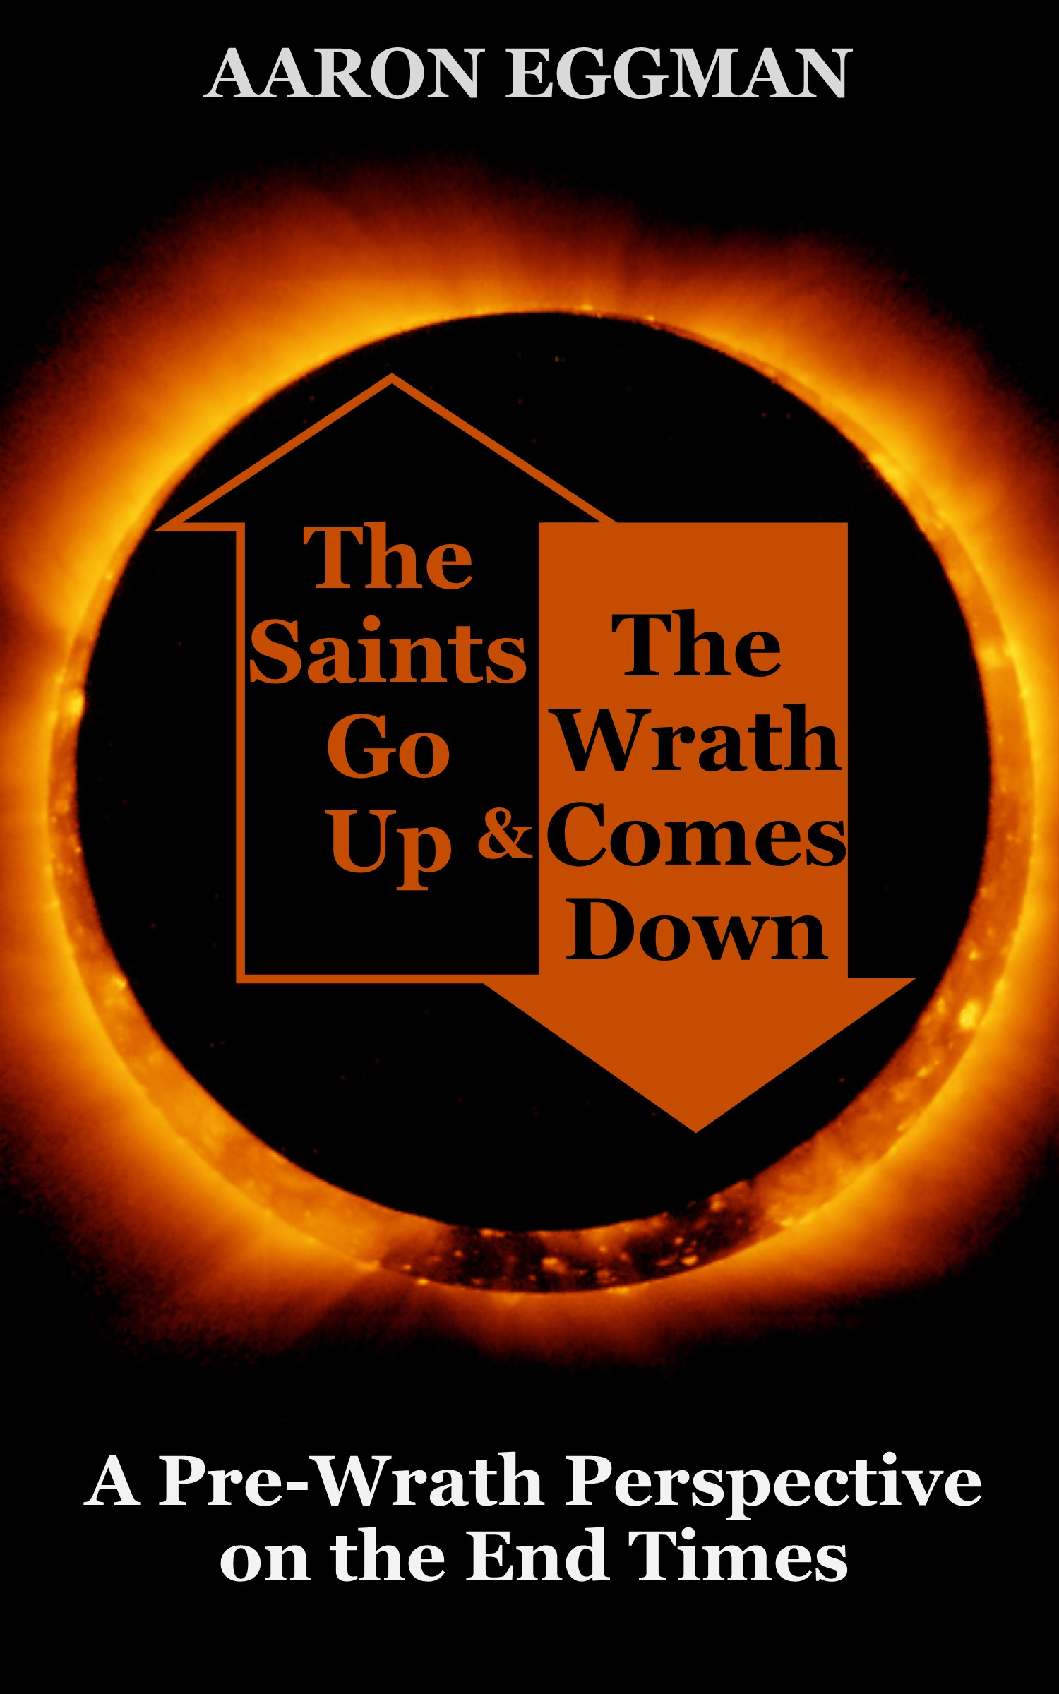
Part 2:
Events leading up to the Great Tribulation
Matthew 24:1-8, 15; Revelation 6:1-8, 12:7-17;
2 Thessalonians 2:1-9; Luke 21:20-24; Daniel 10-12
Notes:
Welcome to Part 2 of the teaching series based on the book, “The Saints Go Up and the Wrath Comes Down.” In this section entitled “Events leading up to the great tribulation” will discuss the time period called the “beginning of birth pains” and see how it interacts with the first four seals of Revelation 6: 1-8. we will also talk about the revealing of the man of lawlessness and the force that currently restrains him. Let’s start by seeing the Matthew 24 timeline in context.

Slide 16

Matthew 24: 1-3
¹Jesus left the temple and was walking away when his disciples came up to him to call his attention to its buildings. ² “Do you see all these things?” he asked. “Truly I tell you, not one stone here will be left on another; every one will be thrown down.” ³ As Jesus was sitting on the Mount of Olives, the disciples came to him privately. “Tell us,” they said, “when will this happen, and what will be the sign of your coming and of the end of the age?”
Notes:
This brings us back to the first three verses of Matthew 24. Let’s read it:
¹Jesus left the temple and was walking away when his disciples came up to him to call his attention to its buildings. ² “Do you see all these things?” he asked. “Truly I tell you, not one stone here will be left on another; every one will be thrown down.”
³ As Jesus was sitting on the Mount of Olives, the disciples came to him privately. “Tell us,” they said, “when will this happen, and what will be the sign of your coming and of the end of the age?”
After Jesus left the temple, he pointed at the temple buildings and once again prophesied that judgment would come: the temple would be destroyed and torn down. (which occurred in 70 A.D.). The disciples were curious the temple would be destroyed, so they asked the following questions: When would this happen, and what would be the sign of Jesus’ coming and of the end of the age? In Jesus' response, he did not answer their first question, when would the temple be destroyed, as he had just finished saying that the generation alive at the time would see the temple torn down. Instead, he answered the second two questions, What would be the sign of his coming? and what would be the sign of the end of the age
Matthew 24 contains Jesus’ answer to his disciples’ questions about the signs of his second coming and the beginning of a new era. Jesus’ answer contains events that happen before the man of lawlessness appears on the world scene, as well as events that will occur after he is revealed. They are not just events, but signs. For example, Jesus says that persecution will occur before his second coming. Currently, there are Christians being persecuted around the world. However, in the future, it will be intensified to the point that all nations will hate Christians. It will be a clear sign that Jesus’ coming is drawing near. Another sign is a great apostasy. It is true that around the world, some Christians decide to turn their backs on Jesus and give up their faith. However, in the future, it will be such a large number of people that it will be an actual sign of the times that Christians will be able to notice if they are watching.
Jesus gives an important exhortation in Matthew 24:13, “the one who stands firm to the end will be saved.” Jesus never gives an exhortation if he is not fully committed to helping his people walk it out successfully. Jesus will provide believers with enough grace and power to walk out his command to endure. It is possible by his strength! When we read Matthew 24, it should not cause us to feel fear. We can see Jesus’ heart behind revealing this information to us by reading John 16:33 (quoted from the NKJV): “These things I have spoken to you, that in Me you may have peace. In the world you will have tribulation; but be of good cheer, I have overcome the world .” Jesus had just told his disciples that he was leaving, and also that they would be persecuted.
His heart behind telling us his plans before they happen is not so that we would be afraid; on the contrary, it is so that we would have peace in him. Now that we have a context for the Olivet discourse, lets move on to talk about the time called, “the beginning of birth pains.”

Slide 17




The beginning of birth pains
Matthew 24: 4-8: ⁴ Jesus answered: “Watch out that no one deceives you. ⁵ For many will come in my name, claiming, ‘I am the Messiah,’ and will deceive many. ⁶ You will hear of wars and rumors of wars, but see to it that you are not alarmed. Such things must happen, but the end is still to come. ⁷ Nation will rise against nation, and kingdom against kingdom. There will be famines and earthquakes in various places. ⁸ All these are the beginning of birth pains.
Notes:
Just read

Slide 18
Notes:
In this section Jesus talks about a period of time that will occur before the end of the age. Jesus says that these things must happen, yet the end is still to come. He calls these things the beginning of birth pains. When a woman goes into labor, it signals that the hour of her baby's delivery is near. Women experience contractions during labor, which, if we follow the analogy, increase in frequency and intensity until finally the baby is delivered (Jesus’ second coming can be likened to the delivery). The contractions before the delivery are called "birth pains," and according to these verses, they include: People coming in Jesus’ name saying, 'I am the Messiah." People being deceived because of these false Christs. Wars and rumors of wars because nations and kingdoms rise up against each other, Famines, Earthquakes, And Plagues
These birth pains have been occurring on the earth for a long time now, but they are increasing in frequency and they will continue to increase until the end. During the final generation of the Lord’s return (possibly during the first 3 ½ years of Daniel’s 70th ‘seven’) these “birth pains” will have greater intensity than ever before in history. At this time, these birth pains will align with the opening of the first four seals of Revelation 6:1-8, specifically the first, second, and fourth seals.

Slide 19



The opening of seal 1 correlates to the birth pain of false Christs
Revelation 6: 1-2: ¹ I watched as the Lamb opened the first of the seven seals. Then I heard one of the four living creatures say in a voice like thunder, “Come!” ²I looked, and there before me was a white horse! Its rider held a bow, and was given a crown, and he rode out as a conqueror bent on conquest.
Notes:
Read Verse…The opening of seal one correlates to the birth pain of false Christs arising. In Rev 6:1-2 we see a rider on a white horse who has a crown and a bow. Although the identity of the rider is not specifically mentioned, it is likely that the rider on the white horse is the man of lawlessness. Jesus will come back on a white horse, and the anti-Christ is a counterfeit Christ-figure who rises in the world prior to Jesus' second coming. This is not Jesus, as Jesus is the one opening the seal and has yet to come back to the earth. The rider has a bow but no arrow. Initially, the man of lawlessness will conquer territory through diplomacy and tact, rather than through warfare, as the world must be at relative peace before the next rider comes and takes peace from the earth. The man of lawlessness with have authority and a moderate sphere of influence, and will progressively gain power until he has authority over the whole earth as prophesied in Rev 13:3.

Slide 20




The opening of seal 2 correlates to the birth pain of wars.
Revelation 6: 3-4: ³When the Lamb opened the second seal, I heard the second living creature say, “Come!” ⁴Then another horse came out, a fiery red one. Its rider was given power to take peace from the earth and to make people kill each other. To him was given a large sword.
Notes:
Read verse..At the opening of seal two, we see the world go to war. This is depicted by a rider on a red horse that carries a sword and takes peace from the earth. This rider may manifest in the form of an individual who initiates a world war that involves many nations.

Slide 21



The opening of seal 4 correlates to the birth pains of famine and plague
Revelation 6: 7-8: When the Lamb opened the fourth seal, I heard the voice of a forth living creature say, “Come!” I looked, and there before me was a pale horse! Its rider was named Death, and Hades was following close behind him. They were given power over a fourth of the earth to kill by sword, famine and plague, and by the wild beasts of the earth.
Notes:
The opening of seal four correlates to the birth pain of famines and plagues. We skipped seal three, because there is no direct correlation, although there is an indirect correlation. For now, we will focus on the 4th seal. At the opening of the fourth seal, a fourth of the world dies from the sword, famine, plague and wild beast attacks. This is depicted by a rider on a pale horse named Death and Hades.

Slide 22
Comparing the Beginning of Birth Pains with Seals of Revelation
False messiah(s) rise | Matt 24:5 | Seal 1: Rev 6:2
War | Matt 24:7 | Seal 2: Rev 6:4
Famine and Plague | Matt 24:7, Mark 13:8 | Seal 4: Rev 6:8
Notes:
This table presents the aligning of the birth pains and seals that will occur during the final generation before Jesus’ return, specifically the first three and a half years of Daniel’s seventieth week. Here we can how similar the birth pains are with the first four seals of Revelation 6. They both include: False Messiahs, war and famine and plague.

Slide 23
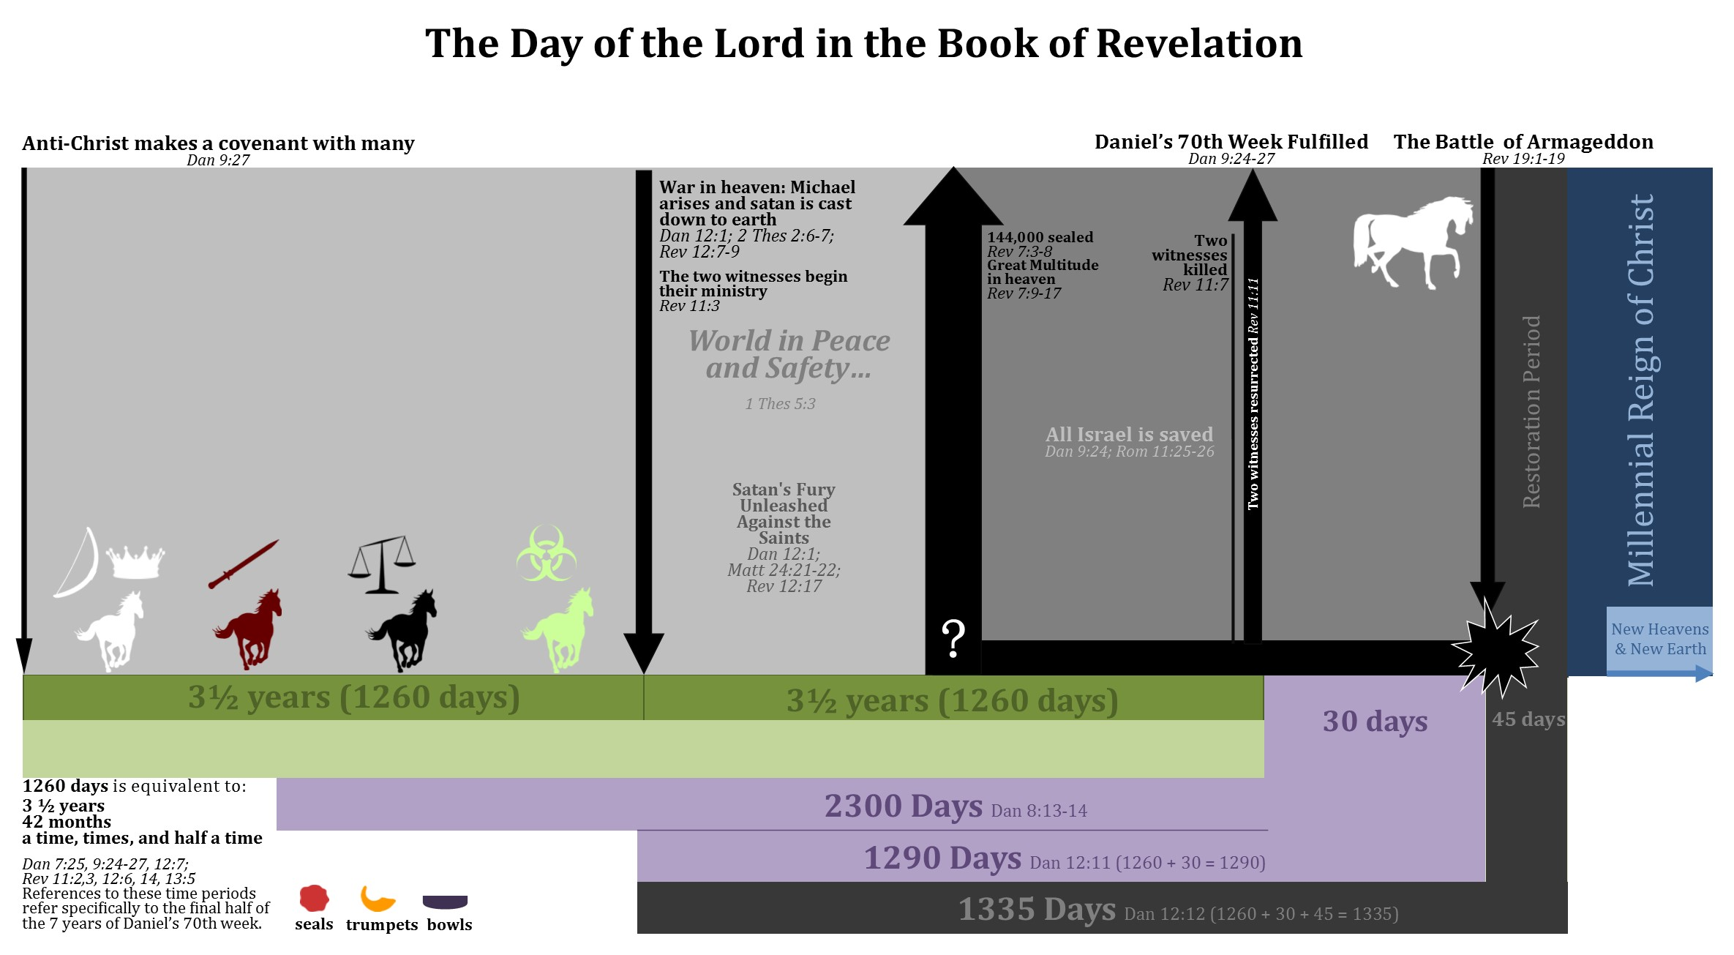
World in Chaos…
Daniel’s Seventieth ‘Seven’ (7 years)
Notes:
This chart depicts the time period prior to the Great Tribulation as “the world in chaos” because the aligning of the birth pains and the opening of the first four seals of Revelation 6 will devastate the world. The world will be at war, in economic crisis, and at least a fourth of the world will die by sword, famine, plague and wild beast attacks. The world will be in terrible crisis and fall into total chaos. The governments of the world will be in their direst hour, and will be unable to devise solutions to their compounding problems. The world leaders will be so desperate for someone to rise and fix the world’s problems. At this time, it appears the world stage is set for the man of lawlessness to be revealed and transition from a regional ruler to the ruler of the entire earth. He could use the world being in chaos to his advantage, solving the world’s problems. He could find a way to stop the plagues, solve world hunger, author a peace accord that everyone can agree on, and solve the world’s economic crisis. Whatever happens, we know from Revelation 17:12-13 that ten major rulers of the world at that time will hand their authority over to the man of lawlessness This is what it says: “¹²The ten horns you saw are ten kings who have not yet received a kingdom, but who for one hour will receive authority as kings along with the beast [the anti-Christ]. ¹³They have one purpose and will give their power and authority to the beast [the anti-Christ].” The beast in this passage refers to the anti-Christ, or man of lawlessness. But we still have to discuss other prophesied events before we talk about this in depth. Let’s turn our attention to the revealing of the man of lawlessness, (circle on chart) who is also called the Anti-Christ.

Slide 24
Matthew 24:4-8
Matthew 24:9-14
Notes:
If you are following along in your bible in Matthew 24, you will notice that Jesus first discussed events that would happen before the abomination that causes desolation is set up. These events are found in Matthew 24:4-8. Then in the following verses, Matthew 24: 9-14, he switches to the events that happen after the abomination that causes desolation is set up. Jesus indicates this change by his use of the word “then” in verse nine and by indicating that as a result of the events that would occur in Matthew 24:9-14 those who live in Judea should run for the mountains when they see the abomination standing in the Holy Place of the temple. Since Matthew 24: 9-14 concerns the time of the Great Tribulation we will hold off and skip to Matthew 24:15, the revealing of the man of lawlessness.

Slide 25


The man of lawlessness is revealed
Matthew 24: 15: ¹⁵ “So when you see standing in the holy place ‘the abomination that causes desolation,’ spoken of through the prophet Daniel—let the reader understand—
Daniel 9: 27: …In the middle of the ‘seven’ he [the man of lawlessness] will put an end to sacrifice and offering. And at the temple he will set up an abomination that causes desolation, until the end that is decreed is poured out on him.
2 Thessalonians 2:4: ⁴ He [the man of lawlessness] will oppose and will exalt himself over everything that is called God or is worshiped, so that he sets himself up in God’s temple, proclaiming himself to be God.
Notes:
Matthew 24: 15: ¹⁵ “So when you see standing in the holy place ‘the abomination that causes desolation,’ spoken of through the prophet Daniel—let the reader understand— Verse 15 puts us on Daniel’s 70th ‘7’ timeline. We know that when the man of lawlessness sets up the abomination that causes desolation we are right in the middle of the seven, exactly 3 ½ years before the fulfillment of the seventy ‘sevens’ prophecy of Daniel 9. Notice that Jesus declares here that people will be able to see the abomination that causes desolation being set up. Today we have media and can broadcast live events that are happening in one place around the world. This important event is going to be broadcast world-wide. At the time Christians and Jews hear that a man has entered into the Jewish temple and has set up the abomination that causes desolation, both Christians and Jews will know that it is the Anti-Christ. This is the moment the man of lawlessness is revealed to the world. Paul also discussed this event in 2 Thessalonians 2: 3-4 by saying “ he will oppose and will exalt himself over everything that is called God or is worshiped, so that he sets himself up in God’s temple, proclaiming himself to be God. Paul calls this event the revealing of the man of lawlessness. Here Paul was not mentioning an event that no one had ever heard of before, or something not found anywhere else in scriptures. Paul was pointing to the public, visible event that both Jesus and Daniel spoke about. At the moment the man of lawlessness sits in God’s temple declaring himself to be God and sets up the abomination that causes desolation any Christian or Jew who has read either the new testament or old testament will know that this man is the Anti-Christ.

Slide 26
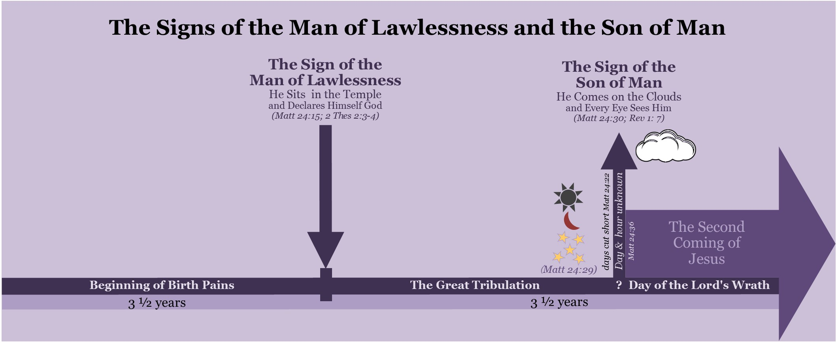
Notes:
This simple graph talks about the clear visible signs Christians are given in order to guard against deception. Every Christian should know these signs and be able to recognize them when they occur. Unfortunately, today many Christians don’t know these clear signs and thus make guesses at identifying who the man of lawlessness is and when Jesus will come back. If the Church knew these biblical signs they would not need to make these speculations. One very dangerous false teaching even goes so far as to claim that Jesus’ coming as detailed in Matthew 24 has already occurred and that there will be no future coming of the man of lawlessness, in addition, this false teaching states that a falling away from the faith will never occur. This doctrine is dangerous because it makes Christians susceptible to these deceptions when the come. Another issue that has arisen are conspiracy theories about how the devil will take control of the earth. These conspiracy theories are based on what Satan is currently doing on the earth and get people to focus on the plans of the enemy. Christians need to get their eyes off of the devil’s scheming and instead, focus their eyes on Jesus and his end time plans. Focusing on the devil breeds fear, while focusing on Jesus and his plans produces faith that Jesus is in perfect control. God is in perfect control and the devil is unable to execute his plans before God allows him to do so. Let’s now turn our attention to the two most obvious signs. The first is the sign that reveals the man of lawlessness to the world. This sign occurs in the middle of Daniel’s seventieth ‘7’ when a man enters into the Jewish temple and declares himself to be God. This also indicates that the Great Tribulation has begun, which we will discuss in part three. The second sign is found in the fact that every single eye on the face of the earth will see Jesus coming on the clouds. We will discuss this more in part 5. I cannot stress enough the importance of understanding these two signs.

Slide 27
The man of lawlessness revealed (2 Thess 2: 3) | The man of lawlessness is revealed when he sits in God's temple declaring himself to be God and sets up the abomination that causes desolation, which occurs at the three-and-a-half year mark of Daniel’s 70th ‘Seven’ (Dan 9:27, Dan 11:31; Matt. 24:15; Mark 13:14; 2 Thes 2:3-4).
Notes:
Let’s define the first of these two signs. The man of lawlessness is revealed when he sits in God's temple declaring himself to be God and sets up the abomination that causes desolation, which occurs at the three-and-a-half year mark of Daniel’s 70th ‘Seven’. Paul discusses the revealing of the man of lawlessness in 2 Thessalonians 2: 1-5, so, we’ll now turn our attention to this passage in order to connect it with our Matthew 24 timeline.

Slide 28
2 Thessalonians 2:1-5
¹Concerning the coming of our Lord Jesus Christ and our being gathered to him [the rapture], we ask you, brothers and sisters, ² not to become easily unsettled or alarmed by the teaching allegedly from us—whether by a prophecy or by word of mouth or by letter—asserting that the day of the Lord has already come. ³ Don’t let anyone deceive you in any way, for that day will not come until the rebellion [the great falling away] occurs and the man of lawlessness is revealed, the man doomed to destruction. ⁴ He will oppose and will exalt himself over everything that is called God or is worshiped, so that he sets himself up in God’s temple, proclaiming himself to be God. ⁵ Don’t you remember that when I was with you I used to tell you these things?
Notes:
(Read first) Now let discuss this scripture by examining my 2 thessalonians 2 chart.

Slide 29
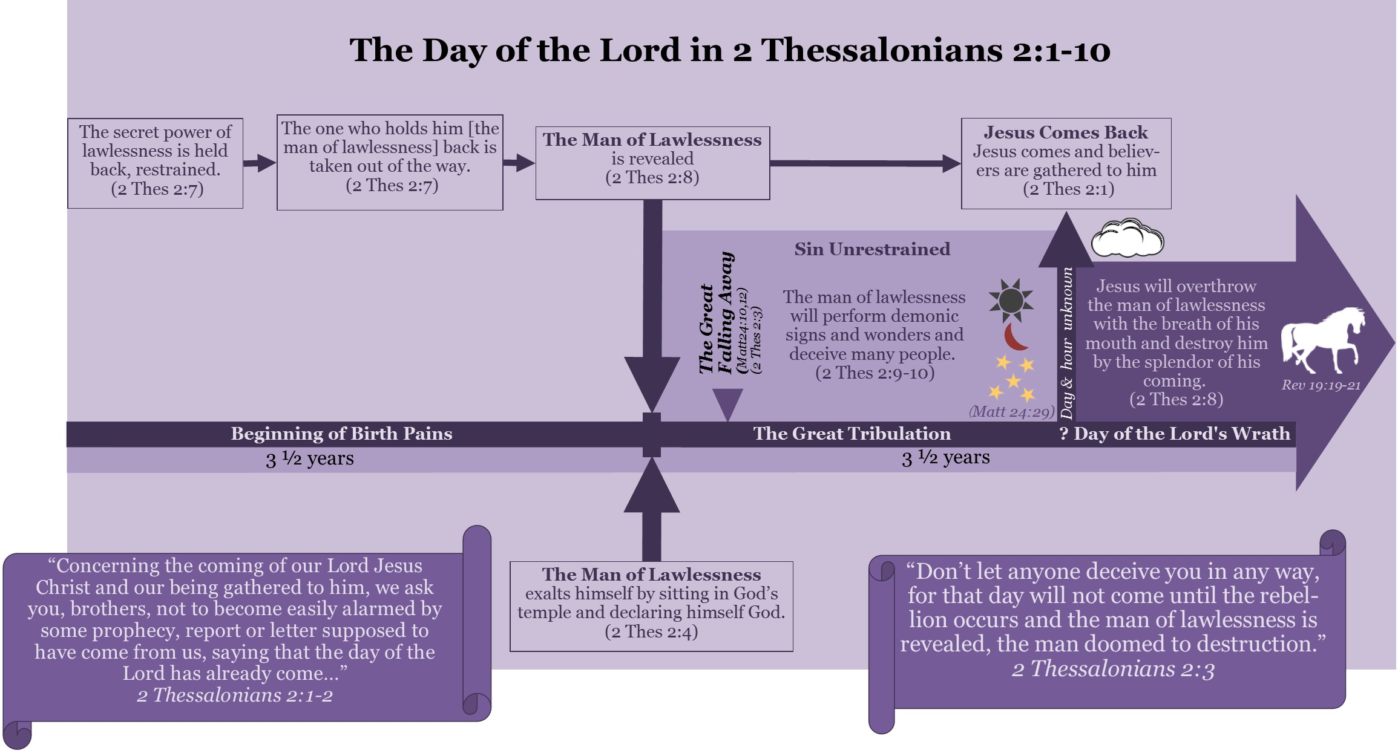
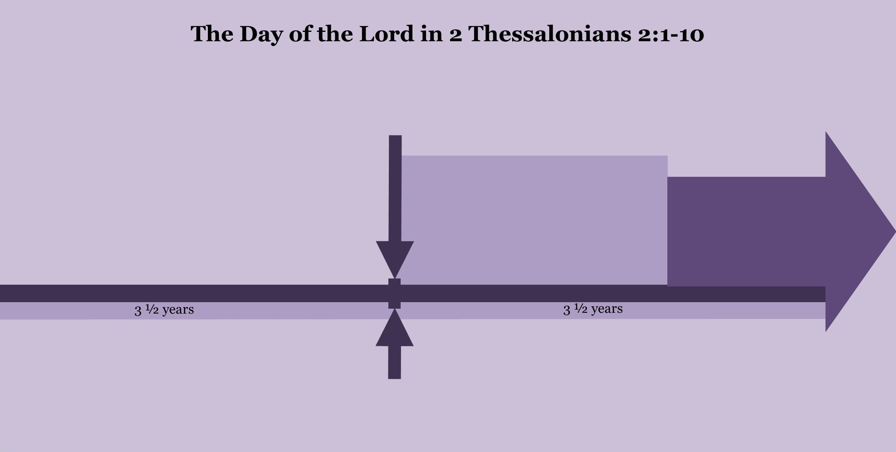

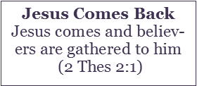


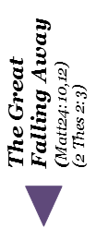

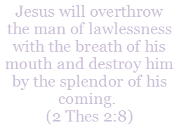
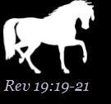


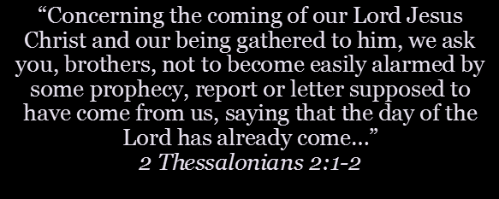
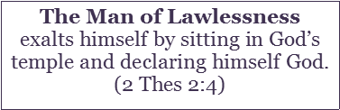
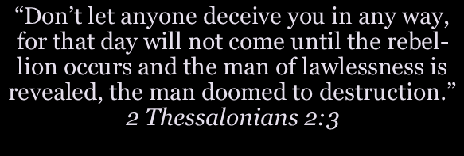
Notes:
When Paul teaches about the second coming of Christ and Christians being gathered to Jesus he is referencing the exact same events Jesus himself taught about his second coming. In this passage, Paul equates the coming of our Lord Jesus and Christians being gathered off the earth to the day of the Lord. These concepts are synonymous in the sense that they will occur at the same time, initiated by the same signs. This passage is one of many that form the New Testament definition of the eschatological Day of the Lord. The Day of the Lord occurs when Jesus comes and gathers the saints from the earth. According to this passage, Jesus will not come back and gather believers from the earth until two events occur. The first is a great “falling away” (NKJV) or “the rebellion” (NIV). The term in Greek is apostasia and means here that many people will turn away from their faith in God. Jesus said of this event that the love of most would grow cold. Before the saints are gathered in the clouds with Jesus, the great falling away will occur. Jesus’ use of the word "most" indicates more than half of Christians who originally had loved God will abandon their faith. The second event is the revealing of the man of lawlessness. Both Jesus and Paul taught on this event. Paul actually defines this event in verse 4, "He will oppose and will exalt himself over everything that is called God or is worshiped, so that he sets himself up in God's temple, proclaiming himself to be God." As mentioned earlier this event occurs at the same time that “the abomination that causes desolation is set up.” Note here that a Jewish temple must also be built before this event can occur. Paul indicates in verse 5 that he had shared this teaching with the Church in Thessalonica at a previous time. Paul really wanted the Church to grasp these ideas as it would help shield them from false teaching that would arise, stating that Jesus had already returned. We can summarize 2 Thessalonians 2: 1-5 by saying that until the man of lawlessness is revealed and the great falling away occurs, Jesus will not come down from heaven on the clouds and gather the saints and initiating the day of the Lord.
One commonly believed doctrine about the end times is the doctrine of immanency, which states that there is not a single sign or event that needs to occur before Jesus comes back. On the positive side, this doctrine prepares people to be ready for Christ’s return at any moment. It is Biblical and right to live like Jesus could come back at any moment. However, 2 Thessalonians 2 poses a big problem for this doctrine, as Paul clearly states, “Concerning the coming of our Lord Jesus Christ and our being gathered to him … that day will not come until the rebellion [the great falling away] occurs and the man of lawlessness is revealed.” Paul lists two events that will occur before the coming of the Lord Jesus Christ and Christians being gathered to him in the clouds. These two events are the great falling away and the revealing of the man of lawlessness. If one examines Jesus’ Olivet Discourse as found in Matthew 24, Mark 13, and Luke 21 which are Jesus’ chronological teaching on his second coming, one will find that this is exactly what Jesus himself taught concerning his second coming. Jesus taught that many different things must transpire on the earth before his coming, most notably the man of lawlessness setting up the abomination that causes desolation, the great falling away, and the signs in the sun, moon, and the stars. Paul in 2 Thessalonians 2: 1-5 was reemphasizing a point that he made in his previous letter when he wrote that the coming of our Lord Jesus and the gathering of the saints to him (which is synonymous with the day of the Lord) should not surprise believers like a thief in the night. Christians should not be surprised by Jesus’ coming. We should be able to watch for the events that both Jesus and Paul taught Christians to watch for. Ok, Let’s continue on to 2 Thessalonians 2: 6-9 to talk about the force that holds back the man of lawlessness.

Slide 30
2 Thessalonians 2: 6-9
⁶ And now you know what is holding him back, so that he may be revealed at the proper time. ⁷ For the secret power of lawlessness is already at work; but the one who now holds it back will continue to do so till he is taken out of the way. ⁸ And then the lawless one will be revealed, whom the Lord Jesus will overthrow with the breath of his mouth and destroy by the splendor of his coming.

Slide 31
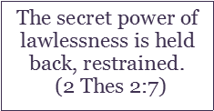
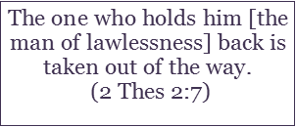




A FORCE
A PERSON
The secret power of lawlessness
The man of lawlessness
^{2:6} And now you know what is holding him back, so that he may be revealed at the proper time.
“Concerning the coming of our Lord Jesus Christ and our being gathered to him,
“Don’t let anyone deceive you in any way,
we
ask you, brothers, not to become easily alarmed by some prophecy, report or letter supposed to have come from us, saying that the day of the Lord has already come…”
2 Thessalonians 2:1-2
for that day will not come until the rebellion occurs and the man of lawlessness is revealed,
the man doomed to destruction.”
2 Thessalonians 2:3
Notes:
2 Thessalonians 2:7-8 reveals two things that are currently being held back: 1.) a force: the secret power of lawlessness and 2.) a person: the man of lawlessness or the anti-Christ. When he who restrains these two things stops restraining them the man of lawlessness will be revealed and the people of the world will follow him into lawlessness in a way the earth has never experienced since the days of Noah. 2 Thessalonians 2:6 says "and you know what is holding him back, so that he may be revealed at the appointed time." This statement shows that the restraining force was common knowledge during the days of the early church. Pre-wrath views Michael the archangel as the restraining force holding the man of lawlessness from being revealed. This is an important point to note as many people see the Holy Spirit in believers as the restraining force. The case for Michael the archangel being this restraining force is quite solid and is shown in both the old and new testament. Let’s take a look.

Slide 32
Michael arises directly before the Great Tribulation begins
Daniel 12: 1: At that time Michael, the great prince who protects your people, will arise. There will be a time of distress such as has not happened from the beginning of nations until then.
Matthew 24: 15, 21: ¹⁵ “So when you see standing in the holy place ‘the abomination that causes desolation,’ spoken of through the prophet Daniel—let the reader understand—… ²¹ For then there will be great distress, unequaled from the beginning of the world until now—and never to be equaled again.
2 Thessalonians 2:1-4
Notes:
Let’s start with Daniel 12:1: At that time Michael, the great prince who protects your people, will arise. There will be a time of distress such as has not happened from the beginning of nations until then. It is evident from this verse that after Michael takes action by arising, the Great Tribulation begins. From other passages like Matthew 24:15, 21 and 2 Thessalonians 2:1-4, we know that the Great Tribulation cannot start until the man of lawlessness is revealed. In other words, the man of lawlessness cannot be revealed until Michael, the archangel who protects Israel, takes action. It is after Michael arises that the man of lawlessness will be revealed. Daniel 12:1 indirectly establishes Michael the archangel as a restraining force over the man of lawlessness. Let’s turn our discussion to Daniel 10: 20-21.

Slide 33
Daniel 10:20-21
²⁰So he [a heavenly messenger] said, “Do you know why I have come to you? Soon I will return to fight against the prince of Persia, and when I go, the prince of Greece will come; ²¹but first I will tell you what is written in the Book of Truth. (No one supports me against them except Michael, your prince.)
Notes:
The spiritual world is real, but most of the time it is invisible to the average human. However, at a key time in history, the spiritual world became visible, audible, and tangible to the prophet Daniel! Daniel 10-12 details his experience receiving a prophecy from a heavenly messenger. This prophecy gives us a special look into how unseen spiritual forces are at work in addition to how humans influence these unseen events through prayer. These chapters also establish Michael as one who restrains and wars against demonic principalities that manifest in kings and kingdoms that arise on the earth. This is one of Michael’s job descriptions and heavenly beings know this about michael. In Daniel 10, a heavenly messenger arrived with a message in response to Daniel’s prayer that he prayed twenty-one days prior to that encounter. The heavenly messenger explains that he had been detained by a principality, a demonic “prince” over the kingdom of Persia. His purpose in coming to Daniel is given in Daniel 10:20-21: ²⁰So he said, “Do you know why I have come to you? Soon I will return to fight against the prince of Persia, and when I go, the prince of Greece will come; ²¹but first I will tell you what is written in the Book of Truth. (No one supports me against them except Michael, your prince.) This heavenly messenger came to reveal information from the “Book of Truth,” which is recorded in Daniel 11 and 12. This information concerns the overthrow of an earthly kingdom (the kingdom of Persia) and the establishment of a new kingdom, the kingdom of Greece. These events are influenced by struggles in the heavens between demonic “princes,” such as the prince of Persia and the prince of Greece, and those princes who obey God, such as Michael, as the heavenly messenger explains in Daniel 10:20-21.
The spiritual world is real, but most of the time it is invisible to the average human. However, at a key time in history, the spiritual world became visible, audible, and tangible to the prophet Daniel! Daniel 10-12 details his experience receiving a prophecy from a heavenly messenger. This prophecy gives us a special look into how unseen spiritual forces are at work in addition to how humans influence these unseen events through prayer. These chapters also establish Michael as one who restrains and wars against demonic principalities that manifest in kings and kingdoms that arise on the earth. This is one of Michael’s job descriptions and heavenly beings know this about michael. In Daniel 10, a heavenly messenger arrived with a message in response to Daniel’s prayer that he prayed twenty-one days prior to that encounter. The heavenly messenger explains that he had been detained by a principality, a demonic “prince” over the kingdom of Persia. His purpose in coming to Daniel is given in Daniel 10:20-21: ²⁰So he said, “Do you know why I have come to you? Soon I will return to fight against the prince of Persia, and when I go, the prince of Greece will come; ²¹but first I will tell you what is written in the Book of Truth. (No one supports me against them except Michael, your prince.) This heavenly messenger came to reveal information from the “Book of Truth,” which is recorded in Daniel 11 and 12. This information concerns the overthrow of an earthly kingdom (the kingdom of Persia) and the establishment of a new kingdom, the kingdom of Greece. These events are influenced by struggles in the heavens between demonic “princes,” such as the prince of Persia and the prince of Greece, and those princes who obey God, such as Michael, as the heavenly messenger explains in Daniel 10:20-21.

Slide 34



Michael arises by casting Satan out of heaven and confining him to earth
Revelation 12:7-9 ⁷“Then war broke out in heaven. Michael and his angels fought against the dragon, and the dragon and his angels fought back. ⁸But he was not strong enough, and they lost their place in heaven. ⁹ The great dragon was hurled down—that ancient serpent called the devil, or Satan, who leads the whole world astray. He was hurled to the earth, and his angels with him.”
Revelation 12:12 (NKJV): ¹² Therefore rejoice, O heavens, and you who dwell in them! Woe to the inhabitants of the earth and the sea! For the devil has come down to you, having great wrath, because he knows that he has a short time.”
Notes:
When the time comes for the anti-Christ to be revealed, God will signal for Michael to arise. Michael arises when he fights a heavenly battle with Satan and casts Satan to the earth. After this arising, Michael stops holding back the man of lawlessness from being revealed. At this point, Satan expresses his authority via the Man of lawlessness who is revealed by going into the Jewish Temple declaring himself God and setting up an abomination that causes desolation. At this time, the anti-Christ is given authority to carry out the destruction that has been foreknown and prophesied by Daniel and John in the book of Revelation. However, the anti-Christ will be held accountable for every action he takes with the authority given him, to his condemnation. Revelation 12 gives us insight into what it looks like when Michael arises and what occurs upon the earth directly afterwards. Revelation 12:7-9 shows how Michael arises, it reads, “Then war broke out in heaven. Michael and his angels fought against the dragon, and the dragon and his angels fought back. But he was not strong enough, and they lost their place in heaven. 9 The great dragon was hurled down—that ancient serpent called the devil, or Satan, who leads the whole world astray. He was hurled to the earth, and his angels with him.” Michael arises by casting Satan and his angels to the earth and confining them there. Satan, now unrestrained, releases his wrath and anger against the earth. Revelation 12: 12 states that that the time after Satan is cast down to the earth is the time he pours out his wrath, “Therefore rejoice, O heavens, and you who dwell in them! Woe to the inhabitants of the earth and the sea! For the devil has come down to you, having great wrath, because he knows that he has a short time.”

Slide 35


Satan unleashes his wrath against Israel
Revelation 12:13-16 ¹³ When the dragon saw that he had been hurled to the earth, he pursued the woman…
Luke 21: 20-24 ²⁰ “When you see Jerusalem being surrounded by armies, you will know that its desolation is near... ^{23b} There will be great distress in the land and wrath against this people...
Notes:
Satan unleashes his wrath first against Israel when he makes an attack on Jerusalem. Revelation 12:13-16 together with Luke 21: 20-24 show that Satan, the dragon, (via the person of the man of lawlessness) makes this attack against Israel directly after the man of lawlessness sets up the abomination that causes desolation in the middle of Daniels 70th ‘7’. The Jews, who heed Jesus instructions, will flee Jerusalem when they see armies surrounding Israel in addition to the abomination that causes desolation being set up. They will have a wilderness place of protection provided for them for the entirety of the final three and a half years of Daniel’s 70th ‘7’. Satan sees Israel (the woman) fleeing the city and pursues her but finds out that she is protected by God. At this point Satan goes to attack the saints, bringing us to the time known as the Great Tribulation.

Slide 36
The Great Tribulation
Revelation12:17: ¹⁷ Then the dragon [Satan through the man of the anti-Christ] was enraged at the woman [The people of Israel] and went off to wage war against the rest of her offspring—those who keep God’s commands and hold fast their testimony about Jesus.
Revelation 13:5-7: ⁵The beast [the man of lawlessness] was given a mouth to utter proud words and blasphemies and to exercise its authority for 42 months. ⁶ It opened its mouth to blaspheme God, and to slander his name and his dwelling place and those who live in heaven. ⁷ It was given power to wage war against God’s holy people and to conquer them.
Notes:
Revelation12:17: ¹⁷ Then the dragon was enraged at the woman and went off to wage war against the rest of her offspring—those who keep God’s commands and hold fast their testimony about Jesus. Revelation 13:5-7: ⁵The beast was given a mouth to utter proud words and blasphemies and to exercise its authority for 42 months. ⁶ It opened its mouth to blaspheme God, and to slander his name and his dwelling place and those who live in heaven. ⁷ It was given power to wage war against God’s holy people and to conquer them. Let’s briefly summarize the deductions made about the restraining force discussed in this section: First: the Great tribulation will not begin until until michael arises by casting Satan to the earth. Second, Because we know that Great Tribulation begins after the man of lawlessness is revealed, we can infer that the man of lawlessness will not be revealed until Michael arises. Two things happen when Michael takes action: the man of lawlessness is revealed and the Great Tribulation begins.

Slide 37
Important definition
Restraining force (2 Thess 2: 7) | Michael the angelic prince who protects Israel (Dan 10-12, Rev 12-13)
Notes:
The restraining force who holds back the secret power of lawlessness and the man of lawlessness from being revealed is Michael, the angelic prince who protects Israel.

Slide 38
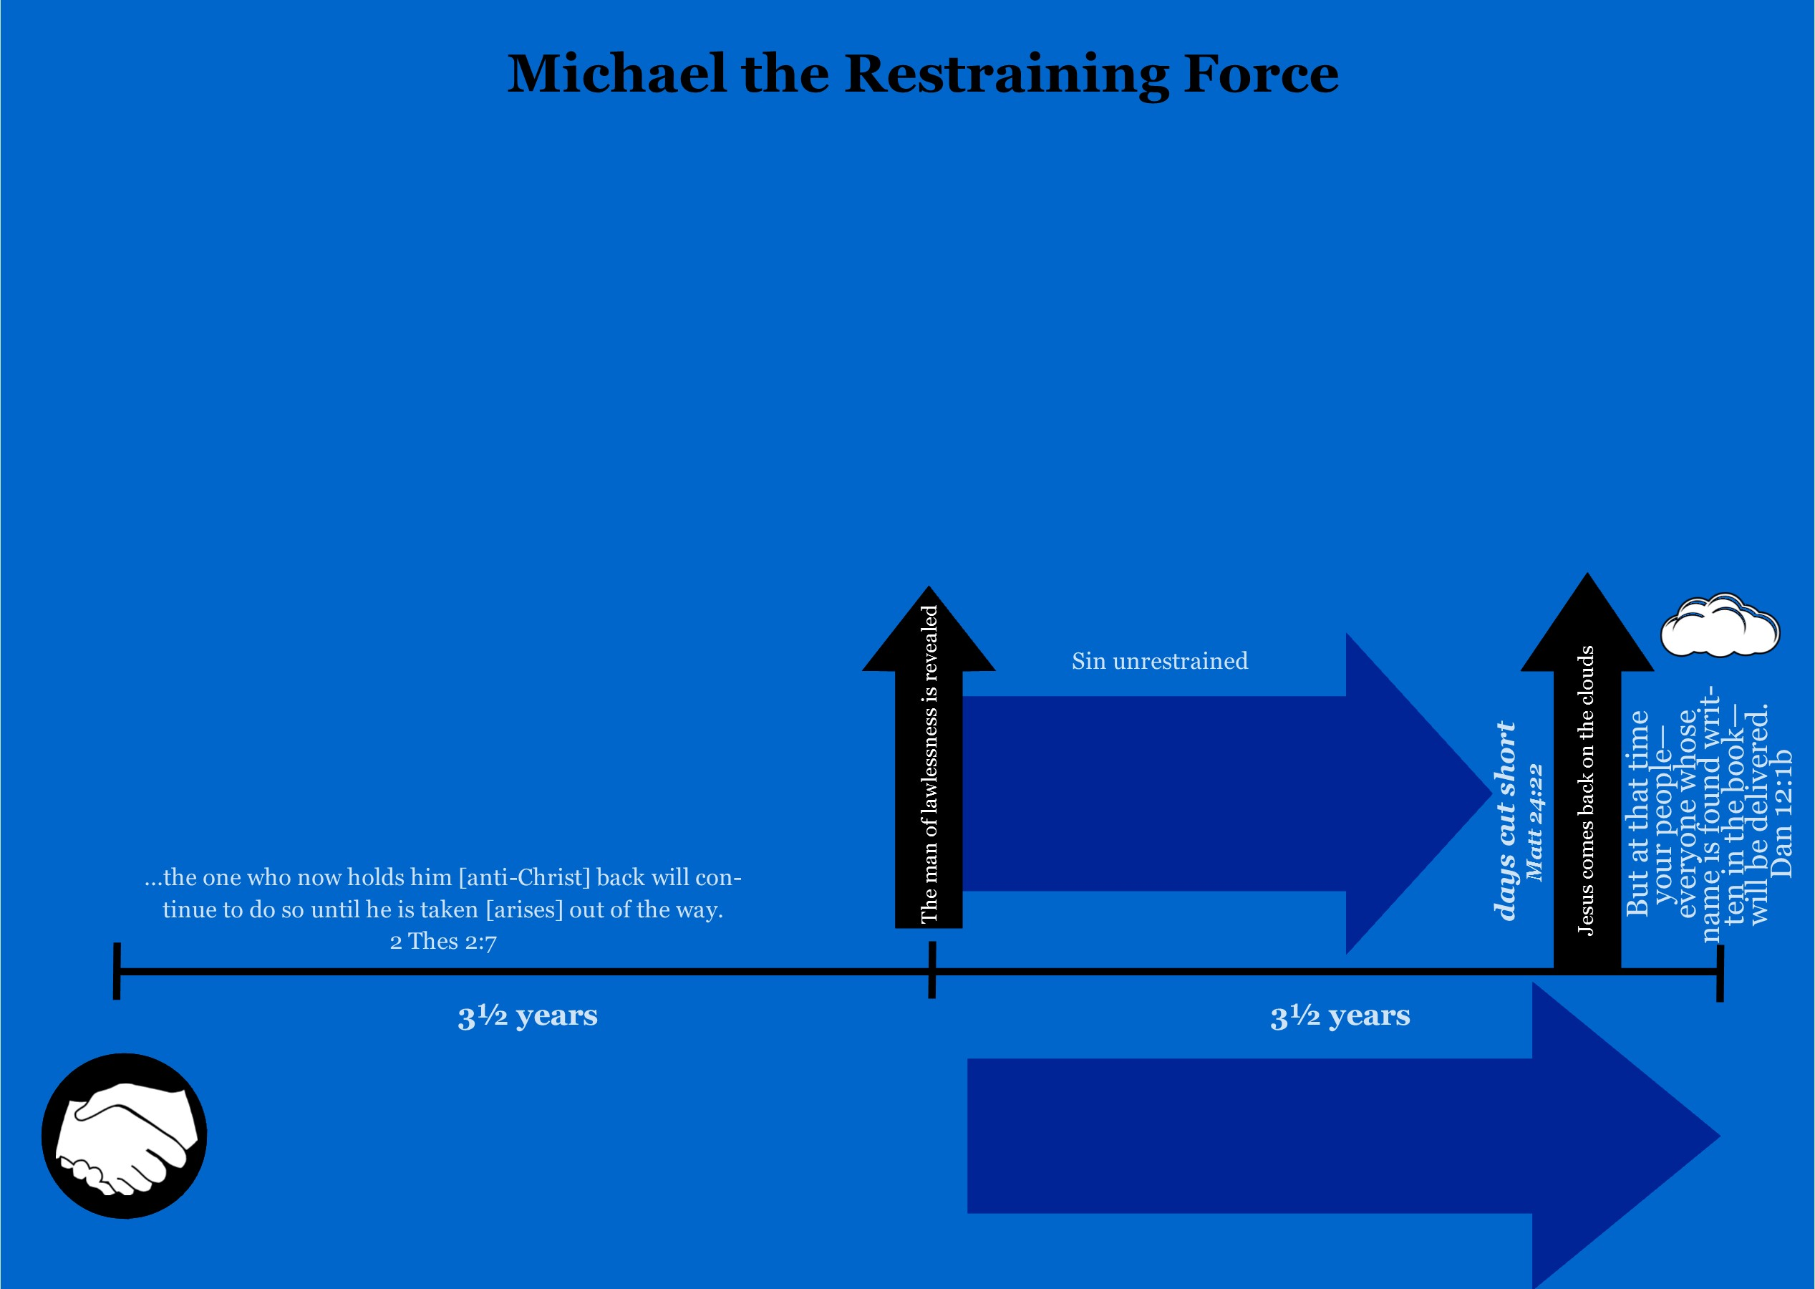
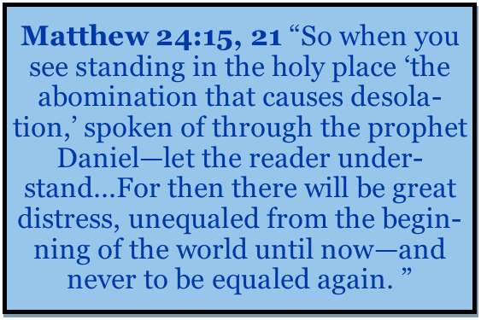
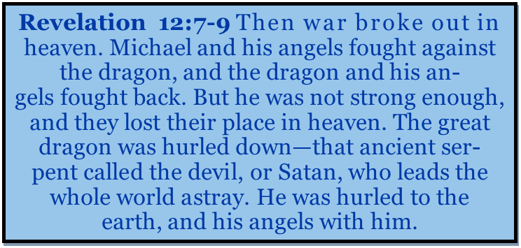
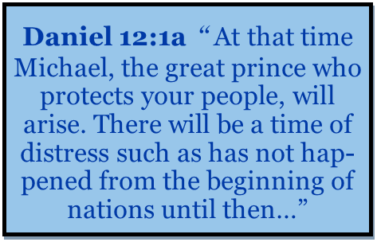

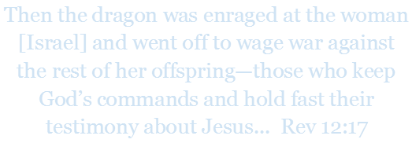




Notes:
This chart is quite heavy on verses. It would be good to take some time and familiarize yourself with these verses in order to understand the chart. Daniel 12:1 reveals that Michael arises directly before the time of Great tribulation. Revelation 12: 7-9, and verse 17 show michael arising to fight Satan in a heavenly battle directly before an attack on Israel occurs and the Great Tribulation begins. Matthew 24:15 and verse 21 show us that directly before the Great Tribulation begins, the abomination that causes desolation is set up and the man of lawlessness is revealed. Combine all this evidence with the fact that Daniel 10-12 show that Michael the archangel is Israel’s protector and that his Job in the past has been to restrain demonic principalities threatening Israel, and you get a very convincing argument that Michael is the restraining force found in 2 Thes 2:7.
Let’s focus our attention now to the artistic depiction of Michael and Satan. At some time before the midpoint of Daniel’s seventieth 7, Michael and Satan engage in battle in the heavenly realm. Michael prevails over Satan, and Satan is cast down to the earth. After this, the man of lawlessness is revealed, and the Great Tribulation begins in which Christians and Jews are persecuted. Jewish people who heed Jesus’ command to flee Judea will be protected for the full 3 ½ years of the Anti-Christs reign. At the end of this 3 ½ years, all Jewish people living on the earth will believe in Jesus as their Lord and Savior.

Slide 39

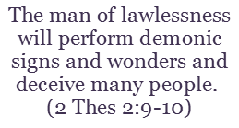
Notes:
We can now systematically go through 2 Thessalonians 2: 1-10 and understand every detail of it. It would be good to read these verses yourself in your Bible straight through before you listen to this section, as we will examine the verses somewhat out of order. We are now able to situate Paul’s teachings here into our Matthew and Daniel timeframes. Verses 7 mentions the restraining force holding back the secret power of lawlessness and the anti-Christ from being revealed. We examined in previous slides that this restraining force is the archangel Michael. Verse 8 is the revealing of the man of lawlessness, which happens at the midpoint of Daniel’s 70th ‘7’. It is directly before the man of lawlessness is revealed that Michael casts Satan out of heaven and ceases his work of restraining, thereby allowing the man of lawlessness to exercises his authority to attack Israel and set up the abomination that causes desolation. Verse 4, details the manner in which the man of lawlessness will be revealed. Verses 9 and 10 show that the man of lawlessness will use false signs and wonders to deceive the world. Verses 1-3 state that Jesus will come back and gather Christians from the earth sometime after the man of lawlessness is revealed and the great falling away occurs. We know from Matthew 24 that Jesus’ second coming occurs when Jesus cuts short the days of the Great Tribulation. At some point during the day of the Lord, Jesus will defeat the man of lawlessness and his kingdom, ending his reign of terror and beginning a new age.

Slide 40
World in Chaos…
Daniel’s Seventieth ‘Seven’ (7 years)
Notes:
Based on the information found in both part one and part two of this study, we are now able to understand all the events that lead up to the Great Tribulation. Lets review this information. At the beginning of Daniel’s 70th ‘7’ the man of lawlessness makes a covenant with many. Before the midpoint of Daniel’s 70th seven, the birth pains that Jesus talked about will align with the first four seals and the world will be plunged into choas. Over a fourth of the world will die during this time. In the middle of the seven the man of lawlessness stops the Jewish daily sacrifice and offering and is revealed when he sits in the temple and declares himself God. At this point he sets up the abomination that causes desolation and attacks Jerusalem. This is the teaching series based upon the book, “The Saints Go Up and the Wrath Comes Down” by Aaron Eggman. In Part Three we will examine the time period known as the Great Tribulation.

Slide 41
Part 3: The Great Tribulation
Matthew 24: 9-28, Revelation 6: 9-11; Revelation 13
Notes:
(Insert Video) Welcome to Part 3 of my teaching series based on my book, “The Saints Go Up and the Wrath Comes Down.” In part three we are going to discuss the time of the Great Tribulation as found in Matthew 24: 21 that occurs directly after the man of lawlessness declares himself God in the Jewish temple. Some major questions we are going to answer are, “What events transpire during the Great Tribulation?”, “Whose wrath is the Great Tribulation? God’s or Satan’s?” “Who are the elect Jesus talk about?”, “Will Christians be on the earth during this time period?” “When does the salvation of Israel begin?” This and others will be answered in this section. Let’s start by picking back up where we left off in our Matthew 24 timeline.

Slide 42
Instructions to those in Judea
Matthew 24: 15-20: ¹⁵ “So when you see standing in the holy place ‘the abomination that causes desolation,’ spoken of through the prophet Daniel—let the reader understand—¹⁶ then let those who are in Judea flee to the mountains. ¹⁷ Let no one on the housetop go down to take anything out of the house. ¹⁸ Let no one in the field go back to get their cloak. ¹⁹ How dreadful it will be in those days for pregnant women and nursing mothers! ²⁰ Pray that your flight will not take place in winter or on the Sabbath.
Luke 21: 20-24: ²⁰When you see Jerusalem being surrounded by armies, you will know that its desolation is near. ²¹Then let those who are in Judea flee to the mountains, let those in the city get out, and let those in the country not enter the city. ²²For this is the time of punishment in fulfillment of all that has been written. ²³How dreadful it will be in those days for pregnant women and nursing mothers! There will be great distress in the land and wrath against this people. ²⁴They will fall by the sword and will be taken as prisoners to all the nations. Jerusalem will be trampled on by the Gentiles until the times of the Gentile are fulfilled.
Notes:
Let’s read Matthew 24:15-20, Jesus’ instructions to those in Judea. READ VERSE. Now, let’s read Luke 21:20-24, which is Luke’s account of the same discourse but with additional details. These verses are written to those who live in Judea. These instructions are meant to help people living there escape to the wilderness place of protection that Jesus has provided during this time (Rev 12: 6, 14-16). Adding Luke’s account of the Olivet Discourse shows that the man of lawlessness will invade Jerusalem immediately after he sets up the abomination that causes desolation. Zechariah 14:2 explains what happens to those who do not heed Jesus’ instructions to get out of Judea, especially Jerusalem. “² I will gather all the nations to Jerusalem to fight against it; the city will be captured, the houses ransacked, and the women raped. Half of the city will go into exile, but the rest of the people will not be taken from the city.” Half of the people of Israel will once again be exiled to the nations, and the other half will stay in Israel, now under the control of the man of lawlessness. Joel 3: 3 explains that the nations will sell and cast lots for the people of Israel. The children will be sold in exchange for prostitutes and other items. Unfortunately, many people who live in Israel do not know of Jesus teachings to flee. As Christians, let us pray that this knowledge gets to as many people as possible before these events occur. Let’s move to the next verse Matthew 24: 21.

Slide 43
The Great Tribulation
Matthew 24: 15, 21-22: ¹⁵ “So when you see standing in the holy place ‘the abomination that causes desolation,’ spoken of through the prophet Daniel—let the reader understand— … ²¹ For then there will be great distress [great tribulation], unequaled from the beginning of the world until now—and never to be equaled again. ²² “If those days had not been cut short, no one would survive, but for the sake of the elect those days will be shortened.
Notes:
Matthew 24: 15, 21-22: ¹⁵ “So when you see standing in the holy place ‘the abomination that causes desolation,’ spoken of through the prophet Daniel—let the reader understand— … ²¹ For then there will be great distress [great tribulation], unequaled from the beginning of the world until now—and never to be equaled again. ²² “If those days had not been cut short, no one would survive, but for the sake of the elect those days will be shortened. Matthew 24: 15- 22 shows us that the Great Tribulation begins immediately after the man of lawlessness sets up the abomination that causes desolation, and Daniel 9: 27 show us that the abomination that causes desolation is set up at the three-and-a-half-year mark of Daniel’s 70th ‘7’. Thus, the Great Tribulation begins at the three-and-a-half-year mark of Daniel’s 70th ‘7’. Soon this study will turn to a discussion of the time of the Great Tribulation, but first it is important to examine who the elect are to whom Jesus is referring in this passage. The days of the Great Tribulation will be so difficult for the elect that if they were on the earth for the full three and a half years of Daniel’s seventieth week, not a single one would be left alive by the end.

Slide 44
Who are the group Jesus terms the “elect”?
Jesus spoke Matthew 24: 4-31 privately to the disciples (Matt 24: 3) and used the pronoun "you" to include the disciples in the group “the elect.”
Matthew 24:24-27, "²⁴ For false messiahs and false prophets will appear and perform great signs and wonders to deceive, if possible, even the elect. ²⁵ See, I have told you ahead of time. ²⁶ “So if anyone tells you, ‘There he is, out in the wilderness,’ do not go out; or, ‘Here he is, in the inner rooms,’ do not believe it. ²⁷ For as lightning that comes from the east is visible even in the west, so will be the coming of the Son of Man."
This group was not just limited to the first twelve disciples, but includes all those who would believe in Jesus after them also.
Notes:
Jesus spoke Matthew 24: 4-31 privately to the disciples (Matt 24: 3) and used the pronoun "you" to include the disciples in the group “the elect.”
Jesus does this in Matthew 24:24-27, "²⁴ For false messiahs and false prophets will appear and perform great signs and wonders to deceive, if possible, even the elect. ²⁵ See, I have told you ahead of time. ²⁶ “So if anyone tells you, ‘There he is, out in the wilderness,’ do not go out; or, ‘Here he is, in the inner rooms,’ do not believe it. ²⁷ For as lightning that comes from the east is visible even in the west, so will be the coming of the Son of Man." The apostles would go on to become the leadership of the Church. Jesus gave this message to the future leaders of the Church, so that they could prepare the Church for this time. The “you” here refers to Christians. Peter, one of the apostles present for Jesus’ Olivet teachings, defines the elect for us in one of his letters to the Church .

Slide 45
How did Peter define the group termed the “elect”?
1 Peter 1: 1-5, “To God’s elect, exiles scattered throughout the provinces of Pontus, Galatia, Cappadocia, Asia and Bithynia, ² who have been chosen according to the foreknowledge of God the Father, through the sanctifying work of the Spirit, to be obedient to Jesus Christ and sprinkled with his blood: Grace and peace be yours in abundance. ³ Praise be to the God and Father of our Lord Jesus Christ! In his great mercy he has given us new birth into a living hope through the resurrection of Jesus Christ from the dead, ⁴ and into an inheritance that can never perish, spoil or fade. This inheritance is kept in heaven for you, ⁵ who through faith are shielded by God’s power until the coming of the salvation that is ready to be revealed in the last time.”
Notes:
1 Peter 1: 1-5, “To God’s elect, exiles scattered throughout the provinces of Pontus, Galatia, Cappadocia, Asia and Bithynia, ² who have been chosen according to the foreknowledge of God the Father, through the sanctifying work of the Spirit, to be obedient to Jesus Christ and sprinkled with his blood: Grace and peace be yours in abundance. ³ Praise be to the God and Father of our Lord Jesus Christ! In his great mercy he has given us new birth into a living hope through the resurrection of Jesus Christ from the dead, ⁴ and into an inheritance that can never perish, spoil or fade. This inheritance is kept in heaven for you, ⁵ who through faith are shielded by God’s power until the coming of the salvation that is ready to be revealed in the last time.” Peter defines the elect as those “who have been chosen according to the foreknowledge of God the Father, through the sanctifying work of the Spirit, to be obedient to Jesus Christ and sprinkled with his blood.” The elect are those who have been born again, believe in Jesus Christ, and have an inheritance kept for them in heaven. This inheritance is kept for them in heaven until Jesus is revealed at his coming. When Jesus said the elect would go through the Great Tribulation, he included all those who had believed in him and were washed by his blood. It is important to note that all individuals who fall under the category of elect will be taken up at meet Jesus in the Clouds at his coming. Paul also defines the elect.

Slide 46
How did Paul define the group termed the “elect”?
Romans 11: 5-7: ⁵ So too, at the present time there is a remnant chosen by grace. ⁶ And if by grace, then it cannot be based on works; if it were, grace would no longer be grace. ⁷ What then? What the people of Israel sought so earnestly they did not obtain. The elect among them did, but the others were hardened.
Notes:
Romans 11: 5-7: ⁵ So too, at the present time there is a remnant chosen by grace. ⁶ And if by grace, then it cannot be based on works; if it were, grace would no longer be grace. ⁷ What then? What the people of Israel sought so earnestly they did not obtain. The elect among them did, but the others were hardened.
Paul defines this group as those of Israel, who at this present time, are a remnant chosen by grace. In other words, the elect are the people of Israel who accepted Jesus as their savior and messiah before Jesus’ coming. Paul makes a clear distinction that those of Israel who have not accepted Jesus are not “the elect”.

Slide 47
An Important Definition
The Elect | The elect refers to those of “this present time” that are a remnant saved by grace who have been chosen according to the foreknowledge of God the Father, through the sanctifying work of the Spirit to be obedient to Jesus Christ, sprinkled with his blood. They have been born again, consisting of both Jewish and Gentile followers of Jesus (Matt 24:21-31; Mark 13:20-27; Romans 8, 33, Romans 11: 5-7; col 3: 12, Titus 1:1; 1 Peter 1:1; 2: 4, 9 and 2 Peter 1: 10.)
Notes:
The elect refers to those of this present time that are a remnant saved by grace who have been chosen according to the foreknowledge of God the Father, through the sanctifying work of the Spirit and to be obedient to Jesus Christ and sprinkled with his blood and have been born again, consisting of both believing Jews and Gentiles. Notice here that the elect are those of “this present time” who have believed in Jesus. To understand this definition fully it is now important for us to find out and define what “this present time” refers to.

Slide 48
What is the time period termed, “This present time?”
Romans 11: 25-27, “²⁵ I do not want you to be ignorant of this mystery, brothers and sisters, so that you may not be conceited: Israel has experienced a hardening in part until the full number of the Gentiles has come in, ²⁶ and in this way all Israel will be saved. As it is written: “The deliverer will come from [the heavenly] Zion; he will turn godlessness away from Jacob. ²⁷ And this is my covenant with them when I take away their sins.”
Isaiah 59:18-21 ¹⁸ According to what they have done, so will he repay wrath to his enemies and retribution to his foes; he will repay the islands their due. ¹⁹ From the west, people will fear the name of the Lord, and from the rising of the sun, they will revere his glory. For he will come like a pent-up flood that the breath of the Lord drives along. ²⁰ “The Redeemer will come to Zion [Jerusalem], to those in Jacob who repent of their sins,” declares the Lord. ²¹ “As for me, this is my covenant with them,” says the Lord. “My Spirit, who is on you, will not depart from you, and my words that I have put in your mouth will always be on your lips, on the lips of your children and on the lips of their descendants—from this time on and forever,” says the Lord.
Notes:
Romans 11: 25-27, “²⁵ I do not want you to be ignorant of this mystery, brothers and sisters, so that you may not be conceited: Israel has experienced a hardening in part until the full number of the Gentiles has come in, ²⁶ and in this way all Israel will be saved. As it is written: “The deliverer will come from Zion; he will turn godlessness away from Jacob. ²⁷ And this is my covenant with them when I take away their sins.” As we examined in a previous slide,, there are two types of Jewish people on the earth during the time period known as “this present time”: The “elect” who believe in Jesus, and those of Israel whose hearts are being hardened and do not put their faith into Jesus., Romans 11: 25-27 shows us that there is a coming time after the full number of Gentiles believe in Jesus, when Jesus comes from heavenly Zion to turn godlessness away from Israel and make a lasting covenant with them. It is at this point that all of Israel is saved. Having made these connections we can conclude that “this present time” will come to an end when the full number of Gentiles put there faith in Jesus who comes from the heavenly Zion and makes a covenant with the people of Israel. Paul’s message in Romans 11:26-27 is actually referencing an old testament passage: Isaiah 59: 18-21, which details this covenant Jesus makes with Israel, “Isaiah 59:18-21 ¹⁸ According to what they have done, so will he repay wrath to his enemies and retribution to his foes; he will repay the islands their due. ¹⁹ From the west, people will fear the name of the Lord, and from the rising of the sun, they will revere his glory. For he will come like a pent-up flood that the breath of the Lord drives along. ²⁰ “The Redeemer will come to Zion, to those in Jacob who repent of their sins,” declares the Lord. ²¹ “As for me, this is my covenant with them,” says the Lord. “My Spirit, who is on you, will not depart from you, and my words that I have put in your mouth will always be on your lips, on the lips of your children and on the lips of their descendants—from this time on and forever,” says the Lord.” It is important to note that this covenant is different from the covenant Jesus makes with Christians. Jesus’ covenant with the people of Israel includes future offspring, His covenant with Christians includes a resurrected body which will not marry or be given in marriage (according to Matthew 22:30). Since Israel's covenant include offspring, all of Israel will not be saved until after the rapture and the first resurrection have already taken place.

Slide 49
All of Israel is not saved when Jesus comes back on the clouds
Revelation 1: 7 “Look, he is coming with the clouds, and every eye will see him, even those who pierced him; and all the peoples of the earth will mourn because of him. So shall it be! Amen.”
Zechariah 12: 10-14, 13: 1 ¹⁰ “And I will pour out on the house of David and the inhabitants of Jerusalem a spirit of grace and supplication. They will look on me, the one they have pierced, and they will mourn for him as one mourns for an only child, and grieve bitterly for him as one grieves for a firstborn son….13 ¹“On that day a fountain will be opened to the house of David and the inhabitants of Jerusalem, to cleanse them from sin and impurity.
Notes:
This idea is again supported in Revelation 1: 7 by the fact that when Jesus comes on the clouds, “those who have pierced him” will see Jesus and mourn, showing that not all of Israel have received salvation. They do not rejoice at Jesus’ coming but rather mourn. They are sad to the point of weeping at seeing their messiah come back. Zechariah 12: 10-14, 13: 1 shows that at the time that Israel looks upon Jesus, they begin to receive salvation ¹⁰ “And I will pour out on the house of David and the inhabitants of Jerusalem a spirit of grace and supplication. They will look on me, the one they have pierced, and they will mourn for him as one mourns for an only child, and grieve bitterly for him as one grieves for a firstborn son….13 ¹“On that day a fountain will be opened to the house of David and the inhabitants of Jerusalem, to cleanse them from sin and impurity. When Jesus comes back, the elect of Israel will be raptured and the rest of Israel’s hearts will no longer be hardened. Israel will see their messiah come to rapture Christians from the earth. They will be devastated that they did not believe in Jesus and will watch as those who did believe are caught up to meet Jesus in the clouds. In this way they will be provoked to jealousy. Romans 10:19 (NKJV): But I say, did Israel not know? First Moses says: “I will provoke you to jealousy by those who are not a nation, I will move you to anger by a foolish nation.” Think about how unbelieving Jews will feel when they see their Jewish messiah come back and gather countless gentiles to him. Can you imagine being a Jew and seeing your messiah come back for people whom you thought were part of a false religion? It would be heart breaking! Jesus’ coming signals that the full number of Gentiles of “this present time” have believed. The time is now ripe for Israel to receive salvation.

Slide 50
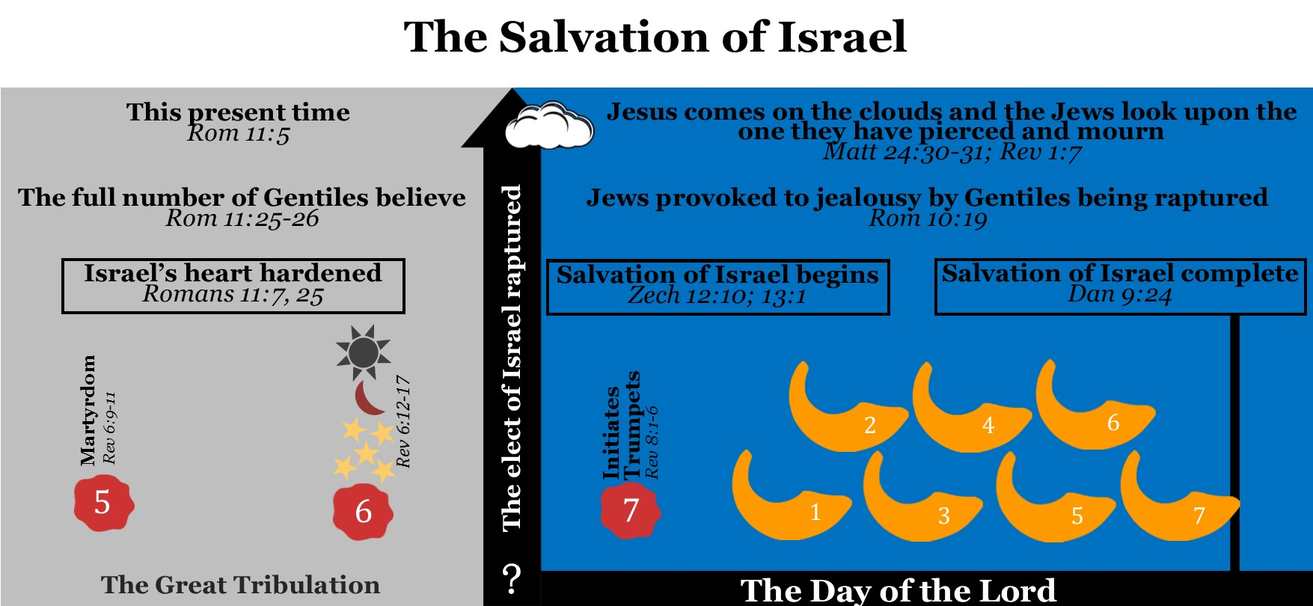
Notes:
Let’s now review all this information using this chart. Israel’s hearts will remain hardened until the time period termed, “this present time” comes to an end when the full number of Gentiles believe in Jesus. Jesus will then come back and rapture “the elect” of Israel but not those of Israel who have been hardened. At Jesus’ coming, every eye will see him and the Jews who have not believed in Jesus will mourn. Jews will see the gentiles who believe in Jesus be raptured from the earth and they will be provoked to Jealously. Their hearts will be softened towards Jesus and the salvation of Israel will begin. By the end of Daniel’s 70th week, all living Jews will have believed in Jesus.

Slide 51
An Important definition
This present time | “This present time” is a Biblical phrase which refers to the time period beginning after Jesus’ death until the time of his second coming (Rom 11: 5). “This present time” ends after Jesus cuts short the days of the Great Tribulation when he comes on the clouds and gathers Christians off the earth.
Notes:
Let’s define “this present time.” This present time is a Biblical phrase talking about the time after Jesus’ death to the time of his coming. This present time ends after Jesus cuts short the days of the Great Tribulation when he comes on the clouds and gathers Christians off the earth.

Slide 52
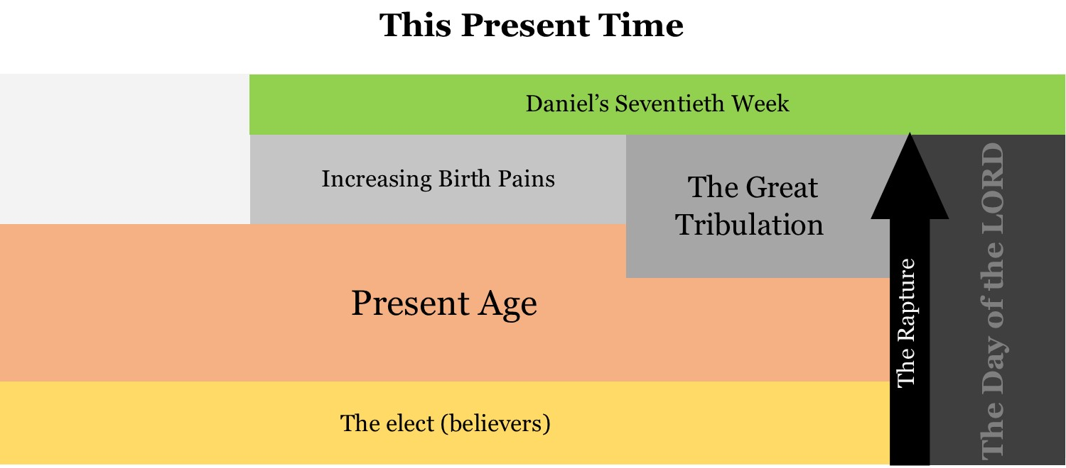
Notes:
This chart depicts the beginning and ending of this present time or present age, and how it relates to Daniel’s seventieth week. We can see on this chart that before Daniel’s seventieth week is completed, this present time ends. This occurs when Jesus cuts short the days of the Great Tribulation and raptures the saints from the earth. At this point, the elect are taken off the earth and meet Jesus in the clouds. Following the rapture, those of Israel whose hearts had been hardened will begin to give their lives to Jesus. By the end of Daniel’s seventieth week, all of Israel will be saved.

Slide 53
Important concept:
When is all of Israel saved? | The commencing of all of Israel’s salvation begins at Jesus’ coming and will be completed before the end of Daniel’s 70th “Seven.” At Jesus’ coming he will gather the “elect” of Israel and the “full number of Gentiles” from the earth (Matt 30-31). The rest of Israel’s hearts will be softened towards their Messiah when they look upon the one they have pierced.

Slide 54
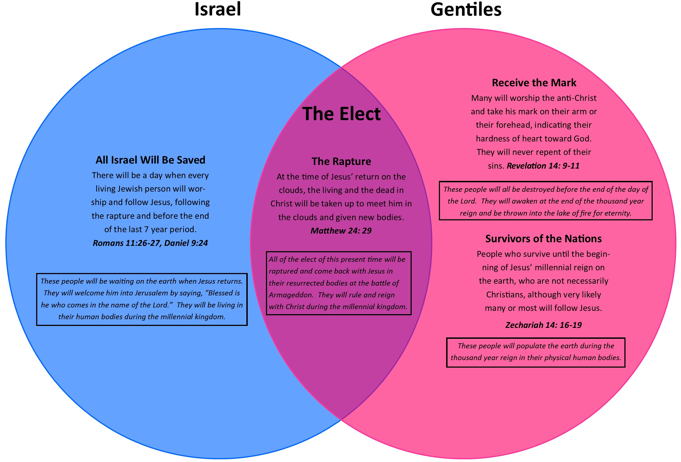
Notes:
This chart depicts three groups of people: the people of Israel, the Elect, and the Gentiles. You can see that the group known as the elect consist of some of the people of Israel and some of the Gentiles. The elect will leave the earth in the rapture when Jesus returns and gathers Christians to meet him in the clouds. What happens to the rest of Israel? The people of Israel whose hearts were hardened before Jesus’ second coming will be left on the earth following the rapture. However, their hearts will begin to be softened and by the end of Daniel’s seventieth week, they will all have given their lives to Jesus. The Gentiles who do not believe in Jesus prior to the rapture are split into two different groups: those who worship the man of lawlessness, and those who did not worship the man of lawlessness but who were not Christians. During the day of the Lord, all those who worship the man of lawlessness will be killed. The rest of the Gentiles will give their lives to Jesus during the day of the Lord.

Slide 55
God shortens the Great Tribulation
Matthew 24: 21-22: ²¹ For then there will be great distress [great tribulation], unequaled from the beginning of the world until now—and never to be equaled again. ²² “If those days had not been cut short, no one would survive, but for the sake of the elect those days will be shortened.
Notes:
Having defined the elect as people who believe in Jesus before the rapture, or Christians in this present time, we can now proceed to talk about the time of the Great Tribulation. The time of the Great Tribulation is a time of tribulation, distress, and persecution against the saints. If the full three and a half years of this time period were allowed to take place not a single Christian would survive. As soon as the God ordained number of martyrs have been reached, Jesus will cut short the Great Tribulation (Rev 6: 11). It is for the sake of the elect that God shortens the three and a half years of the Great Tribulation, and after the tribulation of those days, Jesus himself comes down from heaven and with the sound of a trumpet he gathers his elect to him in the clouds (Matt 24: 29-30).

Slide 56




Jesus’ description of the Great Tribulation
Matthew 24: 9-14: ⁹ “Then you will be handed over to be persecuted and put to death, and you will be hated by all nations because of me. ¹⁰ At that time many will turn away from the faith and will betray and hate each other, ¹¹ and many false prophets will appear and deceive many people. ¹² Because of the increase of wickedness, the love of most will grow cold, ¹³ but the one who stands firm to the end will be saved. ¹⁴And this gospel of the kingdom will be preached in the whole world as a testimony to all nations, and then the end will come.
Notes:
Earlier we skipped Matthew 24: 9-14 because it was talking about the time period known as the Great Tribulation. It’s time for us to take a look at it now. Matthew 24: 9-14: ⁹ “Then you will be handed over to be persecuted and put to death, and you will be hated by all nations because of me. ¹⁰ At that time many will turn away from the faith and will betray and hate each other, ¹¹ and many false prophets will appear and deceive many people. ¹² Because of the increase of wickedness, the love of most will grow cold, ¹³ but the one who stands firm to the end will be saved. ¹⁴And this gospel of the kingdom will be preached in the whole world as a testimony to all nations, and then the end will come. According to this verse the time of the Great Tribulation includes: 1.) Persecution and hatred of Christians on a worldwide scale 2.) False prophets who deceive many 3.) The great falling away that includes more than half of Christians (or those who love Jesus), and 4.) The preaching of the gospel of the kingdom to every people group of the world (which is also mentioned in Rev 14:6

Slide 57
Jesus’ description of the Great Tribulation
Matthew 24: 23-28: ²³ At that time if anyone says to you, ‘Look, here is the Messiah!’ or, ‘There he is!’ do not believe it. ²⁴ For false messiahs and false prophets will appear and perform great signs and wonders to deceive, if possible, even the elect. ²⁵ See, I have told you ahead of time. ²⁷For as lightning that comes from the east is visible in the west, so will be the coming of the Son of Man. ²⁸Wherever there is a carcass, there vultures will gather.
Notes:
Matthew 24: 23-28 also concerns the time of the Great Tribulation. Matthew 24: 23-28: ²³ At that time if anyone says to you, ‘Look, here is the Messiah!’ or, ‘There he is!’ do not believe it. ²⁴ For false messiahs and false prophets will appear and perform great signs and wonders to deceive, if possible, even the elect. ²⁵ See, I have told you ahead of time. ²⁷For as lightning that comes from the east is visible in the west, so will be the coming of the Son of Man. ²⁸Wherever there is a carcass, there vultures will gather. Jesus says the time of the Great Tribulation is a time of false Messiahs appearing who preform demonic signs and wonders and warns that it will be very deceptive. People will even claim that Jesus’ has come back and will tell others to go see this so called “Jesus”. Jesus here declares that we should not believe them, as when he comes back it will be visible to everyone on the face of the earth. Every Eye will see him.

Slide 58
Notes:
Here on our Matthew 24 chart we can now fill in the details of the Great Tribulation. This is a time of intense persecution of Christians. It is a time of deception and apostasy in which many people who at once were Christians will fall away from the faith. It is a time in which false prophets and false messiahs arise on the world scene. It is also a time in which sin will increase to greater levels than it ever has before. Notice here how the wrath of God is absent from Jesus’ description of the Great Tribulation. The Great Tribulation is a very misunderstood term in the body of Christ. Many teachers teach that the Great Tribulation is synonymous with the day of the Lord and that this is a time of God's wrath being poured out on the earth. The pre-wrath view does not view the Great Tribulation and the Day of the Lord as concurrent events but rather sequential. The Great Tribulation occurs first and the day of the Lord directly after it. The Great Tribulation is a time of unrestrained sin and a time of Satan pouring out his wrath and anger via the man of lawlessness against the Church, whereas, the day of the Lord is the time God rescues the church and pours out his wrath. To illustrate this lets look to other major passages that talk about the time of the Great Tribulation and see how they describe it.

Slide 59
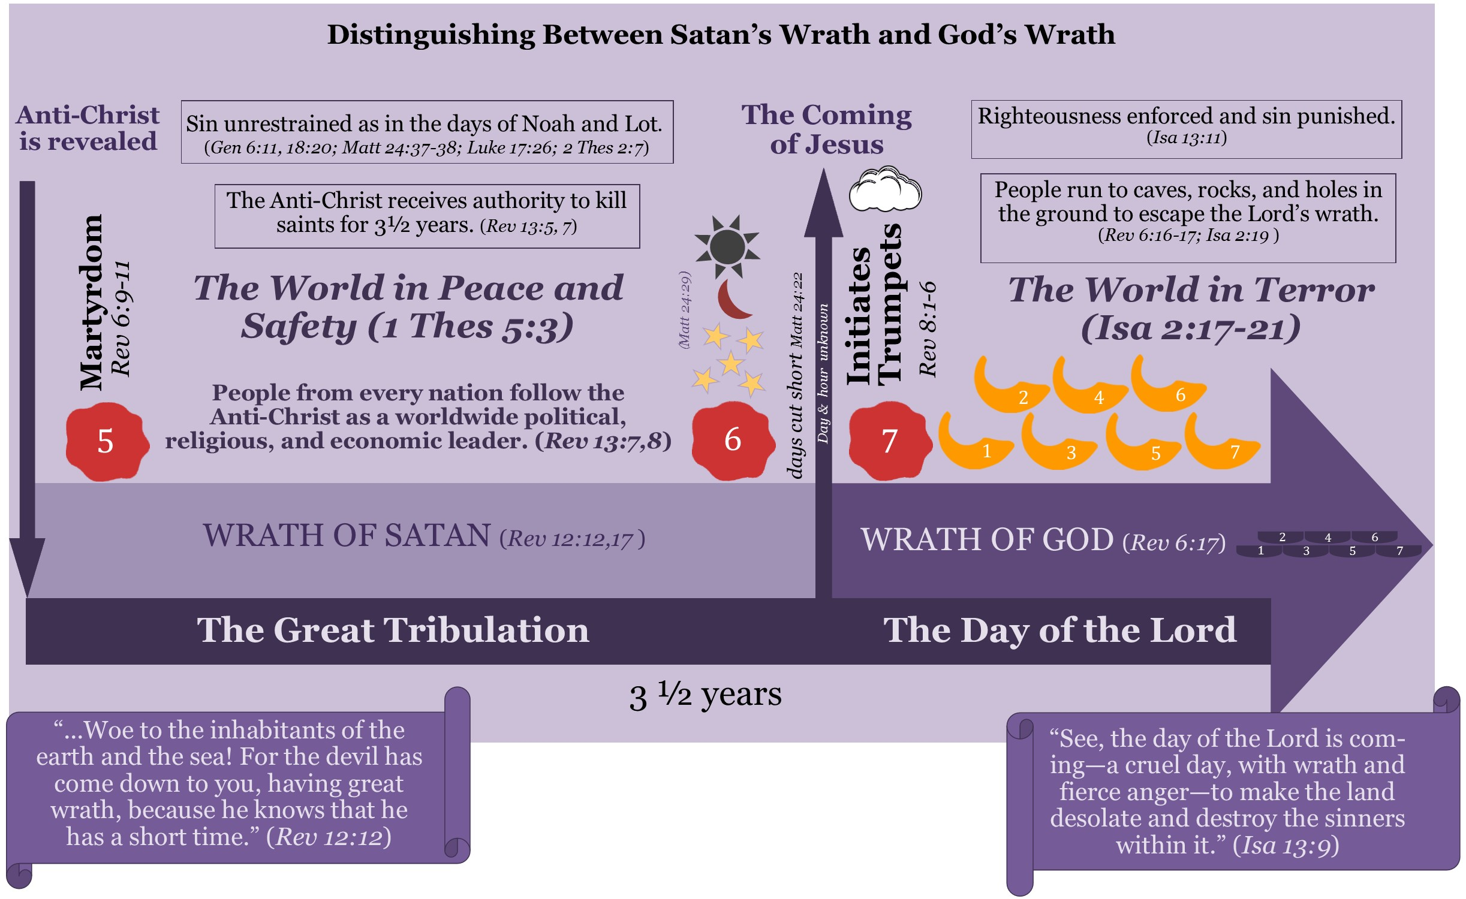
Notes:
Let's examine what life will be like for the followers of the man of lawlessness during the Great Tribulation directly before Jesus comes back. Revelation 13 depicts how the man of lawlessness will be the so called god-ruler over the whole earth and will set up a one world government, one world religion, and a one world economic system. The people of the world will be filled with wonder at the man of lawlessness and follow him willingly ( we can see this in Rev 13: 3). They will see the man of lawlessness as not only their ruler but as their god. They will be living in unrestrained sinfulness as in the days of Noah and Lot. In Noah’s day people were living in deep sin unware that judgement was impending. People thought they could do whatever they wanted and not face judgment from God for their actions. It was the same in Lot’s day. The people of Sodom were living in such immorality that they thought nothing of vioating travelers visiting their city. They thought they could continue to live in sin and never face punishment for their actions. Just as it was in the days of Noah and Lot, so it will be in the days before Jesus comes back. People who follow the man of lawlessness will be saying “peace and safety” and live life as normal—eating , drinking, marrying, buying and selling, planting and building . Life will seem good for the followers of the man of lawlessness. Christians who are experiencing the Great Tribulation will have to resist the urge to have an easier life through following the man of lawlessness. Let’s examine what the book of Daniel and Revelation says about what life will be like for Christians and Jews during this time.

Slide 60
The Great Tribulation is a time of authority for the man of lawlessness
Revelation 13:5-8 (NKJV): ⁵ And he was given a mouth speaking great things and blasphemies, and he was given authority to continue for forty-two months. ⁶ Then he opened his mouth in blasphemy against God, to blaspheme His name, His tabernacle, and those who dwell in heaven. ⁷ It was granted to him to make war with the saints and to overcome them. And authority was given him over every tribe, tongue, and nation. ⁸ All who dwell on the earth will worship him, whose names have not been written in the Book of Life of the Lamb slain from the foundation of the world.
Daniel 7: 25, “He [the man of lawlessness] will speak against the Most High and oppress his holy people [both Jews and Christians] and try to change the set times and the laws. The holy people [both Jews and Christians] will be delivered into his hands for a time, times and half a time.”
Notes:
The days of the Great Tribulation are not marked by God pouring out his judgments on the man of lawlessness, rather it is the time when the man of lawlessness is given authority to rule. He is given authority to rule for three and a half years (42 months), or a time, times and half a time. Revelation 13:5-8 (NKJV): ⁵ And he was given a mouth speaking great things and blasphemies, and he was given authority to continue for forty-two months. ⁶ Then he opened his mouth in blasphemy against God, to blaspheme His name, His tabernacle, and those who dwell in heaven. ⁷ It was granted to him to make war with the saints and to overcome them. And authority was given him over every tribe, tongue, and nation. ⁸ All who dwell on the earth will worship him, whose names have not been written in the Book of Life of the Lamb slain from the foundation of the world. Daniel 7: 25, “He [the man of lawlessness] will speak against the Most High and oppress his holy people [both Jews and Christians] and try to change the set times and the laws. The holy people [both Jews and Christians] will be delivered into his hands for a time, times and half a time.”

Slide 61
The Fifth seal is opened during the Great Tribulation
Revelation 6: 9-11: ⁹ When he opened the fifth seal, I saw under the altar the souls of those who had been slain because of the word of God and the testimony they had maintained. ¹⁰ They called out in a loud voice, “How long, Sovereign Lord, holy and true, until you judge the inhabitants of the earth and avenge our blood?” ¹¹ Then each of them was given a white robe, and they were told to wait a little longer, until the full number of their fellow servants, their brothers and sisters, were killed just as they had been.
Revelation 12:12 (NKJV)¹² Therefore rejoice, O heavens, and you who dwell in them! Woe to the inhabitants of the earth and the sea! For the devil has come down to you, having great wrath, because he knows that he has a short time.”
Notes:
the man of lawlessness is given authority over the earth for 42 months or three and a half prophetic years (also known as a time, times, and half a time). The man of lawlessness uses his authority to persecute the Church. We have seen how the first four seals coincided with the beginning of birth pains. The opening of the fifth seal brings us to the Great Tribulation. Let’s read .Revelation 6: 9-11, ⁹ When he opened the fifth seal, I saw under the altar the souls of those who had been slain because of the word of God and the testimony they had maintained. ¹⁰ They called out in a loud voice, “How long, Sovereign Lord, holy and true, until you judge the inhabitants of the earth and avenge our blood?” ¹¹ Then each of them was given a white robe, and they were told to wait a little longer, until the full number of their fellow servants, their brothers and sisters, were killed just as they had been. Those Christians slain during the Great Tribulation go to heaven and from under the altar pray for God to avenge their deaths. They pray for the wrath of God to come. They are told that a certain number of saints have been appointed to die, and until that number is reached God will not avenge their deaths. The saints killed during the Great Tribulation are not avenged until the day of the Lord begins. This passage shows that the wrath of God is not yet being poured out on the earth. It is the time Satan pours out his wrath by persecuting Christians via the man of lawlessness . The Great Tribulation is the time directly after Michael and his angels cast Satan out of heaven, who is then confined to the earth (Rev 12: 7-9). After Satan is cast down a voice proclaims woe to the inhabitants of the earth because the devil has been cast down (Rev 12:12). The devil’s wrath manifests differently for Christians and non-Christians during this time. For non-Christians Satan’s wrath manifests in getting them to commit terrible acts of sin. Satan will persuade them to worship him via the man of lawlessness. Satan’s wrath toward unbelievers will not necessarily look like killing them or causing them bodily harm as it will for believers.

Slide 62
Satan’s wrath towards non-believers
2 Thessalonians 2:9-12 ⁹ The coming of the lawless one will be in accordance with how Satan works. He will use all sorts of displays of power through signs and wonders that serve the lie, ¹⁰ and all the ways that wickedness deceives those who are perishing. They perish because they refused to love the truth and so be saved. ¹¹ For this reason God sends them a powerful delusion so that they will believe the lie ¹² and so that all will be condemned who have not believed the truth but have delighted in wickedness.
Notes:
2 Thessalonians 2:9-12 reads ⁹ The coming of the lawless one will be in accordance with how Satan works. He will use all sorts of displays of power through signs and wonders that serve the lie, ¹⁰ and all the ways that wickedness deceives those who are perishing. They perish because they refused to love the truth and so be saved. ¹¹ For this reason God sends them a powerful delusion so that they will believe the lie ¹² and so that all will be condemned who have not believed the truth but have delighted in wickedness.
The man of lawlessness is one aspect of the powerful delusion God sends the unbelieving world, because people refuse to love the truth and be saved. The people of the earth will embrace the man of lawlessness as savior and king and follow him into sin. In doing so they store up God’s wrath which will be poured out during the day of the Lord.

Slide 63
Satan’s wrath against Christians and Jews is persecution
Revelation12: 17 ¹⁷ Then the dragon [Satan through the man of the anti-Christ] was enraged at the woman [certain people of Israel] and went off to wage war against the rest of her offspring—those who keep God’s commands and hold fast their testimony about Jesus.
Notes:
Let’s turn our attention now to how Satan’s wrath looks for Christians and Jews. Revelation12: 17 ¹⁷ Then the dragon was enraged at the woman and went off to wage war against the rest of her offspring—those who keep God’s commands and hold fast their testimony about Jesus. To those of the earth who refuse to follow him and worship him, Satan’s wrath looks like persecution. The man of lawlessness will especially target Christians and Jews, and cause the world to hate them and not feel bad persecuting and killing them. This is the time Satan gets enraged at Christians and pours out his wrath upon them. The persecution will be so intense that if God did not shorten the Great Tribulation not a single Christian would be left alive (Matt 24: 22).

Slide 64
Table 2: Events of the Great Tribulation
Table 2: Events of the Great Tribulation
Persecution, Martyrdom | Matt 24:9 |  | Rev 6:9, 13:7
Apostasy | Matt 24:10, 12 | 2 Thes 2:3
False Prophets | Matt 24:11, 24 |  | Rev 19:20
People are deceived | Matt 24:11, 24 | 2 Thes 2:9-10 | Rev 13:14, 19:20
Deceiving signs and wonders | Matt 24:24 | 2 Thes 2:9 | Rev 13:13-14, 19:20
Increase of wickedness | Matt 24:12 | 2 Thes 2:7 | Rev 13:8
Notes:
This table has compiled teachings from Jesus, Paul and John in order to show how the bible talks about the time of the Great Tribulation. Notice that the themes do not mention the Great Tribulation as a time when God’s wrath is poured out. The events listed show us that this is a time Satan is given authority over the earth. With this authority Satan leads the world into increased wickedness. he uses false prophets to perform false signs and wonders to deceive the inhabitants of the earth. Christians will have two choices at this time, the can either turn away from their faith or face persecution and martyrdom. Let’s look at what the Bible says about persecution.

Slide 65
Concerning Persecution
1 Peter 4:12-14: ¹² Dear friends, do not be surprised at the fiery ordeal that has come on you to test you, as though something strange were happening to you. ¹³ But rejoice inasmuch as you participate in the sufferings of Christ, so that you may be overjoyed when his glory is revealed. ¹⁴ If you are insulted because of the name of Christ, you are blessed, for the Spirit of glory and of God rests on you.
Luke 6: 22-23: ²² Blessed are you when people hate you, when they exclude you and insult you and reject your name as evil, because of the Son of Man. ²³ “Rejoice in that day and leap for joy, because great is your reward in heaven. For that is how their ancestors treated the prophets.
Notes:
Persecution is not something the Church should be afraid of. We need to embrace the same attitude the early Church had concerning persecution. The early Church would rejoice when God counted them worthy to share in Christ’s sufferings. Peter urged Christians not to be surprised or find it strange that we would go through persecution and martyrdom for Jesus’ name, instead he urged the Church rejoice and be glad because of their great reward in heaven. 1 Peter 4:12-14: says ¹² Dear friends, do not be surprised at the fiery ordeal that has come on you to test you, as though something strange were happening to you. ¹³ But rejoice inasmuch as you participate in the sufferings of Christ, so that you may be overjoyed when his glory is revealed. ¹⁴ If you are insulted because of the name of Christ, you are blessed, for the Spirit of glory and of God rests on you. This verse declares that those who are persecuted for Christ are blessed and the Spirit of glory and of God rests on them. Jesus too, declares how blessed Christians are to go through persecution for the sake of his name: Luke 6: 22-23: ²² Blessed are you when people hate you, when they exclude you and insult you and reject your name as evil, because of the Son of Man. ²³ “Rejoice in that day and leap for joy, because great is your reward in heaven. For that is how their ancestors treated the prophets. If you are counted worthy to be on the earth during the Great Tribulation, then you will have an unprecedented chance to store up treasures in heaven. This life is so short and eternity is forever. This verse says those who suffer for Christ have a great reward, one that will last for eternity.

Slide 66
Christians overcome the anti-Christ by refusing to deny Christ, even unto death
Revelation 12: 11:"They [the saints] overcame him [Satan via the anti-Christ] by the blood of the Lamb and by the word of their testimony; they did not love their lives so much as to shrink from death."
Notes:
If God counts you worthy to be on the earth during the Great Tribulation, then he will give you the grace to stand and not deny Christ. You will overcome the man of lawlessness by being faithful to Jesus even under the threat of death. Revelation 12: 11 "They overcame him by the blood of the Lamb and by the word of their testimony; they did not love their lives so much as to shrink from death." The Great Tribulation is not a time of defeat and powerlessness of the church, rather it is the church’s finest hour. The gates of hell cannot prevail against the church. Although it looks to the world that the anti-Christ is conquering and overcoming the church, it is actually the saints who are overcoming him. Although Revelation 13: 7 says that the anti-Christ overcomes the saints, this is only true from a physical standpoint. In reality, it is the saints who are overcoming him. The anti-Christ only overcomes their physical bodies but never can overcome their love for Jesus.

Slide 67
God has called Christians to patient endurance and faithfulness during the Great Tribulation.
Revelation 13:8-10: ⁸ All inhabitants of the earth will worship the beast—all whose names have not been written in the Lamb’s book of life, the Lamb who was slain from the creation of the world. ⁹ Whoever has ears, let them hear. ¹⁰ “If anyone is to go into captivity, into captivity they will go. If anyone is to be killed with the sword, with the sword they will be killed.” This calls for patient endurance and faithfulness on the part of God’s people.
Notes:
God has called Christians to patient endurance and faithfulness during the Great Tribulation.
Revelation 13:8-10 ⁸ All inhabitants of the earth will worship the beast—all whose names have not been written in the Lamb’s book of life, the Lamb who was slain from the creation of the world. ⁹ Whoever has ears, let them hear. ¹⁰ “If anyone is to go into captivity, into captivity they will go. If anyone is to be killed with the sword, with the sword they will be killed.” This calls for patient endurance and faithfulness on the part of God’s people. During the Great Tribulation, Christians will encounter unprecedented persecution and martyrdom. The Great Tribulation is a time of refining for the body of Christ. The fire of persecution will cause nominal Christians to fall away, then a mighty revival will come and passion for Jesus will be ignited in Christians so that they love Jesus more than they love their own lives. Jesus is not coming back to a helpless church. He is coming back to a victorious overcoming church that God is pouring out His Spirit upon. Signs, wonders, miracles and the gifts of the Spirit will be exploding during this time in history like never before. The Holy Spirit isn't going to be lifted off the earth during the Great Tribulation like some teach, rather God will pour out his Spirit on all flesh. The partial fulfillment of Joel 2 that occurred on the Pentecost following Jesus’ ascension into heaven will be fully fulfilled in the days of the Great Tribulation. As Christians become persecuted worldwide, the Spirit of God and of glory will come and rest upon the Church like never before in history. The bride that Jesus comes back for is going to be full of passion and the Holy Spirit. They will be the fiery passionate lovers of Jesus. These Christians will hold to Jesus no matter the cost, even unto death. It is during this time that the Church becomes a beautiful spotless bride that has washed her clothes and made herself ready (Rev 19: 7-8). Jesus laid his life down for us so that we might live, now we have a glorious chance to lay down our lives for him.

Slide 68
The world will be drunk on the blood of the Christians
Daniel 7:28, ²⁸ “This is the end of the matter. I, Daniel, was deeply troubled by my thoughts, and my face turned pale…”
Daniel 8:27 (NKJV), ²⁷ And I, Daniel, fainted and was sick for days…”
Notes:
I am not trying to underplay the intensity of the persecution that will come upon the Church during the Great Tribulation. The world will be drunk on the blood of the saints. The Great Tribulation is a time of unrestrained sinfulness and much of the world’s anger and perversion will be directed at the saints and the people of Israel that have not fled to the wilderness place of protection. When the prophet Daniel saw what would occur during this time he felt sick; Daniel 7:28, ²⁸ “This is the end of the matter. I, Daniel, was deeply troubled by my thoughts, and my face turned pale…” and Daniel 8:27 (NKJV), ²⁷ And I, Daniel, fainted and was sick for days…” If when studying the end times you begin to feel like Daniel did, strengthen yourself in the Lord and ask him to give you peace and determination to remain faithful no matter what happens around you.
We have nothing to fear, but we also need to know the truth of what will happen. Let’s ask God to perfect us in love so that we do not fear persecution for his name sake, as 1 John 4: 18 states, “There is no fear in love. But perfect love drives out fear, because fear has to do with punishment. The one who fears is not made perfect in love.”
God gave us the information in Daniel, Revelation, and other prophetic scriptures in order to prepare us. Martyrdom is already happening on the earth. It is not something that we are waiting for to begin, but instead, it is increasing on the earth. Christians are already being persecuted. We don’t always want to look ahead at what will happen, but let us determine now in our hearts that we will stand in the day of trial, just like countless Christians are already doing in this day and age.

Slide 69
God will not tolerate these actions taken against Christians for long
2 Thessalonians 1:5-10: ⁵ All this is evidence that God’s judgment is right, and as a result you will be counted worthy of the kingdom of God, for which you are suffering. ⁶ God is just: He will pay back trouble to those who trouble you ⁷ and give relief to you who are troubled, and to us as well. This will happen when the Lord Jesus is revealed from heaven in blazing fire with his powerful angels. ⁸ He will punish those who do not know God and do not obey the gospel of our Lord Jesus. ⁹ They will be punished with everlasting destruction and shut out from the presence of the Lord and from the glory of his might ¹⁰ on the day he comes to be glorified in his holy people and to be marveled at among all those who have believed. This includes you, because you believed our testimony to you.
Notes:
Many people wonder why God’s judgments during the day of the Lord are so severe. The answer to that question is something not many people are willing to see, because they will be sick like Daniel if they see and understand the answer. Jesus will not tolerate unrestrained sinful behavior for long. He will not tolerate these kinds of actions committed against his people for long. Jesus sees the difficulty and for the sake of the elect shortens the days of the Great Tribulation. Jesus, at his coming, will give relief to Christians who are being persecuted and will punish all the horrendous acts that were committed during that time of unrestrained sinfulness.
2 Thessalonians 1:5-10 ⁵ All this is evidence that God’s judgment is right, and as a result you will be counted worthy of the kingdom of God, for which you are suffering. ⁶ God is just: He will pay back trouble to those who trouble you ⁷ and give relief to you who are troubled, and to us as well. This will happen when the Lord Jesus is revealed from heaven in blazing fire with his powerful angels. ⁸ He will punish those who do not know God and do not obey the gospel of our Lord Jesus. ⁹ They will be punished with everlasting destruction and shut out from the presence of the Lord and from the glory of his might ¹⁰ on the day he comes to be glorified in his holy people and to be marveled at among all those who have believed. This includes you, because you believed our testimony to you.
When Jesus comes back he brings with him salvation for the Christian but eternal condemnation for the followers of the man of lawlessness. At the time we accept Jesus as Lord and Savior, we receive salvation of our spirit. At Jesus’ coming Christians receive the fullness of our salvation promises, gaining salvation in their body and soul. They will follow Jesus back to heaven and be rewarded. Suffering is temporary but the glory that will result is eternal. May God change the attitude of the Church to that of the early Churches.

Slide 70
The Great Tribulation will last less than three and a half years
Revelation 2:10-11: ¹⁰ Do not be afraid of what you are about to suffer. I tell you, the devil will put some of you in prison to test you, and you will suffer persecution for ten days. Be faithful, even to the point of death, and I will give you life as your victor’s crown. ¹¹ Whoever has ears, let them hear what the Spirit says to the churches. The one who is victorious will not be hurt at all by the second death.
Notes:
The Great Tribulation will be less than three and a half years--nothing in the scheme of eternity. Remember what Jesus said to the church in Smyrna concerning a time of persecution. Revelation 2:10-11 ¹⁰ Do not be afraid of what you are about to suffer. I tell you, the devil will put some of you in prison to test you, and you will suffer persecution for ten days. Be faithful, even to the point of death, and I will give you life as your victor’s crown. ¹¹ Whoever has ears, let them hear what the Spirit says to the churches. The one who is victorious will not be hurt at all by the second death.
Just as the church in Smyrna would suffer persecution for 10 days, so the church in the great tribulation will suffer persecution for a short time period in light of eternity. With eternity in mind, Christians can live out the exhortation Jesus gives to this church: Do not be afraid, and be faithful.

Slide 71
The Great Tribulation | The final three and a half years of Daniel's 70th week, also called the "great distress," (Matt 24:21). This begins when the man of lawlessness is revealed, which is the time he receives authority to persecute Christians and Jews. This time period is Satan’s fury against the saints. It is not God’s wrath being poured out on the saints. It is a time of peace and safety to those who follow the man of lawlessness but a time of persecution and great distress for Christians (1 Thess 5: 3). The Great Tribulation lasts until Jesus cuts short the days and comes back to gather Christians and pour out his wrath on the earth

Slide 72
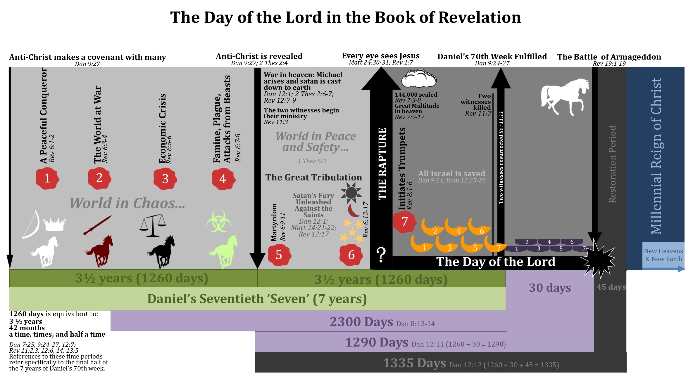
Notes:
Having come to the end of our discussion of the Great Tribulation, let’s review all that we have learned about the Great Tribulation. The Great Tribulation starts when the man of lawlessness is revealed. He is revealed to the world when he enters the Jewish Temple declaring himself to be God and sets up the abomination that causes desolation. The Great Tribulation is the rise of the man of lawlessness, and before the end of it, the whole world will follow him and worship him. Those who follow the man of lawlessness will live lives as normal but will be engaging in unrestrained sinfulness. They will have feelings of peace and safety for the future. For Christians the Great Tribulation is a time of distress and persecution that would last 42 months if God would not have shortened this time period. The persecution will be so great that if God did not shorten this time period not a single Christian would be left alive, but in God’s zealousness he shortens the time period and brings relief to the saints and punishment and wrath to the followers of the man of lawlessness. This concludes part 3 of the series based on the book, The Saints Go Up and the Wrath Comes Down. Please proceed to part 4 entitled The Day of the Lord.

Slide 73
Part 4: The Day of the Lord
Notes:
Hello and welcome to part 4 of my teaching series based on my book, The Saints Go Up and the Wrath Comes Down.. In this section we are going to be examining the time known as the Day of the Lord. Understanding the Day of the Lord is the key to unlocking a correct end times chronology. I will start by examining the signs in the sun, moon, and starts that are prophesied to appear before the Day of the Lord commences. Next, I will let the bible itself define this time period and use both old testament and the new testament to do so. Then we examine how the bible distinguishes between the Great Tribulation and the Day of the Lord. Finally, I will examine how Jesus’ taught that on the day that Jesus rescues his saints from the earth through the rapture is the day that the day of the Lord begins and wrath of God gets poured out. Let’s begin starting back where we left off in Matthew 24.

Slide 74

Signs that announce the day of the Lord
Matthew 24: 29: ²⁹ “Immediately after the distress of those days “‘the sun will be darkened, and the moon will not give its light; the stars will fall from the sky, and the heavenly bodies will be shaken.’
Joel 2: 10b, 30-31:…^{10b}the sun and moon are darkened, and the stars no longer shine….³⁰ I will show wonders in the heavens and on the earth, blood and fire and billows of smoke. ³¹ The sun will be turned to darkness and the moon to blood before the coming of the great and dreadful day of the Lord."
Notes:
Matthew 24: 29
²⁹ “Immediately after the distress of those days “‘the sun will be darkened, and the moon will not give its light; the stars will fall from the sky, and the heavenly bodies will be shaken.’ This verse explains what is going to happen immediately after the Great Distress (or Great Tribulation) and right before Jesus comes on the clouds and raptures the saints and pours out his wrath. Jesus is referencing Old Testament day of the Lord prophecies here: Joel 2: 10b, 30-31…^{10b}the sun and moon are darkened, and the stars no longer shine….³⁰ I will show wonders in the heavens and on the earth, blood and fire and billows of smoke. ³¹ The sun will be turned to darkness and the moon to blood before the coming of the great and dreadful day of the Lord."
Notice here that Joel prophesied that these signs will occur before the day of the Lord, and Jesus declared these signs were going to after the “tribulation of those days”. This gives clear evidence that the Great Tribulation occurs directly before the day of the Lord. Jesus uses the signs in the sun, moon, and stars to announce his imminent coming and the impending start of the day of the Lord.

Slide 75
Signs that announce the day of the Lord
Isaiah 13:9-11: ⁹ See, the day of the Lord is coming—a cruel day, with wrath and fierce anger—to make the land desolate and destroy the sinners within it.¹⁰ The stars of heaven and their constellations will not show their light. The rising sun will be darkened and the moon will not give its light.¹¹ I will punish the world for its evil, the wicked for their sins. I will put an end to the arrogance of the haughty and will humble the pride of the ruthless.
Notes:
Isaiah was another prophet to connect the signs in the sun, moon and starts with the imminent coming of the day of the Lord. Isaiah 13:9-11 ⁹ See, the day of the Lord is coming—a cruel day, with wrath and fierce anger—to make the land desolate and destroy the sinners within it.¹⁰ The stars of heaven and their constellations will not show their light. The rising sun will be darkened and the moon will not give its light.¹¹ I will punish the world for its evil, the wicked for their sins. I will put an end to the arrogance of the haughty and will humble the pride of the ruthless.

Slide 76
Signs that announce the day of the Lord
Revelation 6: 12-17 (NKJV): ¹² I watched as he opened the sixth seal. There was a great earthquake. The sun turned black like sackcloth made of goat hair, the whole moon turned blood red, ¹³ and the stars in the sky fell to earth, as figs drop from a fig tree when shaken by a strong wind. ¹⁴ The heavens receded like a scroll being rolled up, and every mountain and island was removed from its place.
¹⁵ Then the kings of the earth, the princes, the generals, the rich, the mighty, and everyone else, both slave and free, hid in caves and among the rocks of the mountains. ¹⁶ They called to the mountains and the rocks, “Fall on us and hide us from the face of him who sits on the throne and from the wrath of the Lamb! ¹⁷ For the great day of their wrath has come, and who can withstand it?”
Notes:
The book of Revelation also details that these signs happen directly before the day of the Lord begins. Revelation 6: 12-17 (NKJV) ¹² I watched as he opened the sixth seal. There was a great earthquake. The sun turned black like sackcloth made of goat hair, the whole moon turned blood red, ¹³ and the stars in the sky fell to earth, as figs drop from a fig tree when shaken by a strong wind. ¹⁴ The heavens receded like a scroll being rolled up, and every mountain and island was removed from its place. ¹⁵ Then the kings of the earth, the princes, the generals, the rich, the mighty, and everyone else, both slave and free, hid in caves and among the rocks of the mountains. ¹⁶ They called to the mountains and the rocks, “Fall on us and hide us from the face of him who sits on the throne and from the wrath of the Lamb! ¹⁷ For the great day of their wrath has come, and who can withstand it?” In verse 12 we again see the signs that Jesus prophesied about in Matthew 24: 29. Revelation 6 helps readers to connect the chronological timeline of the seals and the trumpets in book of Revelation with Jesus’ chronological teachings on the events of his second coming. In verse 17 readers can see that it is after the opening of the sixth seal that the day of the Lord’s wrath has come. This is the first time in Revelation the day of the Lord’s wrath is proclaimed.

Slide 77
Signs that announce the day of the Lord
Isaiah 34:4: ⁴ All the stars in the sky will be dissolved and the heavens rolled up like a scroll; all the starry host will fall like withered leaves from the vine, like shriveled figs from the fig tree.
Notes:
The imagery used in this passage in Revelation connects it with Isaiah 34: 4. Isaiah 34:4 ⁴ All the stars in the sky will be dissolved and the heavens rolled up like a scroll; all the starry host will fall like withered leaves from the vine, like shriveled figs from the fig tree. Isaiah 34: 1-15 is another passage that prophesies about events that occur during the day of the Lord, although this passage focuses the reader’s attention on the climax of the day of the Lord, which is the battle of Armageddon.

Slide 78
Signs that announce the day of the Lord
Luke 21:25-28 ²⁵ “There will be signs in the sun, moon and stars. On the earth, nations will be in anguish and perplexity at the roaring and tossing of the sea. ²⁶People will faint from terror, apprehensive of what is coming on the world, for the heavenly bodies will be shaken. ²⁷ At that time they will see the Son of Man coming in a cloud with power and great glory. ²⁸ When these things begin to take place, stand up and lift up your heads, because your redemption is drawing near.”
Notes:
Luke 21:25-28 talks about two kind of responses people will have when they see the signs appear in the sky. The believers will stand up and lift up their heads because they know their redemption is near, whereas the unbelievers will faint from terror apprehensive of what is coming. Luke 21:25-28 ²⁵ “There will be signs in the sun, moon and stars. On the earth, nations will be in anguish and perplexity at the roaring and tossing of the sea. ²⁶People will faint from terror, apprehensive of what is coming on the world, for the heavenly bodies will be shaken. ²⁷ At that time they will see the Son of Man coming in a cloud with power and great glory. ²⁸ When these things begin to take place, stand up and lift up your heads, because your redemption is drawing near.”

Slide 79
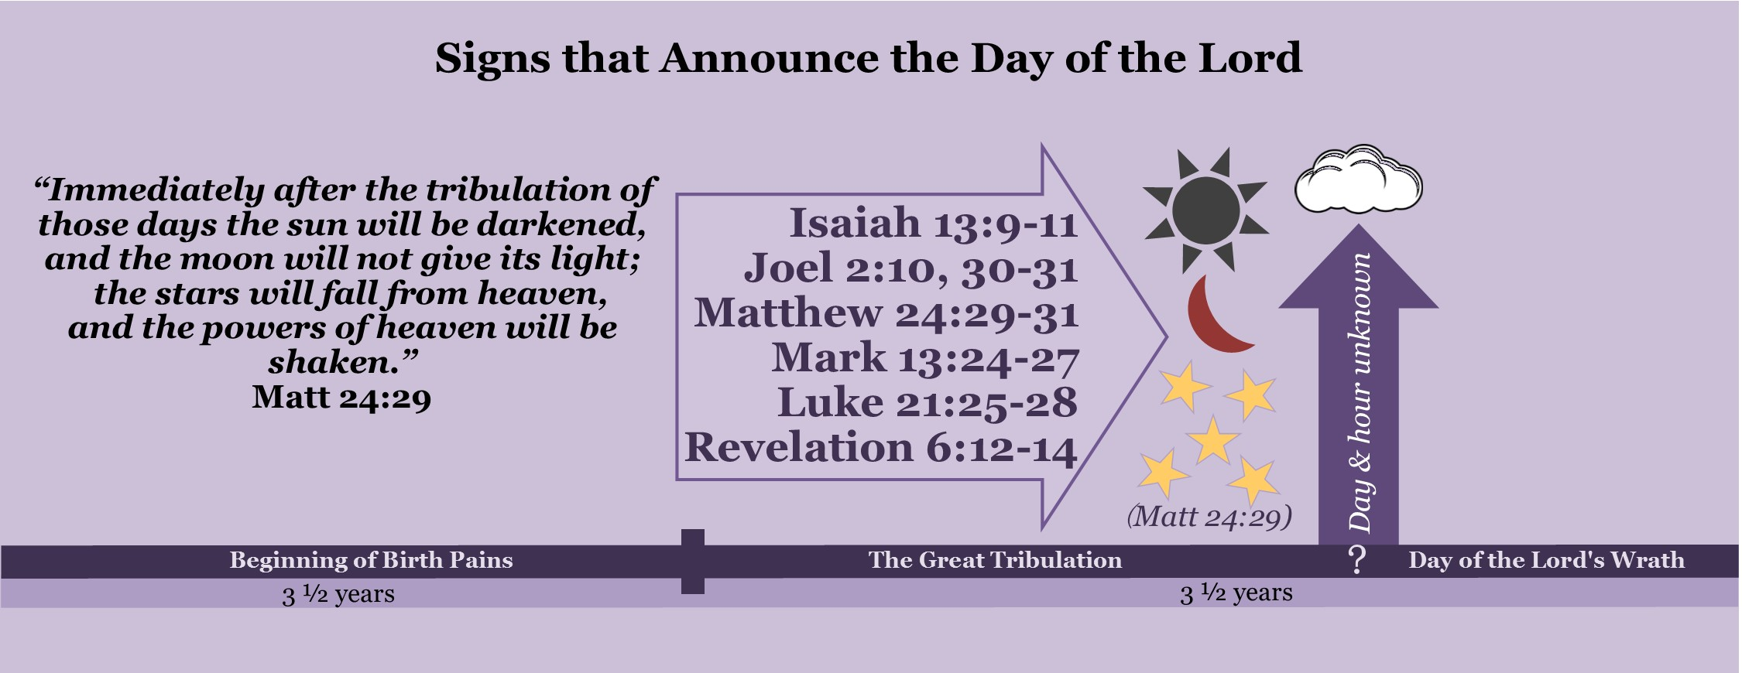
Notes:
One can see that the signs that announce the day of the Lord are found described in the new testament and the old. Never once does the bible talk about them occurring before the time of the Great Tribulation. They occur before the day of the Lord after the days of the Great Tribulation are shortened. The occur directly before the coming of Jesus.

Slide 80
Notes:
This situates these signs as occurring after the Great Tribulation and before the day of the Lord. This creates a solid link between the timeline Jesus’ gave in Matthew 24 and the timeline of the seals and trumpets given in book of Revelation, as it situates Jesus’ coming after the sixth seal is opened and before the seventh is. It comes as no surprise then that in between the sixth seal and the seventh that the saints are seen in a great multitude in heaven having just came out of the Great Tribulation. It is proclaimed that from this moment on Christians will never hunger, thirst, or cry. Jesus’ coming signals that the day of the Lord has begun.

Slide 81
The definition of the day of the Lord from Isaiah
Isaiah 13:9, 11: ⁹ See, the day of the Lord is coming—a cruel day, with wrath and fierce anger—to make the land desolate and destroy the sinners within it… ¹¹ I will punish the world for its evil, the wicked for their sins. I will put an end to the arrogance of the haughty and will humble the pride of the ruthless.
Notes:
Let’s look to scriptures in both the Old and New Testaments to come up with a definition for the day of the Lord: Isaiah 13:9, 11: ⁹ See, the day of the Lord is coming—a cruel day, with wrath and fierce anger—to make the land desolate and destroy the sinners within it… ¹¹ I will punish the world for its evil, the wicked for their sins. I will put an end to the arrogance of the haughty and will humble the pride of the ruthless. This passage in Isaiah calls this the day of God's wrath and anger where God will pour out his anger on the land and punish the people of the earth for its evil. It is a day where the prideful are humbled.

Slide 82
The definition of the day of the Lord from Zephaniah
Zephaniah 1:14-18: ¹⁴ The great day of the Lord is near— near and coming quickly. The cry on the day of the Lord is bitter; the Mighty Warrior shouts his battle cry. ¹⁵ That day will be a day of wrath— a day of distress and anguish, a day of trouble and ruin, a day of darkness and gloom, a day of clouds and blackness— ¹⁶ a day of trumpet and battle cry against the fortified cities and against the corner towers. ¹⁷ “I will bring such distress on all people that they will grope about like those who are blind, because they have sinned against the Lord. Their blood will be poured out like dust and their entrails like dung. ¹⁸ Neither their silver nor their gold will be able to save them on the day of the Lord’s wrath.” In the fire of his jealousy the whole earth will be consumed, for he will make a sudden end of all who live on the earth.
Notes:
Zephaniah 1:14-18: ¹⁴ The great day of the Lord is near— near and coming quickly. The cry on the day of the Lord is bitter; the Mighty Warrior shouts his battle cry. ¹⁵ That day will be a day of wrath— a day of distress and anguish, a day of trouble and ruin, a day of darkness and gloom, a day of clouds and blackness— ¹⁶ a day of trumpet and battle cry against the fortified cities and against the corner towers. ¹⁷ “I will bring such distress on all people that they will grope about like those who are blind, because they have sinned against the Lord. Their blood will be poured out like dust and their entrails like dung. ¹⁸ Neither their silver nor their gold will be able to save them on the day of the Lord’s wrath.” In the fire of his jealousy the whole earth will be consumed, for he will make a sudden end of all who live on the earth. This passage in Zephaniah calls the day of the Lord a day of wrath, anguish, trouble and ruin for those who have sinned against the Lord. During the day of the Lord the whole earth will be consumed and he will bring an end to all who do not turn to God. This includes all who have taken the mark of the beast as they will be unwilling to repent of their sins.

Slide 83
The “Near/“Far” dimension of prophecy
God used prophets of the Old Testament to prophesy about their generation and used them to prophesy about his second coming at the same time.
The "near" application was for the hearers of the prophecy so that they would turn away from their evil ways and seek the Lord.
The "far" application of the day of the Lord refers to the wrath of God being poured out against the man of lawlessness and his followers, not against Israel.
These “far” fulfillments are often called the eschatological day of the Lord.
Notes:
When examining Old Testament prophecies concerning the day of the Lord it is important to understand that these prophecies have a "near" application and a "far" application to them. God used prophets of the Old Testament to prophesy about their generation and used them to prophesy about his second coming at the same time. The "near" application was for the hearers of the prophecy so that they would turn away from their evil ways and seek the Lord. The fulfillment of the "near" day of the Lord often looked like a foreign invasion against the nation of Israel. The "far" application of the day of the Lord refers to the wrath of God being poured out against the man of lawlessness and his followers, not against Israel. These “far” fulfillments are often called the eschatological day of the Lord.

Slide 84
The definition of the day of the Lord from the New Testament
2 Thessalonians 2:1-3: ¹Concerning the coming of our Lord Jesus Christ and our being gathered to him, we ask you, brothers and sisters, ² not to become easily unsettled or alarmed by the teaching allegedly from us—whether by a prophecy or by word of mouth or by letter—asserting that the day of the Lord has already come. ³ Don’t let anyone deceive you in any way, for that day will not come until the rebellion occurs and the man of lawlessness is revealed, the man doomed to destruction.
Notes:
Although the Old testament speaks mostly of wrath and judgment that will occur on the day of the Lord, the new testament adds an important aspect to this day. In addition to calling this a day when God pours out his wrath against the ungodly, the new testament adds what happens to the saints during this day. The new testament declares that the day of the Lord is the time where Jesus comes back and gathers Christians from the earth and grants them eternal life. Both Peter and Paul write about this day.
Peter and Paul used the phrase “the day of the Lord” as a synonymous term with the coming of our Lord Jesus. Paul even goes so far to define it as, "the coming of our Lord Jesus and our being gathered to him." Let's take a look: 2 Thessalonians 2:1-3: ¹Concerning the coming of our Lord Jesus Christ and our being gathered to him, we ask you, brothers and sisters, ² not to become easily unsettled or alarmed by the teaching allegedly from us—whether by a prophecy or by word of mouth or by letter—asserting that the day of the Lord has already come. ³ Don’t let anyone deceive you in any way, for that day will not come until the rebellion occurs and the man of lawlessness is revealed, the man doomed to destruction. Paul equates the day of the Lord with the coming of our Lord Jesus and our being gathered to him. The passage is incomprehensible if you attempt to give the phrases separate meanings. Verse one and verse two cannot be separated from each other.

Slide 85
Paul’s definition of the day of the Lord
1 Thessalonians 4: 16- 5: 1-3: ¹⁶“For the Lord himself will come down from heaven, with a loud command, with the voice of the archangel and with the trumpet call of God, and the dead in Christ will rise first. ¹⁷After that, we who are still alive and are left will be caught up together with them in the clouds to meet the Lord in the air.” ¹⁸Therefore encourage each other with these words. ¹Now, brothers and sisters, about times and dates we do not need to write to you, ² for you know very well that the day of the Lord will come like a thief in the night. ³While people are saying “peace and safety,” destruction will come upon them suddenly, as labor pains on a pregnant woman, and they will not escape.
Notes:
1 Thessalonians 4: 16- 5: 1-3: ¹⁶“For the Lord himself will come down from heaven, with a loud command, with the voice of the archangel and with the trumpet call of God, and the dead in Christ will rise first. ¹⁷After that, we who are still alive and are left will be caught up together with them in the clouds to meet the Lord in the air.” ¹⁸Therefore encourage each other with these words. ¹Now, brothers and sisters, about times and dates we do not need to write to you, ² for you know very well that the day of the Lord will come like a thief in the night. ³While people are saying “peace and safety,” destruction will come upon them suddenly, as labor pains on a pregnant woman, and they will not escape. Paul is again connecting the coming of Jesus with the day of the Lord. He is directly referencing Jesus’ teachings on his coming by using the exact same imagery Jesus used: Jesus coming like a thief (Mat 24: 36-44, Luke 12: 39-40, Rev 3:3; 16: 15). Although Jesus is not a thief in an unholy, ungodly sense, His coming will have the result of a thief for people who are not prepared, because they will suffer loss. This passage defines the day of the Lord as the time when Jesus comes down from heaven and catches up the saints up to him in the clouds, and destruction comes upon the people of the earth.

Slide 86
Peter’s definition of the day of the Lord
2 Peter 3:3-10: ³ Above all, you must understand that in the last days scoffers will come, scoffing and following their own evil desires. ⁴ They will say, “Where is this ‘coming’ he promised? Ever since our ancestors died, everything goes on as it has since the beginning of creation.” ⁵ But they deliberately forget that long ago by God’s word the heavens came into being and the earth was formed out of water and by water. ⁶ By these waters also the world of that time was deluged and destroyed. ⁷ By the same word the present heavens and earth are reserved for fire, being kept for the day of judgment and destruction of the ungodly
⁸ But do not forget this one thing, dear friends: With the Lord a day is like a thousand years, and a thousand years are like a day. ⁹ The Lord is not slow in keeping his promise, as some understand slowness. Instead he is patient with you, not wanting anyone to perish, but everyone to come to repentance. ¹⁰ But the day of the Lord will come like a thief. The heavens will disappear with a roar; the elements will be destroyed by fire, and the earth and everything done in it will be laid bare.
Notes:
2 Peter 3:3-10: ³ Above all, you must understand that in the last days scoffers will come, scoffing and following their own evil desires. ⁴ They will say, “Where is this ‘coming’ he promised? Ever since our ancestors died, everything goes on as it has since the beginning of creation.” ⁵ But they deliberately forget that long ago by God’s word the heavens came into being and the earth was formed out of water and by water. ⁶ By these waters also the world of that time was deluged and destroyed. ⁷ By the same word the present heavens and earth are reserved for fire, being kept for the day of judgment and destruction of the ungodly. ⁸ But do not forget this one thing, dear friends: With the Lord a day is like a thousand years, and a thousand years are like a day. ⁹ The Lord is not slow in keeping his promise, as some understand slowness. Instead he is patient with you, not wanting anyone to perish, but everyone to come to repentance. ¹⁰ But the day of the Lord will come like a thief. The heavens will disappear with a roar; the elements will be destroyed by fire, and the earth and everything done in it will be laid bare. Peter defines the day of the Lord to be a day of judgment and destruction of the ungodly where the earth will be purged by fire. He also clearly connects the day of the Lord to the coming of Jesus, as he like Paul quotes Jesus teachings on his coming saying that the day of the Lord will come like a thief. This is the very same this Jesus says about his coming (Mat 24: 36-44, Luke 12: 39-40, Rev 3:3; 16: 15). This verse states the reason for Jesus delaying his coming to be that he is patient wanting everyone to come to repentance.

Slide 87
How the use of Jesus’ coming and the day of the Lord differ
Romans 2: 5-8: ⁵But because of your stubborn and your unrepentant heart, you are storing up wrath against yourself for the day of God’s wrath, when his righteous judgement will be revealed. ⁶God “will repay each person according to what they have done.” ⁷To those who persistence in doing good seek glory, honor, and immortality, he will give eternal life. ⁸But for those who are self-seeking and who reject the truth and follow evil, there will be wrath and anger.
Notes:
Both Peter and Paul define the day of the Lord as the time when Jesus comes back hurling the ungodly into a time of destruction. Although the day of the Lord is used synonymously in the three above passages, the two words carry different connotations and are often used to emphasize different aspects of his coming. The phrase “the coming of our Lord Jesus” often focuses on how Jesus' coming will affect the saints whereas, the phrase “the day of the Lord” focuses of how Jesus coming will be for the man of lawlessness and his followers. For the saints this day will bring glory and redemption, but for the man of lawlessness and his followers the day will bring wrath and judgment. The phrase “the day of Christ” (Phil 1: 6, 10; 2: 16), “day of our Lord Jesus” (1 Cor 1: 8), “the day of the Lord Jesus” (2 Cor. 1:14) are used instead of “the day of the Lord” when emphasizing how this day effects Christians. These verses speak that Christ will sustain believers through all the hardships and keep Christians blameless until this day arrives and Christ is revealed. Paul says that on this day he will be able to boast because of all the individuals that held firm to Jesus to the end and are saved because of his life. In the book of Romans, Paul calls the day of the Lord by another name, “The day of God’s wrath.” For evil men he declares this a day of judgment when God will pour out his wrath and anger against them, but for Christians Paul declares this the time when God gives them eternal life. Romans 2: 5-8: ⁵But because of your stubborn and your unrepentant heart, you are storing up wrath against yourself for the day of God’s wrath, when his righteous judgement will be revealed. ⁶God “will repay each person according to what they have done.” ⁷To those who persistence in doing good seek glory, honor, and immortality, he will give eternal life. ⁸But for those who are self-seeking and who reject the truth and follow evil, there will be wrath and anger. The coming of Jesus is not a single event rather a series of events. The Greek word for Jesus' second coming is the word Parousia. Parousia is defined in the third edition of the Greek- English Lexicon of the New Testament as "an arrival and a continuing presence." Just as Jesus' first coming was a series of events, his birth until his death so will his second coming be a series of events. Jesus’ coming beings at the when he comes on the clouds and continues through the day of the Lord as his wrath is poured out, this climaxes at the battle of Armageddon. A Greek-English Lexicon of the New Testament and Other Early Christian Literature, rev. and ed. Fredrick W. Danker, 3rd ed. (Chicago: University of Chicago Press, 2000).

Slide 88
An important definition:
The Coming of Jesus | The coming of Jesus begins when the sign of the Son of Man appears in the sky, in which every eye will see Jesus coming on the clouds of heaven. At this time, Jesus sends forth his angels to gather his saints to meet him in the clouds. After his initial appearing, “the coming of Jesus” refers to the pouring out of his wrath on the earth and his arrival on a white horse with the armies of heaven for the Battle of Armageddon.
Notes:
The Coming of Jesus: The coming of Jesus begins when the sign of the Son of Man appears in the sky, in which every eye will see Jesus coming on the clouds of heaven. At this time, Jesus sends forth his angels to gather his saints to meet him in the clouds. After his initial appearing, “the coming of Jesus” refers to the pouring out of his wrath on the earth and his arrival on a white horse with the armies of heaven for the Battle of Armageddon.

Slide 89
An important definition:
The Day of the Lord | “The Day of the Lord” refers to the coming of the Lord and believers being gathered to him (2 Thess 2:1) as well as the wrath of God on the anti-Christ, his kingdom, and his followers. It is a day of judgment and destruction of the ungodly (2 Peter 3: 7). This day begins after the signs in the heavens: the sun turning to darkness, the moon turning the color of blood, and stars falling from the sky (Joel 2: 31, Isaiah 13: 9-11; 24: 23, Matt 24: 29, Mark 13: 24, Rev 6: 12) with Jesus returning on the clouds and rapturing the saints. “The Day of the Lord” ends after the battle of Armageddon when the wrath of God has been fully poured out.
Notes:
The day of the Lord is also a term that refers to a time period rather than just a 24-hour time slot. The day of the Lord starts in Revelation 6: 12-17 after the signs in the sun, moon and stars appear in the sky when the people of the earth flee to the caves and mountains. Verse 17 gives evidence to this as it says, "the great day of their [Father God and Jesus’] wrath has come, and who can stand?" The day of the Lord continues through the trumpets and the bowls climaxing in the battle of Armageddon when the wrath of God has been fully poured out.
The Day of the Lord: “The Day of the Lord” refers to the coming of the Lord and believers being gathered to him (2 Thess 2:1) as well as the wrath of God on the anti-Christ, his kingdom, and his followers. It is a day of judgment and destruction of the ungodly (2 Peter 3: 7). This day begins after the signs in the heavens: the sun turning to darkness, the moon turning the color of blood, and stars falling from the sky (Joel 2: 31, Isaiah 13: 9-11; 24: 23, Matt 24: 29, Mark 13: 24, Rev 6: 12) with Jesus returning on the clouds and rapturing the saints. “The Day of the Lord” ends after the battle of Armageddon when the wrath of God has been fully poured out.

Slide 90
Notes:
Now lets examine the chart highlighting what we have learned so far. Immediately after the Great Tribulation is shortened, the sixth seal is opened and signs appear in the sun moon and stars. Jesus comes and gathers his saints to him in the clouds and takes them to heaven where they will be no longer in any sort of pain. The followers of the man of lawlessness are caught up in wrath and punishment for the sins. A major problem of Pre-Tribulation, Mid-Tribulation, and Post-Tribulation rapture views is their failure to show the distinct difference between the Great Tribulation—the wrath of Satan and the day of the Lord--the wrath of God. These different views lump God’s wrath and Satan’s wrath together, believing that they occur during the same time period, the Great Tribulation. The general idea that distinguishes Pre-Tribulation from Post-Tribulation view is that God will rescue believers from the earth before God pours out his wrath, which includes the rule and reign of the anti-Christ. Post-Tribulation view explains that believers will be on the earth during the wrath of God, but they will not be harmed by God’s wrath. Instead, they will suffer at the hand of the anti-Christ. This sixth seal Pre-Wrath view agrees with parts of each view. As Pre-Tribulation view holders also declare, it is true that Jesus will rapture believers before God’s wrath is poured out on the earth. As Post-Tribulation view holders declare, it is true that believers will suffer persecution at the hand of the anti-Christ. Satan’s wrath (manifest through the man of lawlessness) is against the Jewish people and Christians during the time of the Great Tribulation, whereas God’s wrath is his judgment poured out in full measure against the sins that have been committed on the earth after Jesus gathers the saints from the earth during the day of the Lord.

Slide 91
Jesus compared the days of the Great Tribulation to the days of Noah and Lot
Luke 17: 26-35
Notes:
Jesus used the example of the days of Lot to illustrate the difference between the days before his coming (the Great Tribulation) and after (the day of the Lord (Luke 17: 26-35). The days of the Great Tribulation are compared to the people who lived in Sodom. People who lived in Sodom lived lives of drunkenness, orgies, sexually immorality, idolatry, greed, and thought nothing of taking violence against the righteous. The people of Sodom did not even feel bad to break into a house and rape individuals who came as guest to their city. These people will fully fit the fit the description found in 2 Timothy 3: 1-4, 8b, “But mark this: There will be terrible times in the last days. People will be lovers of themselves, lovers of money, boastful, proud, abusive, disobedient to their parents, ungrateful, unholy, without love, unforgiving, slanderous, without self-control, brutal, not lovers of good, treacherous, rash, conceited, lovers of pleasure rather than lovers of God…They are men of depraved minds, who, as far is the faith is concerned, are rejected.” God will give the people of the earth over to depraved minds and they will engage in unrestrained sinfulness. Just like the people of Sodom they will be unaware that their actions are storing up the wrath and judgment of God. The day of the Lord is likened to the fire that came from heaven and destroyed Sodom. As soon as the righteous had been taken out of Sodom the judgment started. The bible shows us that this destruction will not be immediate but progressive, and by the end of this time all the wicked of the earth will be destroyed. Jesus also gave the example of the days of Noah. In this example the days before the flood are compared to the time of the Great Tribulation and the day of the Lord is linked to the time that God’s hand sovereignly shut the ark and the rain began. Remember that this lasted forty days and forty nights. During this time of wrath the people of the earth were killed through drowning. Whereas, God destroyed the earth through water in Noah’s day, God will destroy the earth through fire during the day of the Lord (2 Peter 3:6-7). The bible shows us that the day of the Lord will last longer than five months, as effects of the sounding of the fifth trumpet last that long (Rev 9: 5). The bible clearly separates these two time periods. It is after Jesus cuts short the Great Tribulation that the day of the Lord begins. The Great Tribulation is the time of unrestrained sinfulness, whereas the day of the Lord is the time when sin is punished. During the time of the Great Tribulation God’s Judgement are still future.

Slide 92
Great Tribulation | Day of the Lord
Satan’s wrath against Christians and Jews (Rev 12: 12, 17) | God’s wrath against sinners (Isa 13: 11)
People saying "Peace and Safety" (2 Thess 5:3) | People under destruction, seeking death but not finding it (2 Thess 3: 5, Rev 9: 6)
Followers of the man of lawlessness living life as normal (Luke 17: 27-28) | Followers of the man of lawlessness living in terror, aguish, trouble and ruin (Isa 13: 6-8, Zeph 1: 15)
Sin unrestrained (2 Thess 2: 7) | Sin punished (Isa 13: 11)
Man of lawlessness being revealed marks the start of this day (Matt 24: 15, 21) | After signs appear in the sun, moon and stars every eye seeing Jesus coming with the clouds marks the start of this day (Matt 24: 19-30, Joel 2: 30-32, Isa 13: 9-10, Rev 6: 12-17)
Man of lawlessness exalted (Rev 13: 4-8) | God alone exalted (Isa 2:18)
The anti-Christ Kingdom will set up his kingdom all over the earth. All the people will follow him. (Rev 13: 8) | Earth and people on the earth being destroyed (Zeph 1: 18)
Notes:
I have created the table below to help in distinguishing between the Great Tribulation (Statan’s wrath) and the day of the Lord (God’s wrath):

Slide 93
Great Tribulation | Day of the Lord
Human arrogance and pride at all-time high (Rev 13: 4-6) | Human arrogance and pride brought low (Isa 2: 17)
Idols set up (Rev 13: 14-15) | Idols being destroyed (Isa 2: 18, 20)
World economic system set up and people buying and selling (Rev 13: 16-17, Luke 17: 28) | Wealth of the nations plundered and money is thrown to the ground as worthless (Eze 7: 19, Zeph 1: 11, 13)
Christians persecuted (2 Thess 1: 6-7, Rev 6: 9-11; 12: 17; 13: 7, 10) | Christians delivered (2 Thess 1: 6-7, Rev 7: 9-17, Rev 14: 15-16)
Jews who are not in the wilderness place of protection sent out as exiles to the nations and sold into slavery (Joel 3: 6-8.) | Lord a stronghold of protection for Israel (Joel 3: 16)
People building (Luke 17: 28) | Buildings torn down (Zeph 1: 13)
God’s wrath is yet a future event (Rev 6: 9-11, Rev 14:9-10) | God’s wrath has come (Rev 6: 17, Rev 14: 17-19)

Slide 94
Notes:
The Great Tribulation is the time that the man of lawlessness rises to world power. He will be exalted and the people of the earth will see him as their God. The day of the Lord is when the man of lawlessness and his followers are humbled. This is the time where the Lord alone is exalted. Whereas, during the Great Tribulation the man of lawlessness erects idols of himself all over the earth, the day of the Lord is the time that these idols are destroyed and taken down. The Great Tribulation is a time that the man of lawlessness establishes his throne, but the day of the Lord is the time when God topples it.
On my charts I describe the time of the Great Tribulation as, “the world in terror.” The above passage illustrates this well. The people of the world go from saying, “peace and safety” to terror. The bible says that the at certain parts of the day of the Lord people will be in such agony that they “will seek death but not find it; they will long to die, but death will elude them” (Rev 9: 6). No one will be saying “peace and safety” during the day of the Lord, rather they will be cursing God because they know he is the source of their agony (Rev 15: 9, 11; 19: 21).
The distinct difference between the Great Tribulation and the day of the Lord is illustrated well in Daniel 7:25-26, “²⁵ He [the man of lawlessness] will speak against the Most High and oppress his holy people and try to change the set times and the laws. The holy people will be delivered into his hands for a time, times and half a time. ²⁶ “‘But the court will sit, and his power will be taken away and completely destroyed forever.” Verse 25 talks about the rise and rule of the man of lawlessness during the Great Tribulation, whereas verse 26, talks about the day of the Lord when God punishes the man of lawlessness’ through destruction of his followers and the earth.
The difference between the Great Tribulation and the day of the Lord is well illustrated by examining the fifth and sixth seals. At the opening of the fifth seal, the souls of Christian martyrs are seen in heaven crying out to God at the atrocities being allow to occur on the earth. They ask God how long before he judges these actions. They are told that the time of judgment has not yet come but will soon start (Rev 6: 9-11). This judgment occurs after the opening of the sixth seal, during the trumpets and bowls. After the opening of the sixth seal, the souls from under the alter are seen together with all the Christian’s who have come out of the Great Tribulation (Rev 7: 9-17). They are no longer just souls, now they have resurrected bodies and are seen praising God. Their prayers are mixed with fire from God’s alter and hurled down to earth (Rev 8: 3-5). After this occurs the trumpets blow (Rev 8: 6). There is a clear chronology here. The opening of the fifth seal occurs during the time of the Great Tribulation and the day of the Lord begins shortly after the opening of the sixth seal.
This change from the Great Tribulation to the day of the Lord is evident in how the people of the earth respond to the opening of the sixth seal. When the signs appear in the sky every person on the face of the earth sees Jesus come and flees from him in terror (Matt 24: 30, Rev 6: 12-17). The sixth seal shows the people of the earth fleeing for the mountains and hiding in caves, crying out to the mountains and the rocks, "Fall on us and hide us from the face of him who sits on the throne and from the wrath of the Lamb!" (Rev 6: 15). The sixth seal is the first time where the book of Revelation declares that the day of the Lord has started (Rev 6: 17). The terror that the people of the world experience during the day of the Lord is also shown in Isaiah 2: 10-12, 17-18:
Isaiah 2:10-12, 17-21
¹⁰ Go into the rocks, hide in the ground from the fearful presence of the Lord and the splendor of his majesty! ¹¹ The eyes of the arrogant will be humbled and human pride brought low; the Lord alone will be exalted in that day. ¹² The Lord Almighty has a day in store for all the proud and lofty, for all that is exalted (and they will be humbled),
... ¹⁷ The arrogance of man will be brought low and human pride humbled; the Lord alone will be exalted in that day, ¹⁸ and the idols will totally disappear. ¹⁹ People will flee to caves in the rocks and to holes in the ground from the fearful presence of the Lord and the splendor of his majesty, when he rises to shake the earth. ²⁰ In that day people will throw away to the moles and bats their idols of silver and idols of gold, which they made to worship. ²¹ They will flee to caverns in the rocks and to the overhanging crags from the fearful presence of the Lord and the splendor of his majesty, when he rises to shake the earth.

Slide 95
Christian’s are rescued from God’s wrath when Jesus comes back
1 Thessalonians 1: 10: And wait for his Son from heaven, whom he raised from the dead--Jesus, who rescues us from the coming wrath.
1 Thessalonians 5: 9-10: ⁹ For God did not appoint us to suffer wrath but to receive salvation through our Lord Jesus Christ. ¹⁰ He died for us so that, whether we are awake or asleep, we may live together with him.
Romans 5: 9: since we have now been justified by his blood, how much more shall we be saved from God's wrath through him.
Notes:
Paul writes in a number of different places that Christians are not appointed to go through God’s wrath. As I have presented previously, the wrath of Satan occurs during the Great Tribulation, whereas, God’s wrath occurs directly after the Great Tribulation during the day of the Lord. As the Bible explains that Christians will face persecution at the hands of the ungodly, Paul is not talking here about Satan’s wrath during the Great Tribulation, rather God’s wrath during the day of the Lord.
Jesus explained that his coming would occur after the time of the Great Tribulation, when he cuts it short. In 1 Thessalonians 1: 10 Paul explains that Jesus’ coming would rescue the Church from the coming wrath during the day of the Lord; "and wait for his Son from heaven, whom he raised from the dead--Jesus, who rescues us from the coming wrath."
Jesus’ coming initiates the day of the Lord’s wrath to those on the earth. Unbelievers are taken unaware at Jesus’ coming and swept into destruction. Christians are not appointed to this wrath and will be caught up to Jesus and taken off the earth to heaven during the day of the Lord. Paul explains this is detail in 1 Thessalonians 4: 13- 5: 11. He starts by explaining how Jesus’ coming will affect the saints. Jesus comes from heaven and rescues Christians from God’s wrath through the rapture. Paul goes on to explain how Jesus’ coming will affect the people of the earth. The people of the earth who were living in peace and safety under the rule of the man of lawlessness will be caught in destruction during the day of the Lord. Finally, Paul concludes this passage in 1 Thessalonians 5: 9-10 by declaring that Christian’s are not appointed to wrath, rather resurrection; “⁹ For God did not appoint us to suffer wrath but to receive salvation through our Lord Jesus Christ. ¹⁰ He died for us so that, whether we are awake or asleep, we may live together with him.” Putting verse nine into context shows that Christians escape God’s wrath during the day of the Lord and receive salvation of their bodies through resurrection at Jesus’ coming.
It is God’s wrath that Christian’s are saved from. Paul in Romans 5: 9 states this clearly, "since we have now been justified by his blood, how much more shall we be saved from God's wrath through him." When Jesus cuts short the time of the Great Tribulation he comes and rescues us from the coming wrath of God.

Slide 96
Jesus exhorts Christians to be ready for his coming so they may escape the Day of the Lord
Luke 21:34-36 (NKJV): ³⁴ “But take heed to yourselves, lest your hearts be weighed down with carousing, drunkenness, and cares of this life, and that Day come on you unexpectedly. ³⁵ For it will come as a snare on all those who dwell on the face of the whole earth. ³⁶ Watch therefore, and pray always that you may be counted worthy to escape all these things that will come to pass, and to stand before the Son of Man.”
Notes:
Jesus also talked about Christians escaping the day of the Lord. In Luke 21:34-36, Jesus gives us a good look at how the people of the earth who are not keeping Jesus Lord of their lives will be caught by Jesus' coming like a trap, but those who are watching and praying will escape the wrath of God through the rapture:
Luke 21:34-36 (NKJV) ³⁴ “But take heed to yourselves, lest your hearts be weighed down with carousing, drunkenness, and cares of this life, and that Day come on you unexpectedly. ³⁵ For it will come as a snare on all those who dwell on the face of the whole earth. ³⁶ Watch therefore, and pray always that you may be counted worthy to escape all these things that will come to pass, and to stand before the Son of Man.”
This verse is talking about Jesus’ coming and the starting of the day of the Lord. Jesus exhorts believers to be ready for his coming, so that when he comes they will be able to stand before him and escape the wrath of God. The day of the Lord comes like a snare to all those who are not ready for the coming of Jesus. As Christian’s we should watch and pray and always stay ready for Jesus’ coming.

Slide 97
God has established a precedent of always rescuing the righteous before judging the ungodly.
2 Peter 2: 4-9 (NKJV): ⁴ For if God did not spare the angels who sinned, but cast them down to hell and delivered them into chains of darkness, to be reserved for judgment; ⁵ and did not spare the ancient world, but saved Noah, one of eight people, a preacher of righteousness, bringing in the flood on the world of the ungodly; ⁶ and turning the cities of Sodom and Gomorrah into ashes, condemned them to destruction, making them an example to those who afterward would live ungodly; ⁷ and delivered righteous Lot, who was oppressed by the filthy conduct of the wicked ⁸ (for that righteous man, dwelling among them, tormented his righteous soul from day to day by seeing and hearing their lawless deeds)— ⁹ then the Lord knows how to deliver the godly out of temptations and to reserve the unjust under punishment for the day of judgment.
Notes:
God has established a precedent of always rescuing the righteous before judging the ungodly. Peter caught on to this idea and takes the stories of Noah and Lot to explain that the Lord will first deliver Christians before the day of Judgment. Peter defines this day of Judgment as the day of the Lord in 2 Peter 3: 7-10. In Peter 2: 4-9 (NKJV) he writes that just has God first delivered Noah and Lot before pouring out judgment upon the earth, he will be the same before the day of the Lord:
⁴ For if God did not spare the angels who sinned, but cast them down to hell and delivered them into chains of darkness, to be reserved for judgment; ⁵ and did not spare the ancient world, but saved Noah, one of eight people, a preacher of righteousness, bringing in the flood on the world of the ungodly; ⁶ and turning the cities of Sodom and Gomorrah into ashes, condemned them to destruction, making them an example to those who afterward would live ungodly; ⁷ and delivered righteous Lot, who was oppressed by the filthy conduct of the wicked ⁸ (for that righteous man, dwelling among them, tormented his righteous soul from day to day by seeing and hearing their lawless deeds)— ⁹ then the Lord knows how to deliver the godly out of temptations and to reserve the unjust under punishment for the day of judgment.
Peter is directly referencing Jesus’ teaching on his coming here as found in Luke 17:26-35. Jesus uses the deliverance of Noah and Lot from the wrath of God as examples of how he will first rapture the righteous and directly afterwards, pour out his wrath upon the earth. This passage states that on the very same day that God delivers the righteous is the very same day that his judgment and wrath comes upon those who live on the world. In this context, Jesus’ speaks that the people of the world will be living life as normal and caught by surprise at Jesus’ coming. The saints will be taken from the earth and the unrighteous left and swept away in judgment.

Slide 98
On the same day Jesus comes back God’s wrath will start
Luke 17:26-30, 34-35: ²⁶ “Just as it was in the days of Noah, so also will it be in the days of the Son of Man. ²⁷ People were eating, drinking, marrying and being given in marriage up to the day Noah entered the ark. Then the flood came and destroyed them all.²⁸ “It was the same in the days of Lot. People were eating and drinking, buying and selling, planting and building. ²⁹ But the day Lot left Sodom, fire and sulfur rained down from heaven and destroyed them all.³⁰ “It will be just like this on the day the Son of Man is revealed. …³⁴ I tell you, on that night two people will be in one bed; one will be taken and the other left. ³⁵ Two women will be grinding grain together; one will be taken and the other left.”
Notes:
Luke 17:26-30, 34-35
²⁶ “Just as it was in the days of Noah, so also will it be in the days of the Son of Man. ²⁷ People were eating, drinking, marrying and being given in marriage up to the day Noah entered the ark. Then the flood came and destroyed them all.²⁸ “It was the same in the days of Lot. People were eating and drinking, buying and selling, planting and building. ²⁹ But the day Lot left Sodom, fire and sulfur rained down from heaven and destroyed them all.³⁰ “It will be just like this on the day the Son of Man is revealed. …
³⁴ I tell you, on that night two people will be in one bed; one will be taken and the other left. ³⁵ Two women will be grinding grain together; one will be taken and the other left.”
If we look at the earth during Noah’s days we see people living in deep dark sin, seemingly unjudged by the Lord. The very day that Noah and his family [representing Christians] entered the ark [representing the rapture], was day that flood [representing the day of the Lord] came and destroyed the people of the world. On the day that Jesus comes back, is the day that the day of the Lord’s wrath commences. One can confirm that Jesus was meaning literal twenty-four-hour day when they compare it to what happened in Genesis 7: 11-14 (NKJV). This passage states that on the day that Noah and his family entered the ark was the very same day the floodgates of heaven where opened: ¹¹ In the six hundredth year of Noah’s life, in the second month, the seventeenth day of the month, on that day all the fountains of the great deep were broken up, and the windows of heaven were opened. ¹² And the rain was on the earth forty days and forty nights. ¹³ On the very same day Noah and Noah’s sons, Shem, Ham, and Japheth, and Noah’s wife and the three wives of his sons with them, entered the ark— ¹⁴ they and every beast after its kind, all cattle after their kind, every creeping thing that creeps on the earth after its kind, and every bird after its kind, every bird of every sort.
Looking at the example of Lot, we see this twenty-four-hour day truth also. On the same day that Lot [representing Christians] left Sodom [representing the people of the world who follow the anti-Christ] fire and sulfur [representing the wrath of God during the day of the Lord] rained down from heaven and destroyed the city. This same-day truth concerning Lot is found in Genesis 19: 23-24. It was the very same twenty-four-hour day when Lot fled the Sodom, was the day that fire rained down from heaven and destroyed Sodom.
This same day rescue of the saints and the raining down of God's wrath will occur just like it did in Noah's day and in Lot's day. In the same twenty-four-hour day that Jesus’ comes back and raptures Christians out of the Great Tribulation, that the very same day God’s wrath will begin to be poured out. In the chronological section of Revelation 4-11 we see this occur. After the opening of the sixth seal the great multitude is seen in heaven having come out of the Great Tribulation (Rev 6: 12- 7: 17). The seventh seal is then opened and there is a silence in heaven for thirty minutes (Rev 8: 1). After this thirty minutes is over, the prayers of the saints along with fire from the alter is hurled to the earth (Rev 8: 3-5). Trumpet one is blown and a third of the earth is burned up (Rev 8: 7). It is on the day that the saints are raptured from the earth that the seventh seal and first trumpet occur.

Slide 99
Christians will be experiencing joy and healing during the day of the Lord
Malachi 4:1-3: ¹“Surely the day is coming; it will burn like a furnace. All the arrogant and every evildoer will be stubble, and the day that is coming will set them on fire,” says the Lord Almighty. “Not a root or a branch will be left to them. ² But for you who revere my name, the sun of righteousness will rise with healing in its rays. And you will go out and frolic like well-fed calves. ³ Then you will trample on the wicked; they will be ashes under the soles of your feet on the day when I act,” says the Lord Almighty.
Notes:
Malachi 4:1-3 gives a good picture of the difference of the day of the Lord for Christians and unbelievers.
Malachi 4:1-3
¹“Surely the day is coming; it will burn like a furnace. All the arrogant and every evildoer will be stubble, and the day that is coming will set them on fire,” says the Lord Almighty. “Not a root or a branch will be left to them. ² But for you who revere my name, the sun of righteousness will rise with healing in its rays. And you will go out and frolic like well-fed calves. ³ Then you will trample on the wicked; they will be ashes under the soles of your feet on the day when I act,” says the Lord Almighty.
For Christians Jesus comes healing in his wings, and henceforth Christian’s will be like well-fed calves. Well-fed calves are carefree and don’t need to worry about anything. Christian’s will be in heaven with Jesus during the outpouring of God’s wrath. They even play a part in pouring out God’s wrath on the wicked. It is their prayers that are initially hurled down to the earth starting the day of the Lord, and they will come back with Jesus at the Battle of Armageddon. It is at this time that the wicked will turn to ashes under the soles of their feet. The wicked will be set on fire and will turn to stubble and ashes.

Slide 100
Notes:
On the day that Jesus comes back and catches up the saints is the same day that the wrath of God begins. The judgment of God beings after the sixth seal and includes the trumpets and the bowls. The trumpet judgements are poured out in what ever time remains of Daniel’s 70th week once Jesus shortens the days of the Great Tribulation, and the bowls are poured out in the days following the seventh trumpet. This concludes part four of this teaching series which is based on my book, “The Saints Go Up and the Wrath Comes Down.” I’m Aaron Eggman and I thank you for watching. Please continue on to the fifth and final part of my study entitled: The coming of Jesus.

Slide 101
Part 5: The coming of Jesus
Notes:
Hello and welcome to Part 5: of this teaching series based on my book, “The Saints Go Up and the Wrath comes Down.” Section 5 focus on the Saints go up part of the title. We will examine the sign of the Son of Man, the rapture, the resurrection, and what happens to Christians during the day of the Lord. Lets get started by picking up where we left off in Matthew 24.

Slide 102

The sign of the Son of Man
Matthew 24: 30: ³⁰ “Then will appear the sign of the Son of Man in heaven. And then all the peoples of the earth will mourn when they see the Son of Man coming on the clouds of heaven, with power and great glory.
Revelation 1:7, “Look, he is coming with the clouds,” and “every eye will see him, even those who pierced him”; and all peoples on earth “will mourn because of him.” So shall it be! Amen."
Notes:
Matthew 24: 30
³⁰ “Then will appear the sign of the Son of Man in heaven. And then all the peoples of the earth will mourn when they see the Son of Man coming on the clouds of heaven, with power and great glory.
When Jesus comes on the clouds of heaven it is by no means a hidden event. First there are the signs that occur in the sky with the sun, moon and stars. There are loud noises like the shout from an archangel and a loud trumpet blast (1 Thess 4: 16-17). The sign of the Son of Man appears when every person on the face of the earth sees Jesus coming with the clouds. The dead in Christ rise to meet Jesus first and then Christians who are still alive are caught up to meet Jesus in the clouds. The world will be watching all this take place. They will see believers vanish from the earth before their eyes. Matthew 24:40 (NKJV) depicts this occurring, “⁴⁰Then two men will be in the field: one will be taken and the other left.”
Just as the Bible gave clear signs to proclaim Jesus’ first coming such as Isaiah 7: 14, "Therefore the Lord himself will give you a sign: The virgin will be with child and will give birth to a son, and will call him Immanuel” and Zechariah 9:9 "⁹ Rejoice greatly, Daughter Zion! Shout, Daughter Jerusalem! See, your king comes to you, righteous and victorious, lowly and riding on a donkey, on a colt, the foal of a donkey" so Christians have been given signs to look for at his second coming. There are ten times the number of scriptures that talk about Jesus’ second coming than his first coming. Jesus himself gave the clearest possible sign of his coming in Matthew 24: 30, Mark 13:26 and Luke 21: 27 by stating that all the people of the earth will see Jesus coming of the clouds with great power and great glory. This was again emphasized in Revelation 1:7, “Look, he is coming with the clouds,” and “every eye will see him, even those who pierced him”; and all peoples on earth “will mourn because of him.” So shall it be! Amen."

Slide 103
Notes:
To put it simply, the sign that reveals the man of lawlessness is when he sits himself in God’s temple and declares himself God. This happens at the midpoint of Daniel’s 70th week. The sign that reveals the son of man is when he comes on the clouds and every eye sees him. This happens when Jesus cuts short the time of the Great Tribulation.

Slide 104
Jesus’ teachings on the Rapture
Matthew 24: 31: ³¹ And he will send his angels with a loud trumpet call, and they will gather his elect from the four winds, from one end of the heavens to the other.
Matthew 24: 30-31, 36-44: ³⁰At that time the sign of the Son of Man will appear in the sky, and all the nations of the earth will mourn. They will see the Son of Man coming on the clouds of the sky, with power and great glory. ³¹And he will send his angels with a loud trumpet call, and will gather his elect from the four winds, from one end of the heavens to the other. ³⁶ “But about that day or hour no one knows, not even the angels in heaven, nor the Son, but only the Father. ³⁷ As it was in the days of Noah, so it will be at the coming of the Son of Man. ³⁸ For in the days before the flood, people were eating and drinking, marrying and giving in marriage, up to the day Noah entered the ark; ³⁹ and they knew nothing about what would happen until the flood came and took them all away. That is how it will be at the coming of the Son of Man. ⁴⁰ Two men will be in the field; one will be taken and the other left. ⁴¹ Two women will be grinding with a hand mill; one will be taken and the other left. ⁴² “Therefore keep watch, because you do not know on what day your Lord will come. ⁴³ But understand this: If the owner of the house had known at what time of night the thief was coming, he would have kept watch and would not have let his house be broken into. ⁴⁴ So you also must be ready, because the Son of Man will come at an hour when you do not expect him.
Notes:
Matthew 24: 31
³¹ And he will send his angels with a loud trumpet call, and they will gather his elect from the four winds, from one end of the heavens to the other.
This event is informally called many different names: the gathering of the saints, the snatching away of the saints, the catching up of the saints, and most commonly, the rapture. These are all talking about the same event. Let's take a look at the major passages of scriptures where Jesus and Paul teach about the rapture. I will be underlining each part of the passages where Jesus and Paul evoke the same imagery as each other.
Matthew 24: 30-31, 36-44
³⁰At that time the sign of the Son of Man will appear in the sky, and all the nations of the earth will mourn. They will see the Son of Man coming on the clouds of the sky, with power and great glory. ³¹And he will send his angels with a loud trumpet call, and will gather his elect from the four winds, from one end of the heavens to the other.
³⁶ “But about that day or hour no one knows, not even the angels in heaven, nor the Son, but only the Father. ³⁷ As it was in the days of Noah, so it will be at the coming of the Son of Man. ³⁸ For in the days before the flood, people were eating and drinking, marrying and giving in marriage, up to the day Noah entered the ark; ³⁹ and they knew nothing about what would happen until the flood came and took them all away. That is how it will be at the coming of the Son of Man. ⁴⁰ Two men will be in the field; one will be taken and the other left. ⁴¹ Two women will be grinding with a hand mill; one will be taken and the other left. ⁴² “Therefore keep watch, because you do not know on what day your Lord will come. ⁴³ But understand this: If the owner of the house had known at what time of night the thief was coming, he would have kept watch and would not have let his house be broken into. ⁴⁴ So you also must be ready, because the Son of Man will come at an hour when you do not expect him.

Slide 105
Paul’s teachings on the rapture
1 Thessalonians 4: 16-17, 5: 1-5: ¹⁶“For the Lord himself will come down from heaven, with a loud command, with the voice of the archangel and with the trumpet call of God, and the dead in Christ will rise first. ¹⁷After that, we who are still alive and are left will be caught up together with them in the clouds to meet the Lord in the air.” ¹Now, brothers and sisters, about times and dates we do not need to write to you, ² for you know very well that the day of the Lord will come like a thief in the night. ³ While people are saying, “Peace and safety,” destruction will come on them suddenly, as labor pains on a pregnant woman, and they will not escape. ⁴ But you, brothers and sisters, are not in darkness so that this day should surprise you like a thief. ⁵ You are all children of the light and children of the day. We do not belong to the night or to the darkness.
Notes:
Paul in his teachings to the Church in Thessalonica teaches on the rapture.
1 Thessalonians 4: 16-17, 5: 1-5
¹⁶“For the Lord himself will come down from heaven, with a loud command, with the voice of the archangel and with the trumpet call of God, and the dead in Christ will rise first. ¹⁷After that, we who are still alive and are left will be caught up together with them in the clouds to meet the Lord in the air.”
¹Now, brothers and sisters, about times and dates we do not need to write to you, ² for you know very well that the day of the Lord will come like a thief in the night. ³ While people are saying, “Peace and safety,” destruction will come on them suddenly, as labor pains on a pregnant woman, and they will not escape. ⁴ But you, brothers and sisters, are not in darkness so that this day should surprise you like a thief. ⁵ You are all children of the light and children of the day. We do not belong to the night or to the darkness.

Slide 106
Table 4: Comparing Jesus' and Paul’s Teachings on Jesus' Second Coming
About Jesus coming back | Matthew 24: 30 | 1 Thessalonians 4:16
Jesus located in the clouds | Matthew 24: 30 | 1 Thessalonians 4:17
A trumpet occurs before the rapture | Matthew 24: 31 | 1 Thessalonians 4: 16
Angels involved in the rapture | Matthew 24: 31 | 1 Thessalonians 4: 16
Christians raptured | Matthew 24: 31, 40-41 | 1 Thessalonians 4:17
People of the world caught unaware at Jesus’ coming | Matthew 24:39 | 1 Thessalonians 5: 3
Jesus’ coming brings destruction and judgment to the world | Matthew 24: 39 | 1 Thessalonians 5: 3
People of the world are living life as normal when Jesus comes back | Matthew 24: 37-39 | 1 Thessalonians 5: 3
Jesus’ coming will be like a thief in the night to unbelievers | Matthew 24: 43, 48-50 | 1 Thessalonians 5: 2, 4
Believers exhorted to keep watch and to be ready for Jesus’ coming | Matthew 24: 42-44 | 1 Thessalonians 5: 4-6
Notes:
Both of the above scriptural passages are talking about the same event. When you see how Paul structures his teaching on Jesus’ coming to that of when Jesus’ himself taught about his coming you notice striking similarities. Paul was basing his teaching off what Jesus’ taught. He was purposely directing readers to make that connection. I have made a table to show just how similar these two teaching really are:

Slide 107

The Rapture in the book of Revelation
Revelation 14:14-20 (NKJV): ¹⁴ Then I looked, and behold, a white cloud, and on the cloud sat One like the Son of Man, having on His head a golden crown, and in His hand a sharp sickle. ¹⁵ And another angel came out of the temple, crying with a loud voice to Him who sat on the cloud, “Thrust in Your sickle and reap, for the time has come for You to reap, for the harvest of the earth is ripe.” ¹⁶ So He who sat on the cloud thrust in His sickle on the earth, and the earth was reaped. ¹⁷ Then another angel came out of the temple which is in heaven, he also having a sharp sickle. ¹⁸ And another angel came out from the altar, who had power over fire, and he cried with a loud cry to him who had the sharp sickle, saying, “Thrust in your sharp sickle and gather the clusters of the vine of the earth, for her grapes are fully ripe.” ¹⁹ So the angel thrust his sickle into the earth and gathered the vine of the earth, and threw it into the great winepress of the wrath of God. ²⁰ And the winepress was trampled outside the city, and blood came out of the winepress, up to the horses’ bridles, for one thousand six hundred furlongs.
Revelation 1:7: ⁷ “Look, he [Jesus] is coming with the clouds,” and “every eye will see him, even those who pierced him”; and all peoples on earth “will mourn because of him.” So shall it be! Amen.
Notes:
As we have seen, both Paul and Jesus uses the imagery of Jesus coming on the clouds and gathering the saints off the earth to meet him in the sky. Jesus’ coming with the clouds is a reoccurring statement that can help readers connect it with the gathering of the saints. We find this again occurring again in the book of Revelation. In Revelation 14: 14-16 Jesus comes seated on a cloud and harvests the earth. This harvest is not specifically said to be the saints, but it can be inferred based on other scriptures, such as the above two. This is especially clear when we see that directly after Jesus harvests the earth, the wrath of God begins to be poured out upon the earth, as seen in Revelation 14: 17-20.
Revelation 14:14-20 (NKJV): ¹⁴ Then I looked, and behold, a white cloud, and on the cloud sat One like the Son of Man, having on His head a golden crown, and in His hand a sharp sickle. ¹⁵ And another angel came out of the temple, crying with a loud voice to Him who sat on the cloud, “Thrust in Your sickle and reap, for the time has come for You to reap, for the harvest of the earth is ripe.” ¹⁶ So He who sat on the cloud thrust in His sickle on the earth, and the earth was reaped. ¹⁷ Then another angel came out of the temple which is in heaven, he also having a sharp sickle. ¹⁸ And another angel came out from the altar, who had power over fire, and he cried with a loud cry to him who had the sharp sickle, saying, “Thrust in your sharp sickle and gather the clusters of the vine of the earth, for her grapes are fully ripe.” ¹⁹ So the angel thrust his sickle into the earth and gathered the vine of the earth, and threw it into the great winepress of the wrath of God. ²⁰ And the winepress was trampled outside the city, and blood came out of the winepress, up to the horses’ bridles, for one thousand six hundred furlongs.
Verse 20, focuses the reader’s attention on the climax of God’s wrath that happens at the Battle of Armageddon. God’s wrath begins at the 6th seal when Jesus’ comes back on the clouds and continues through the trumpets and the bowls, finally climaxing when Jesus comes back on a white horse with the armies of heaven following him to crush the man of lawlessness and his armies at the battle of Armageddon. Jesus coming on the clouds and Jesus coming on a white horse occur at two distinctly different times: the first starts the day of the Lord and the second concludes it.
Jesus’ coming with the clouds is also shown in Revelation 1:7, ⁷ “Look, he [Jesus] is coming with the clouds,” and “every eye will see him, even those who pierced him”; and all peoples on earth “will mourn because of him.” So shall it be! Amen.
This is a direct reference to Jesus’ Olivet discourse speech. This is really restating Matthew 24: 30-31 just leaving at a couple of details.

Slide 108
An important definition:
The Rapture | The rapture occurs when Jesus comes with the clouds of heaven and with a trumpet blast sends his angels to gather Christians from the earth to meet him in the clouds. The dead in Christ rise first, and then those who are left alive will also meet him. In a twinkling of an eye we are changed and receive a new body. During this event every eye on the earth will see Jesus and mourn. (Matt 24:26-31, 24:36-43; 1 Cor 15:51-54; 1 Thess 4:15-17; 2 Thess 2:1-12; Rev 1: 7, 6:12-7:17, 14:14-16)

Slide 109
Notes:
This finishes off our Matthew 24 chart and know every aspect of this map should be easy to understand. When Jesus cuts short the days of the Great Tribulation, signs appear in the sun moon and stars. Shortly after these appear Jesus will come back with the clouds of heaven and send his angels to rapture the saints from the earth. Let’s discuss what happens to the saints from this point on.

Slide 110
The Resurrection of the dead
1 Corinthians 15: 51-53: ⁵¹ Listen, I tell you a mystery: We will not all sleep, but we will all be changed— ⁵² in a flash, in the twinkling of an eye, at the last trumpet. For the trumpet will sound, the dead will be raised imperishable, and we will be changed. ⁵³ For the perishable must clothe itself with the imperishable, and the mortal with immortality.
Notes:
When Jesus comes on the clouds and gathers Christians--both dead and alive--from the earth, they will all be caught up to Jesus meeting him in the clouds. During this catching up process, in a moment, in a twinkling of an eye our bodies will change. We will be endowed with new resurrected bodies. 1 Corinthians 15: 51-53 details this resurrection.
1 Corinthians 15: 51-53
⁵¹ Listen, I tell you a mystery: We will not all sleep, but we will all be changed— ⁵² in a flash, in the twinkling of an eye, at the last trumpet. For the trumpet will sound, the dead will be raised imperishable, and we will be changed. ⁵³ For the perishable must clothe itself with the imperishable, and the mortal with immortality.
The resurrection of the dead occurs when Jesus comes back and gathers his elect from the earth. This is the trumpet blast that Matthew 24: 31 and 1 Corinthians 1: 16 details. This trumpet call signals to the angels to harvest Christians from the earth. As soon as this trumpet call is heard on the earth, in a twinkling of an eye the rapture takes place. This is the last trumpet that Christians will hear before they receive their resurrected bodies.
Although, the Post-Tribulational view links the final trumpet to the seventh trumpet of Revelation 11: 15 the Pre-Wrath view presented in this book sees this trumpet as occurring at the sixth seal. This verse is not stating that after this trumpet call, no other trumpets will ever be blown again, as Zephaniah 1: 16 calls the day of the Lord, “a day of trumpet and battle cries against the fortified cities.” I foresee these trumpet and battle cries continuing even after the seventh trumpet of Revelation 11: 15, especially during the Battle of Armageddon. Furthermore, I see trumpets continuing to be blown during the millennial kingdom, like during the yearly feast of trumpets when the earth will remember and celebrate Jesus’ coming, and saints will remember their resurrection.

Slide 111
Our bodies will be made like Jesus’s
1 Corinthians 15: 42-44 (NKJV): ⁴² So also is the resurrection of the dead. The body is sown in corruption, it is raised in incorruption. ⁴³ It is sown in dishonor, it is raised in glory. It is sown in weakness, it is raised in power. ⁴⁴ It is sown a natural body, it is raised a spiritual body…
1 Corinthians 15:20-23, 49: ²⁰ But Christ has indeed been raised from the dead, the firstfruits of those who have fallen asleep. ²¹ For since death came through a man, the resurrection of the dead comes also through a man. ²² For as in Adam all die, so in Christ all will be made alive. ²³ But each in turn: Christ, the firstfruits; then, when he comes, those who belong to him….⁴⁹ And just as we have borne the image of the earthly man [Adam], so shall we bear the image of the heavenly man [Jesus].
Notes:
1 Corinthians 15: 42-44 (NKJV) gives more insight into what happens at this trumpet blast that occurs at the sixth seal:
1 Corinthians 15: 42-44 (NKJV): ⁴² So also is the resurrection of the dead. The body is sown in corruption, it is raised in incorruption. ⁴³ It is sown in dishonor, it is raised in glory. It is sown in weakness, it is raised in power. ⁴⁴ It is sown a natural body, it is raised a spiritual body…
Where our current bodies are perishable, dishonorable, weak, and natural our new bodies will be imperishable (eternal), full of glory, full of power, and spiritual. Jesus was the firstborn among many brothers to receive this new body. When he comes back to get his elect, we will be changed just like he was changed.
1 Corinthians 15:20-23, 49: ²⁰ But Christ has indeed been raised from the dead, the firstfruits of those who have fallen asleep. ²¹ For since death came through a man, the resurrection of the dead comes also through a man. ²² For as in Adam all die, so in Christ all will be made alive. ²³ But each in turn: Christ, the firstfruits; then, when he comes, those who belong to him….⁴⁹ And just as we have borne the image of the earthly man [Adam], so shall we bear the image of the heavenly man [Jesus].

Slide 112
Our bodies will be made like Jesus’S
We can look at Jesus' new body after his resurrection to determine what these bodies will look like. After Jesus resurrected from the dead we see that his resurrected body:
  can be both in the spiritual realm and the physical realm (Mark 16: 19)
  can be physically touched (John 20: 27)
  can eat (John 21: 12-13)
  can walk into a locked room (John 20: 26)
  can appear at the location he wishes to be at (John 21: 1)
  can levitate (Mark 16: 19)

Slide 113
The first resurrection
Revelation 20: 4-6: ⁴ I saw thrones on which were seated those who had been given authority to judge. And I saw the souls of those who had been beheaded because of their testimony about Jesus and because of the word of God. They had not worshiped the beast or its image and had not received its mark on their foreheads or their hands. They came to life and reigned with Christ a thousand years. ⁵ (The rest of the dead did not come to life until the thousand years were ended.) This is the first resurrection. ⁶ Blessed and holy are those who share in the first resurrection. The second death has no power over them, but they will be priests of God and of Christ and will reign with him for a thousand years.
Notes:
In Revelation 20: 4-6 John writes down a promise for the saints who have been gathered from the earth and have taken part in the first resurrection. The first resurrection includes those Christians who had already died before the coming of Jesus and those who were still alive at Jesus coming (1 Thess 4: 16-17). ⁴ I saw thrones on which were seated those who had been given authority to judge. And I saw the souls of those who had been beheaded because of their testimony about Jesus and because of the word of God. They had not worshiped the beast or its image and had not received its mark on their foreheads or their hands. They came to life and reigned with Christ a thousand years. ⁵ (The rest of the dead did not come to life until the thousand years were ended.) This is the first resurrection. ⁶ Blessed and holy are those who share in the first resurrection. The second death has no power over them, but they will be priests of God and of Christ and will reign with him for a thousand years. When we compare this with Jesus’ and Paul’s teachings on the rapture and resurrection of the dead we find that this promise includes all who have been gathered from the earth both dead and alive during the rapture, even though it specifically focuses our attention on those who are under the altar during the fifth seal, those who have been martyred during the Great Tribulation (Rev 6: 9-11). The "rest of the dead" is talking about all unbelievers or those who die on the earth after Jesus harvests Christians from the earth.

Slide 114
The First Resurrection | The resurrection of the dead in Christ that occurs at Jesus’ coming, during the rapture. Christians from the earth—both dead and alive—will be caught up to Jesus in the clouds. During this catching up process Christians will receive resurrected, eternal bodies that will never die.

Slide 115
Where do the saints go after the rapture?
John 14:2-3 (NKJV): ² In My Father’s house are many mansions; if it were not so, I would have told you. I go to prepare a place for you. ³ And if I go and prepare a place for you, I will come again and receive you to Myself; that where I am, there you may be also.
Notes:
John 14:2-3 (NKJV)
² In My Father’s house are many mansions; if it were not so, I would have told you. I go to prepare a place for you. ³ And if I go and prepare a place for you, I will come again and receive you to Myself; that where I am, there you may be also.
In this passage, Jesus was explaining to his disciples that soon he was going to be leaving the earth. Jesus was letting them know that he was going to go to heaven and prepare a heavenly dwelling for them. Jesus promises his disciples that one day he will return and take them to heaven to see this dwelling that he has prepared for them. Jesus is currently personally preparing a place for each of us in heaven. He is custom making it according to our likes and dislikes. This scripture helps answer the question about where the saints go during the day of the Lord when God is pouring out his wrath on the earth.

Slide 116
The great multitude in Heaven
Revelation 7: 9-10, 13-14 (NKJV): ⁹ After this I looked, and there before me was a great multitude that no one could count, from every nation, tribe, people and language, standing before the throne and before the Lamb. They were wearing white robes and were holding palm branches in their hands ¹⁰ and crying out with a loud voice, saying, “Salvation belongs to our God who sits on the throne, and to the Lamb!”
¹³ Then one of the elders asked me, “These in white robes—who are they, and where did they come from?” ¹⁴ I answered, “Sir, you know.” And he said, “These are they who have come out of the great tribulation; they have washed their robes and made them white in the blood of the Lamb.
Notes:
This is confirmed in a couple of locations in the book of Revelation. In the chronological timeline of the seals and the bowls found in Revelation 4-11, the saints are seen in heaven after opening of sixth seal and before the 7th seal is opened. At the opening of the sixth seal the signs of Matthew 24: 29 in the sun, moon, and stars appear in the sky. These signs herald that the day of the Lord is at hand. At the start of the day of the Lord, Jesus comes back riding on the clouds and harvests the saints from the earth. Although Revelation 6-7 does not depict this aspect of the day it does depict the aftermath of Jesus harvesting the earth. In Revelation 7: 9-13 the saints (who have come out of the Great Tribulation) are seen in a great multitude before the throne of God in heaven.
Revelation 7: 9-10, 13-14 (NKJV)
⁹ After this I looked, and there before me was a great multitude that no one could count, from every nation, tribe, people and language, standing before the throne and before the Lamb. They were wearing white robes and were holding palm branches in their hands ¹⁰ and crying out with a loud voice, saying, “Salvation belongs to our God who sits on the throne, and to the Lamb!”
¹³ Then one of the elders asked me, “These in white robes—who are they, and where did they come from?” ¹⁴ I answered, “Sir, you know.” And he said, “These are they who have come out of the great tribulation; they have washed their robes and made them white in the blood of the Lamb.
Those in this multitude include all those who have taken part in the first resurrection, not just those who were physically alive at the coming of Jesus Christ. Christian will come out of the Great Tribulation and join in with the heavenly beings in worship before the throne of God. This will be the most amazing worship service to be a part of.

Slide 117
The great multitude in Heaven
Revelation 15: 2, "And I saw what looked like a sea of glass mixed with fire and, standing beside the sea, those who had been victorious over the beast [the man of lawlessness] and his image and over the number of his name."
Notes:
We see this great multitude once again in Revelation 15: 2. This is a part of the Revelation chronological section of Revelation 12-16. In this timeline the dragon (Satan) is confined to the earth by michael and his angels (Rev 12: 7-10), then beasts rise out of the sea (the anti-Christ rises on the world scene) and earth (the false prophet comes to power alongside the anti-Christ) and they persecute the saints (the Great Tribulation) (Rev 13). After the persecution of the saints, we see Jesus coming on the clouds to harvest the saints from the earth (Rev 14: 14-16). Immediately after the saints are harvested the wrath of God begins to be poured out (Rev 14: 17- 16: 20). As the wrath of God is being poured out we see those who had been harvested from the earth standing in heaven. Revelation 15: 2, "And I saw what looked like a sea of glass mixed with fire and, standing beside the sea, those who had been victorious over the beast [the man of lawlessness] and his image and over the number of his name."
In both of these two chronological Revelation passages we first see Christian’s facing heavy persecution at the hands of the anti-Christ (the Great Tribulation). Second, we see events occur that lead these Christians to go from being on the earth to being in heaven (the coming of Jesus and rapture). Finally, we see the wrath of God commence on the earth (the day of the Lord).

Slide 118

The 7th trumpet rewarding of the saints
Revelation 11: 18: “the time has come for judging the dead, and for rewarding your servants the prophets and your people who revere your name, both great and small.”
1 Corinthians 3: 11-15 : ¹¹ For no one can lay any foundation other than the one already laid, which is Jesus Christ. ¹² If anyone builds on this foundation using gold, silver, costly stones, wood, hay or straw, ¹³ their work will be shown for what it is, because the Day will bring it to light. It will be revealed with fire, and the fire will test the quality of each person’s work. ¹⁴ If what has been built survives, the builder will receive a reward. ¹⁵ If it is burned up, the builder will suffer loss but yet will be saved—even though only as one escaping through the flames.
Notes:
While Christian’s are in heaven during the God’s wrath they will appear before the judgment seat of Christ. This judgment occurs at the sounding of the 7th trumpet, as Revelation 11: 18 states that the 7th trumpet is the time for judging the dead, and rewarding God’s servants. Only those who have taken part in the first resurrection—any who have died in Christ though history and those who are gathered off the earth during the rapture--will take part in this judgment. The rest of the dead and those currently alive on the earth will not be judged until after the 1,000-year reign of Christ (Rev 20: 5).
The 7th trumpet rewarding of the saints occurs in heaven. 1 Corinthians 3: 11-15 details what this judgment will be like.:
1 Corinthians 3: 11-15
¹¹ For no one can lay any foundation other than the one already laid, which is Jesus Christ. ¹² If anyone builds on this foundation using gold, silver, costly stones, wood, hay or straw, ¹³ their work will be shown for what it is, because the Day will bring it to light. It will be revealed with fire, and the fire will test the quality of each person’s work. ¹⁴ If what has been built survives, the builder will receive a reward. ¹⁵ If it is burned up, the builder will suffer loss but yet will be saved—even though only as one escaping through the flames.
All those who take part in this rewarding have the same foundation, Christ Jesus. Since this is a believer’s judgment—those who have lived in the light--it is not sin that is being judged. 1 John 1:7 states that if we live in the light then the blood of Christ purifies us from all sin. ⁷ But if we walk in the light, as he is in the light, we have fellowship with one another, and the blood of Jesus, his Son, purifies us from all sin. God has forgiven our sin and remembers them no more (Hebrews 8: 12).

Slide 119
How one lives after becoming a Christian will determine one’s rewards
Matthew 16:27: ²⁷ For the Son of Man is going to come in his Father’s glory with his angels, and then he will reward each person according to what they have done.
Revelation 22:12: ¹² “Look, I am coming soon! My reward is with me, and I will give to each person according to what they have done.
Notes:
It how one lived for Christ that determines their rewards:
Matthew 16:27
²⁷ For the Son of Man is going to come in his Father’s glory with his angels, and then he will reward each person according to what they have done.
Revelation 22:12
¹² “Look, I am coming soon! My reward is with me, and I will give to each person according to what they have done.
Words, thoughts, and deeds believers have done through the grace that God that has given them are considered gold, silver, or precious stones and will reap a reward. Words, thoughts, and deeds where one did not live up to the standard that called them to are considered wood, hay, or straw and will be burnt up. We are all called to live up to the standard God has for our lives, nothing more and nothing less.
God is very generous with his rewards, and will reward us greatly for even small things. Matthew 10:41-42 says that God gives rewards for giving a cup of water to a thirsty individual. Among other things, I believe this judgement will determine how one will be commissioned by Jesus to serve during the thousand-year reign of Christ. In the parable of the ten minas as found in Luke 19: 11-26, Jesus talks about how those who have been faithful stewards of what grace God had given them will be put in charge of cities. These are probably literal cities that the saints will be given charge of during the millennial reign of Christ. Those who were faithful with what God game this in this lifetime, will be greatly rewarded during this time, and the rest of eternity.

Slide 120
The wedding supper of the Lamb
Revelation 19:6-9: ⁶ Then I heard what sounded like a great multitude, like the roar of rushing waters and like loud peals of thunder, shouting: “Hallelujah! For our Lord God Almighty reigns. ⁷ Let us rejoice and be glad and give him glory!
For the wedding of the Lamb has come, and his bride has made herself ready. ⁸ Fine linen, bright and clean, was given her to wear.” (Fine linen stands for the righteous acts of God’s holy people.) ⁹ Then the angel said to me, “Write this: Blessed are those who are invited to the wedding supper of the Lamb!” And he added, “These are the true words of God.”
Notes:
After the rewarding of the saints has occurred and before the coming of Jesus on a white horse at the battle of Armageddon, the wedding of Jesus and the church occurs. After the wedding is the wedding supper of the lamb.
Revelation 19:6-9 is the written right before the passage on the battle of Armageddon, indicating that it occurs directly before.
Revelation 19:6-9
⁶ Then I heard what sounded like a great multitude, like the roar of rushing waters and like loud peals of thunder, shouting: “Hallelujah! For our Lord God Almighty reigns. ⁷ Let us rejoice and be glad and give him glory!
For the wedding of the Lamb has come, and his bride has made herself ready. ⁸ Fine linen, bright and clean, was given her to wear.” (Fine linen stands for the righteous acts of God’s holy people.) ⁹ Then the angel said to me, “Write this: Blessed are those who are invited to the wedding supper of the Lamb!” And he added, “These are the true words of God.”
Matthew 25:1-13 reinforces the idea that the wedding supper of the lamb will occur in heaven before the battle of Armageddon occurs. It talks about a bridegroom (representing Jesus) who comes and brings the five wise virgins (symbolizing all those who remain faithful to Jesus) to the wedding banquet. Remember that the wise virgins were the ones who had oil (representing intimacy with God) during the time before the bridegroom came.

Slide 121
The battle of Armageddon
Revelation 19: 11-15: ¹¹ I saw heaven standing open and there before me was a white horse, whose rider is called Faithful and True [Jesus]. With justice he judges and wages war. ¹² His eyes are like blazing fire, and on his head are many crowns. He has a name written on him that no one knows but he himself. ¹³ He is dressed in a robe dipped in blood, and his name is the Word of God. ¹⁴ The armies of heaven were following him, riding on white horses and dressed in fine linen, white and clean. ¹⁵ Coming out of his mouth is a sharp sword with which to strike down the nations. “He will rule them with an iron scepter.” He treads the winepress of the fury of the wrath of God Almighty.
Notes:
Right after the wedding feast occurs Jesus and the resurrected saints mount white horses in heaven and ride back to the earth to dash the nations to pottery at the Battle of Armageddon.
Revelation 19: 11-15
¹¹ I saw heaven standing open and there before me was a white horse, whose rider is called Faithful and True [Jesus]. With justice he judges and wages war. ¹² His eyes are like blazing fire, and on his head are many crowns. He has a name written on him that no one knows but he himself. ¹³ He is dressed in a robe dipped in blood, and his name is the Word of God. ¹⁴ The armies of heaven were following him, riding on white horses and dressed in fine linen, white and clean. ¹⁵ Coming out of his mouth is a sharp sword with which to strike down the nations. “He will rule them with an iron scepter.” He treads the winepress of the fury of the wrath of God Almighty.
Notice in verse 19, that the description of the army that comes with Jesus are described as those “dressed in fine linen white and clean”. This is a direct reference to Revelation 19: 7-8 talking about the Church (the bride of Christ).

Slide 122
The 1,000 year bodily reign of Christ on the earth
Revelation 2: 26-27: ²⁶ To the one who is victorious and does my will to the end, I will give authority over the nations— ²⁷ that one ‘will rule them with an iron scepter and will dash them to pieces like pottery’—just as I have received authority from my Father.
Notes:
After the Battle of Armageddon Jesus fulfills his promise to the Church that they will share in his authority to “rule the nations” during the 1,000-year reign on earth.
Revelation 2: 26-27
²⁶ To the one who is victorious and does my will to the end, I will give authority over the nations— ²⁷ that one ‘will rule them with an iron scepter and will dash them to pieces like pottery’—just as I have received authority from my Father.
After Jesus’ coming the saints will go back with Jesus to heaven for most of the Day of the Lord. Christians will be shown their custom-made dwelling place, they will join an amazing worship service before the throne of God, they will receive their rewards during the believer’s judgment, they will corporately be married to Jesus and enjoy an amazing wedding feast, finally come back to the earth with Jesus riding on white horses to fight the Battle of Armageddon and help Jesus administer his rule during the 1,000-year reign of Christ on the earth. What an amazing time it will be for the saints!

Slide 123
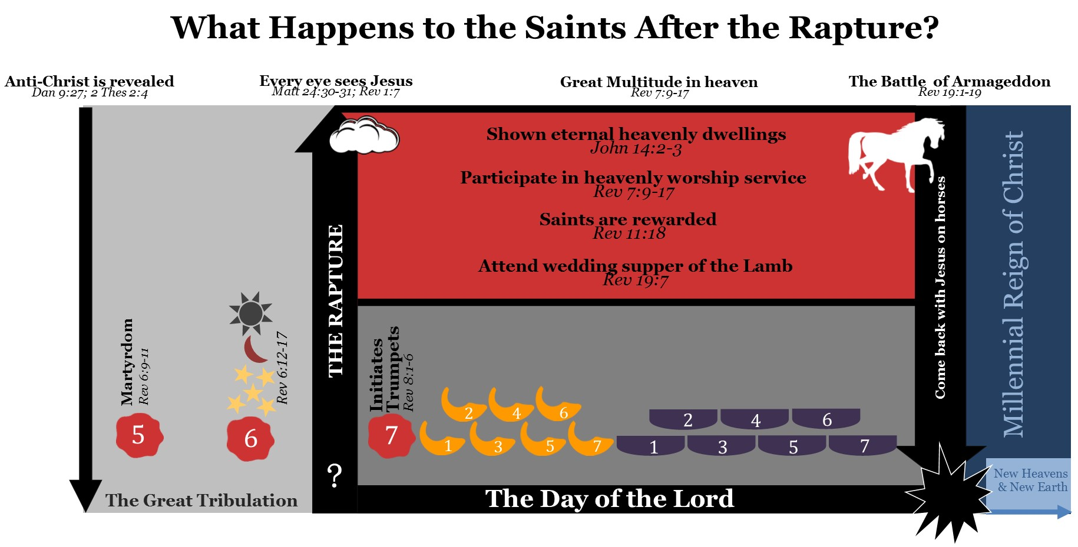
Notes:
This chart sums up all that we have learned in this section. When Jesus comes back he will gather the saints from the earth and take them to heaven. While the inhabitants of the earth are facing the wrath of God, the saints are seen before the throne of God having just came out of the Great Tribulation. During the day of the Lord the saints will be shown their custom made dwelling that Jesus has prepared for them and they will participate in amazing worship services that the mind cannot fathom. At the blowing of the 7th trumpet the time of rewarding occurs. After this rewarding the Church is married to the Lamb and enjoys the wedding feast of the lamb. After the wedding feast the saints mount up on white horses and join Jesus for the battle of Armageddon and destroy the man of lawlessness and his armies. What an amazing time this will be!

Slide 124
Notes:
Now, we are able to understand every major concept on this chart. There are still some minor details that exceed the scope of this book, but all major ideas have been covered. Let’s now review it one last time. Daniel’s 70th week begins when the man of lawlessness makes a covenant with many. This also likely opens up seal one, as the white horse represents a false Christ that arises on the Earth who conquers though peace. Peace is then taken from the earth as seal two opens. The earth continues it’s downward spiral into chaos as economic crisis, famine, plague, wild beast, and the sword kill over one fourth of the population of the earth when seals three and four open. Out of this chaos, arises a man who at the midpoint of Daniel’s 70th week sits in God’s temple declaring himself to be God and sets up an abomination that causes desolation in the temple. This reveals this man to Christians as the Anti-Christ. The anti-Christ wages a war against Christians opening seal five and the great falling away occurs, as the people who don’t love Jesus more then their own life capitulate to the man of lawlessness. It is during the great tribulation that the man of lawlessness sets up his kingdom on the earth. He institutes a one world religion, one world government, and one world currency. He leads the world into deep sin. People who follow the Anti-Christ feel secure in their future and live life as normal. When a certain number of martyrs have been reached, God signals to Jesus that it is time to come back. The days of the Great Tribulation are cut short when the sun, moon, and stars appear in the sky at the opening of seal six. Shortly after the signs appear, Jesus appears in the sky and gathers the Christian’s off the earth taking them to heaven, while those on the earth experience the wrath of God as seen in the trumpet and bowl judgments. After the rewarding of the saints and the wedding of the lamb, the saints mount up on white horses and come back to the earth to fight the battle of Armageddon and to help Jesus set up a kingdom that will last 1,000 years. After the 1,000 years are finished, Satan is released to deceive the nations one more time. Many who did not participate in the first resurrection are deceived and fall under God’s eternal judgment. Satan and his followers are again defeated and after one final judgement are thrown eternally in the lake of fire. God forms a new heaven and a new earth and heaven comes down to earth. This is the eternal home of the righteous.

Slide 125
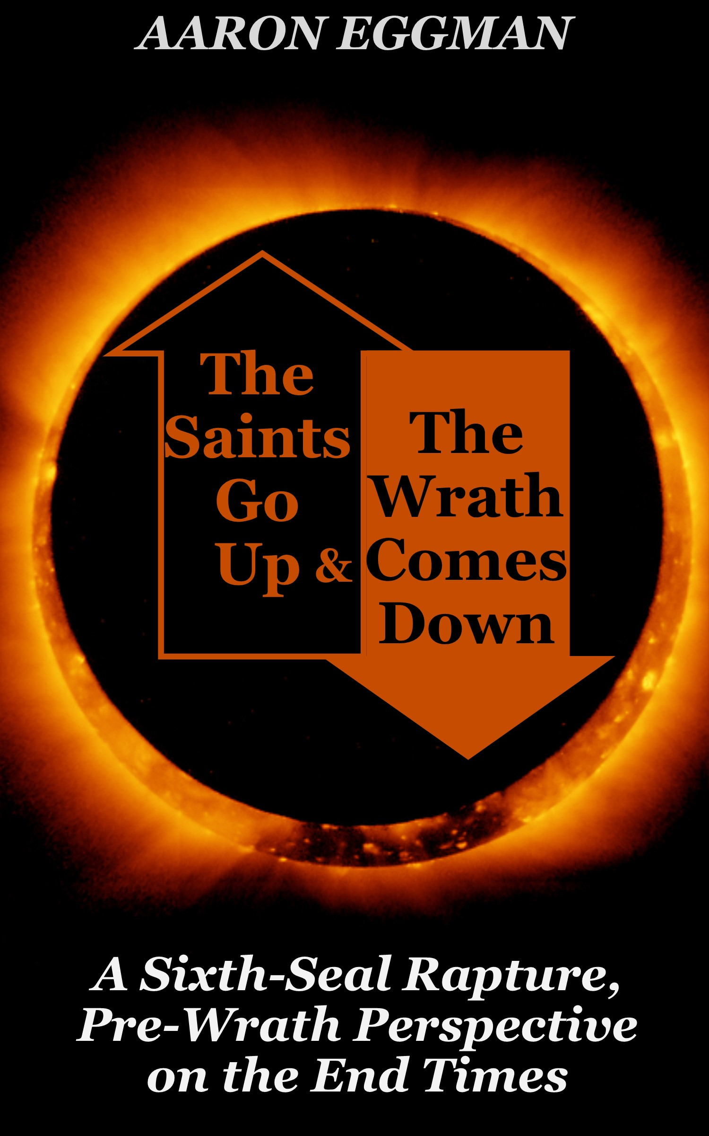
Notes:
Insert video: This concludes my teaching series that is based on my book, The Saints Go Up and the Wrath Comes Down. For a more in depth look at some of the concepts covered in the book and a helpful appendix please refer to the book.

